Slide 1
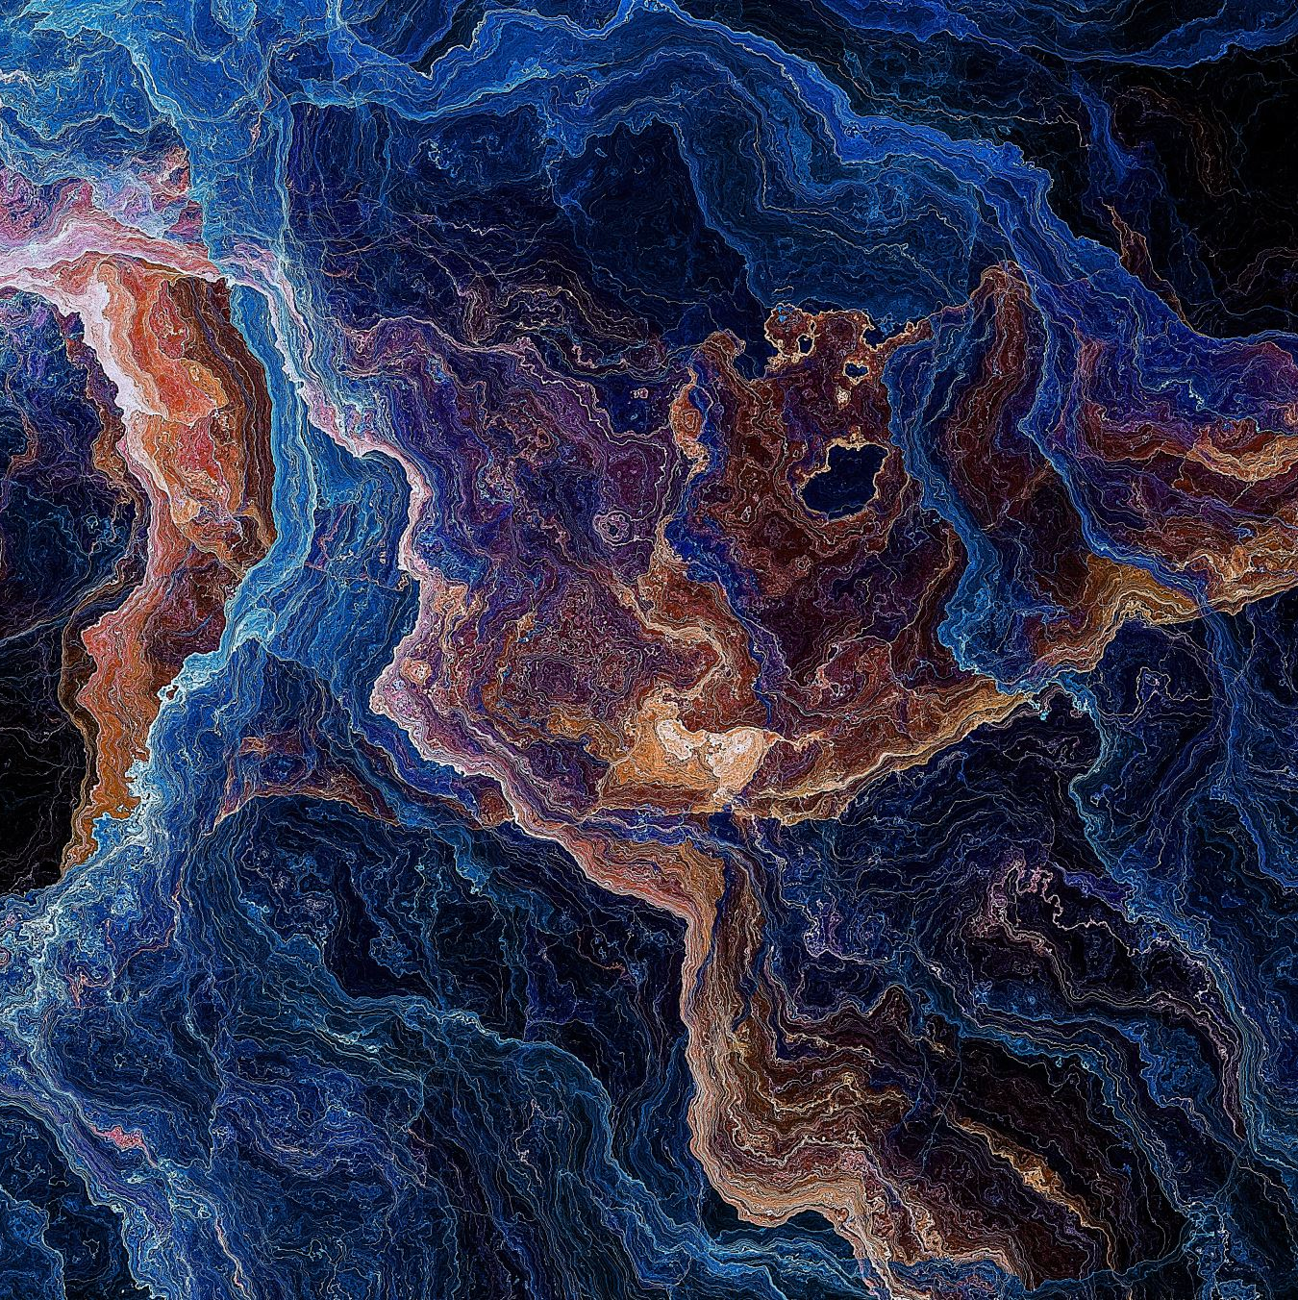
Use of AI in Photography
U3a Digital Photography Group with the help of ChatGPT!!

Slide 2
AI is already a tool in Photography
It is already embedded in the hardware and software that we employ
It can be used to enhance, edit and even create images
Examples
  AI-powered cameras (e.g. smartphones with AI scene detection)
  Photo-editing software (e.g. Photoshop’s AI neural filter features)
  Generative AI (e.g. creating images from text descriptions)

Slide 3
Pro’s of AI in photography
Enhanced Editing: AI simplifies photo editing by automatically adjusting exposure, colour balance, and removing unwanted elements.
Efficiency: AI automates repetitive tasks like tagging, sorting, and basic edits, freeing up time for creative work.
Accessibility: AI tools make advanced techniques accessible to amateur photographers, helping them achieve professional-quality results.
Creativity: AI can suggest new creative ideas, generate unique compositions, and offer artistic filters.

Slide 4
Modern Cameras Use AI to Produce JPEGs
AI Scene Detection: Modern cameras use AI to analyse the scene and automatically adjust settings for the best possible shot (e.g., detecting a landscape vs. portrait).
Real-time Processing: AI algorithms process raw data from the camera sensor in real-time, optimizing sharpness, noise reduction, and colour accuracy.
Smart HDR: AI combines multiple exposures to create a single, high-dynamic-range (HDR) image, capturing more detail in both shadows and highlights.
Portrait Enhancements: AI improves portrait photography by enhancing skin tones, smoothing blemishes, and even applying background blur for a professional look.
JPEG Compression: AI helps in compressing the image without losing significant quality, ensuring that the final JPEG is both high-quality and storage-efficient.

Slide 5
The Cons of AI in Photography
Authenticity Concerns: There's a growing debate over whether AI-generated images can be considered true photography.
Job Displacement: Fear exists that AI might replace human photographers and editors, reducing job opportunities.
Over-Reliance: Over-reliance on AI tools might lead to a loss of manual photography skills and creativity. E.g. relying on auto-correction instead of learning proper exposure techniques
Ethical Issues: Misuse of AI in creating deepfakes or manipulating images raises serious ethical concerns

Slide 6
Case Studies
Successful Integrations:
  Smartphone Cameras: Show how AI in smartphones has revolutionized mobile photography with features like Night Mode and AI scene recognition.
  Software Enhancements: Examples of AI in photo editing software like Adobe Lightroom's AI-based auto settings.
Controversial Uses:
    AI Art Controversies: Cases where AI-generated images have won art contests, sparking debates over authenticity and creativity

Slide 7
Setting sensible boundaries
Transparency and Disclosure
  Clearly mark AI-generated content: In commercial or editorial photography, it’s essential to disclose the use of AI editing or generation to ensure transparency.
  Ethical guidelines for AI manipulation: Set clear rules for what constitutes acceptable AI manipulation in different contexts (e.g., journalism vs. fine art photography).
AI as an Assistant, Not a Replacement
  Human creativity as the core: AI should be used to augment the photographer’s creativity, not replace it. Photographers should remain in control of the final vision.
  Limitations of AI: Emphasize that AI should not be used to manipulate reality in ways that mislead or deceive (e.g., in photojournalism, advertising).
Preserving the Craft
  Develop a balance: Encourage photographers to continue honing their traditional skills (composition, lighting, manual editing techniques), and use AI tools as a supplement, not a crutch.
  Encourage originality: Ensure AI is used to enhance unique artistic expression rather than mimic existing styles.

Slide 8
Shropshire Photographic Society
Images, and all components thereof, which are entered in club competitions must be entirely the work of the photographer
Composite images, and the use of software in the computer or in-camera for image enhancement, such as cloning, content aware or generative fill, compositing, sky or background replacement, blurring, focus stacking, multiple exposure etc. are permitted
Use of images or components from any other source including, but not limited to AI generation, image banks and clipart are not permitted. Images generated solely by AI (Artificial Intelligence, i.e. computer generated) are not permitted

Slide 9
Shropshire Photographic Society
Note that the Nature and Record competitions do not permit post-processed composite images, other than in-camera focus stacking or multiple exposures, i.e. the latter shows items that were there in front of the camera at the time of taking the shot
Processing of the captured image, by cropping, exposure adjustment, colour correction, noise minimisation, dodging/burning, HDR, focus stacking and sharpening, is permitted, as is cloning of image defects and minor distractions including overlapping elements

