Slide 1


Windows accessories and admin tools

Slide 2
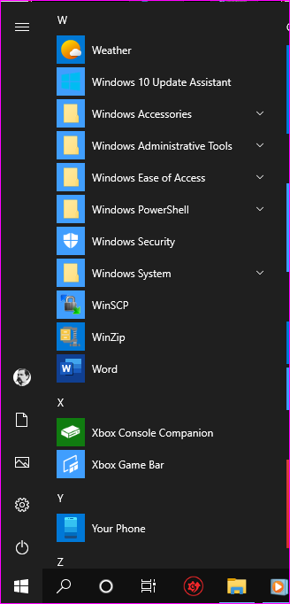
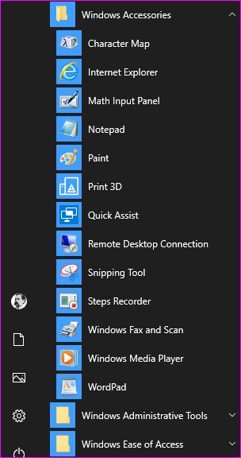
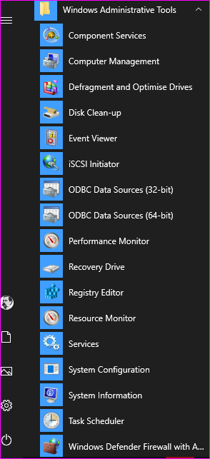

Slide 3
Character Map. Inserts nonstandard characters into your document: The Euro sign, Copyright, Registered, Degree sign etc. Either copy and paste or use numeric keypad “Alt + nnnn”
Math Input. Write equations and paste them into your document
Print 3D. Prepare 3D objects for 3D printing. See also Paint 3D.
Quick Assist. Allows a helper using Win 10 to take control on your Win 10 PC. Needs a code at the client end (so the helper can’t take over without you knowing)
Remote Desktop Connection. Connect to a Win 10 Pro PC from Windows Android or iOS device.
Snipping Tool. Take a screen shot from your screen. Use Ctrl + PrtScn for menus.
Steps Recorder. Record the steps you take doing something to show a helper for troubleshooting.
Notepad | WordPad | Word.
XPS Viewer. Microsoft version of Adobe pdf files.

Slide 4
Computer Management. Scheduled Tasks, Event viewer & Performance Monitor. Disk Manager, Device Manager.
Defragment and Optimise Drives
Disk Cleanup
Event Viewer
Recovery Drive
Registry Editor
Resource Monitor
System Configuration
Task Scheduler
Defender
Memory Diagnostics

