Slide 1

Understanding the Windows Registry: Structure, Function, and Practical Examples
Exploring key components and management techniques
Notes:
This presentation explores the Windows Registry, a critical component of the Windows operating system. We will examine its structure, functions, and practical examples to better understand how it works and how it can be managed effectively.

Slide 2
Setting the Scene
Notes:
I had two legitimate reasons to edit the registry recently, both were related to J&E Woodworks business in Lampeter.

Slide 3
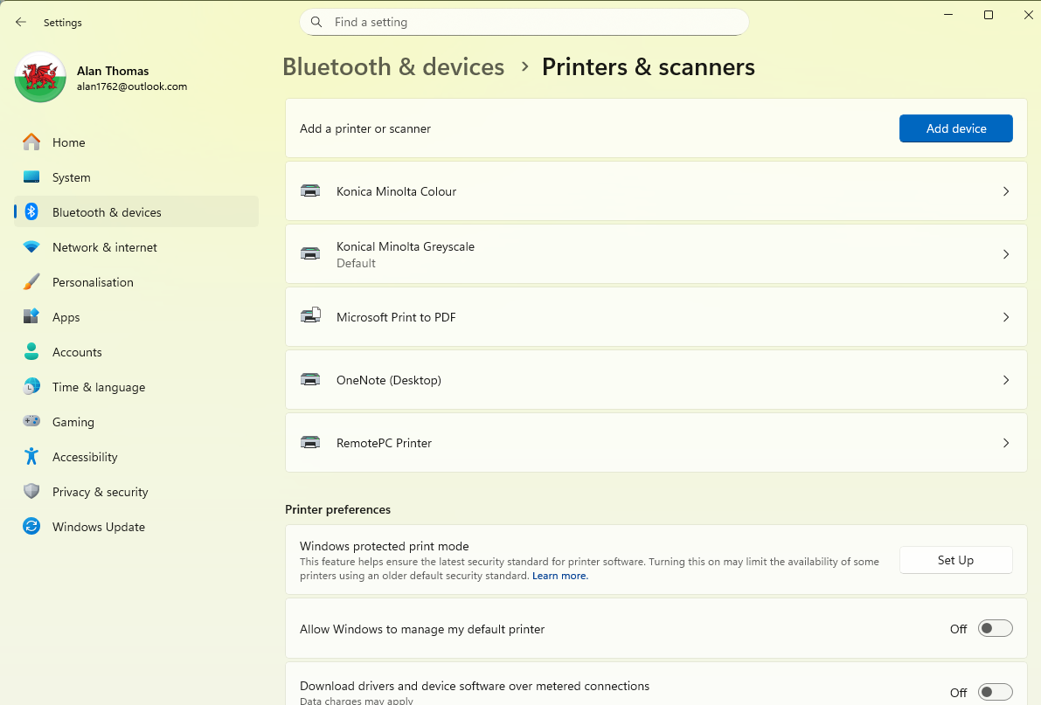
Notes:
By default, ***** “Allow Windows to manage my default Printer” is checked (ticked). This means that Windows will always select the last used Printer. If you don’t want that, then you need to uncheck this option.
As a businessman, Alan is always looking to save money and as colour ink is more expensive than black ink, he would rather the staff print in Greyscale rather than colour. The answer was to have the same printer installed twice. Once with the preferences set to Colour and once with the preferences set to Greyscale. *****
In his case he always wants the default printer to be Greyscale,
so that the staff actually have to do something different if they really need colour. So we have to uncheck the Allow Windows… option and then set the greyscale printer to be the default. ******
When I tried to do this, Windows wouldn’t let me! It should have, it wasn’t greyed out or anything, it should have toggled on and off quite easily. I learnt from Copilot that this is regarded as a “sticky” key. I’d not heard that term used like this before, but it is obvious what it means – it’s just stuck!
The answer I learnt, (also from Copilot) is to change the value in the Registry: From On to Off, from a one to a zero

Slide 4
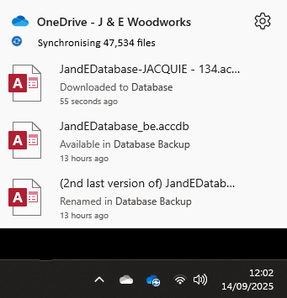
OneDrive Sync Issues
Icons in the Task Bar
Processing the file list
Stuck at 47,500 (ish)
Restart the Computer,
Sign out and Sign in
Reset the ODfB
None of these worked.
We did this by adding an entry into the Registry.
Link into Office 365 Apps Admin Centre to check sync issues.
Notes:
And the second reason was to do with the OneDrive for Business, At the end of reinstalling Windows, as well as all the additional software, printers etc and personalization I add in the “One Drive for Business” it’s pretty much the same as a personal OneDrive, but there is a little more to it if you want. We use the Option “Always Keep on this device” and this is one of the last things I do as once you start, it takes 14 hours plus, to download all his OneDrive data and synchronise.
In this case, the placeholders were showing OK, and eventually files were downloading – and uploading after a change, but the status resolutely failed to get beyond Syncing 47,500 files (from over 300,000)
We tried the obvious:
Restart the Computer
Sign out and then back in to ODfB
And even reset the ODfB – which then starts a full 14 hours plus download again
None of these worked
*****
I then learnt from Copilot that I could check the sync status from a webpage –
Office 365 Apps Admin Centre (as this is a business account)
***** By adding an entry to the Registry

Slide 5
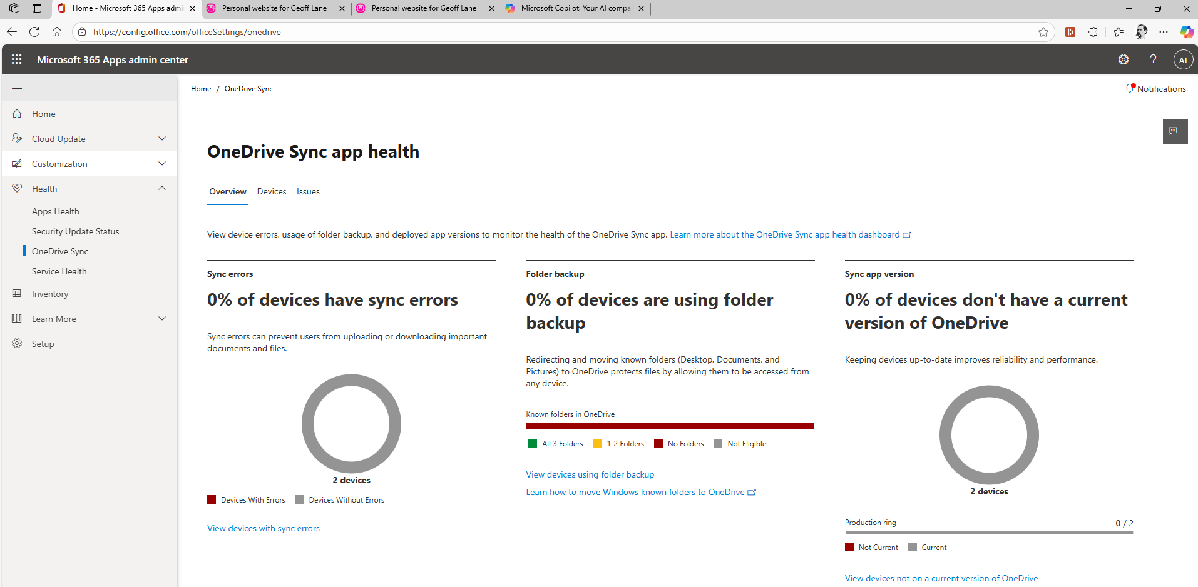
Notes:
**** OneDrive Sync Health
**** Sync errrors

Slide 6

What is the Registry?
Definition: Central configuration database for Windows.
Analogy: Like ‘Mission Control’. Every lever, dial and setting lives here.
System behaviours,
User settings,
Software configurations,
Hardware devices,
Windows OS itself all depend on it.
Notes:
Central Configuration database for Windows
The registry is divided into main sections called hives, such as HKEY_LOCAL_MACHINE and HKEY_CURRENT_USER.
Each hive contains keys and subkeys that hold various data types, including strings, binary data, and DWORDs, to configure system and application behaviour
***** It controls.
Image source: Microsoft 365 content library

Slide 7

Windows Registry Structure
Organised in a hierarchical tree (like Files and Folders)
Root Keys The top-level branches
HKEY_CLASSES_ROOT. File associations and Com objects
HKEY_CURRENT_USER. Settings for the current user
HKEY_LOCAL_MACHINE. System-wide settings
HKEY_USERS. All user profiles
HKEY_CURRENT_CONFIG. Hardware profile information
Subkeys. Like subfolders they hold more specific settings
Values. The actual data entries. Strings, numbers or binary blobs.
A full branch of keys and values is called a HIVE. Stored as files on disks and loaded into memory at startup.
Notes:
The Windows Registry is organized into hives, which are major sections storing related settings and configurations. Within each hive, keys act like folders that hold specific data. Values are the actual data entries within keys, containing settings or options for Windows and applications. This hierarchy ensures organized and efficient configuration management.
And I’ve mentioned that all the Hives start with HKxx. This is short for HOTKey xxx.
Originally, “hot” in computing slang meant immediate, active, or ready to trigger. So a “hotkey” is a key (or combo) that’s wired to instantly perform an action, without needing to navigate menus or click buttons. It’s “hot” because it’s live and responsive—like a shortcut with its finger on the trigger.
🔥 Why They're Called Hotkeys
• Speed: They execute commands instantly—no delays, no detours.
• Focus: You stay in your workflow without reaching for the mouse.
• Power: They often trigger system-level or app-specific actions that aren’t visible in the UI.
Think of it like a hotline—direct access, no intermediaries.
Image source: Microsoft 365 content library

Slide 8
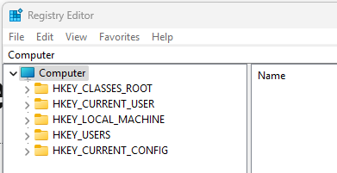
To edit the Registry:
Search “RegEdit” from the search bar
or
Win + R then Regedit
The Top 5 Registry Hives
Notes:
So this is what the Registry first looks like when you open it. Before we drill down deeper, lets take a look at what data types the registry might use

Slide 9

Key Registry Data Types
Plain Text Strings
  REG_SZ stores readable values as plain text strings, making it ideal for easily interpreted settings.
32-Bit Number Values
  REG_DWORD represents 32-bit numbers, perfect for counters, flags, and other numerical settings.
Raw Binary Data
  REG_BINARY stores raw binary data, often used for complex hardware or configuration information.
String Lists and Expandable Strings
  REG_MULTI_SZ holds lists of strings, while REG_EXPAND_SZ allows environment variables in expandable strings.
Notes:
Image source: Microsoft 365 content library
REG_SZ stores plain text strings, commonly used for readable values.
REG_DWORD represents 32-bit numbers, ideal for flags or counters.
REG_BINARY handles raw binary data for hardware or configuration information.
REG_MULTI_SZ holds lists of strings, perfect for multi-value settings.
REG_EXPAND_SZ contains expandable strings, allowing use of environment variables.

Slide 10
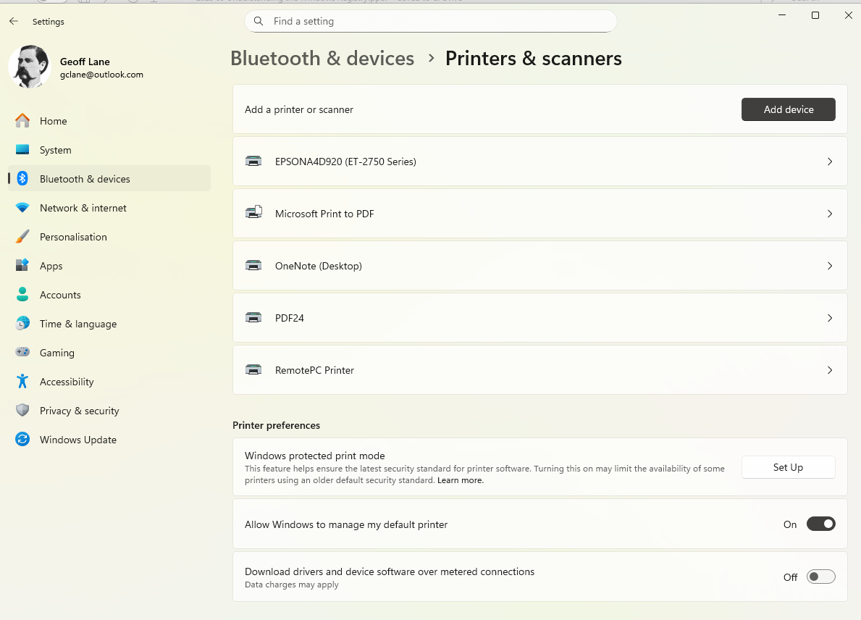
Let’s see it in practice:
Default Printer
Notes:
A real-world Example, as we discussed at the start.
***** Settings
*****Bluetooth and devices – printers and Scanners
*****Printer Preferences
*****Allow Windows to manage my default printer
The Default Printer is always the last printer that you used….. Sometimes you don’t want this you want a permanent Printer. Sometimes, a toggle becomes “Sticky” and won’t change.

Slide 11

Default Printer Management
Registry Path Location
  The default printer setting is stored under a specific registry path in the Windows user hive. It’s a User specific setting.
Manage Default Printer Setting
  The ‘Legacy Default Printer Mode’ value specifies whether or not to use the last printer selected.
Registry Modification Use
  Modifying the registry ‘Legacy Default Printer Mode' value to a 1 keeps a specific printer as a default.
Notes:
---
One practical application is managing the default printer via the registry. The registry path for the default printer setting can be traced and modified under HKEY_CURRENT_USER\Software\Microsoft\Windows NT\CurrentVersion\Windows, where the 'Device' value determines the default printer.
Image source: Microsoft 365 content library

Slide 12

Caution: Editing the Registry
Risk of Mistakes
  Editing the registry can cause serious problems if done incorrectly, including system instability or making your computer unbootable. It can also be bad for your health…..
Importance of Backup
  Always back up the registry before making changes to prevent loss or issues from accidental mistakes.
Understand Before Proceeding
  Only edit the registry if you fully understand what the changes will do and their potential impact.
Notes:
Editing the Windows registry can cause serious issues if done incorrectly. Incorrect changes may lead to system instability, software malfunction, or even make your PC unbootable. Always back up the registry before making changes, and only proceed if you fully understand the impact of your edits.
Image source: Microsoft 365 content library

Slide 13
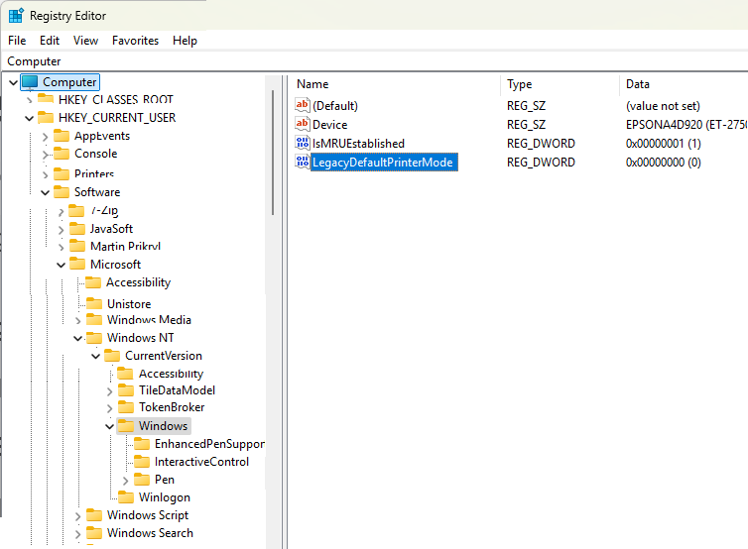
Drilling down to a value
This setting comes from “Allow Windows to Manage my Default Printer”
Go: Settings | Bluetooth & Devices | Printers & Scanners | Printer Preferences
Notes:
***** x 8 to the last one
This value is 0, so Windows is managing my default printer
***** This setting comes from…..

Slide 14
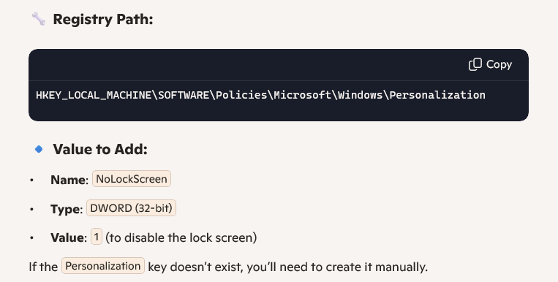
Disable the Lock Screen
Notes:
And another example

Slide 15
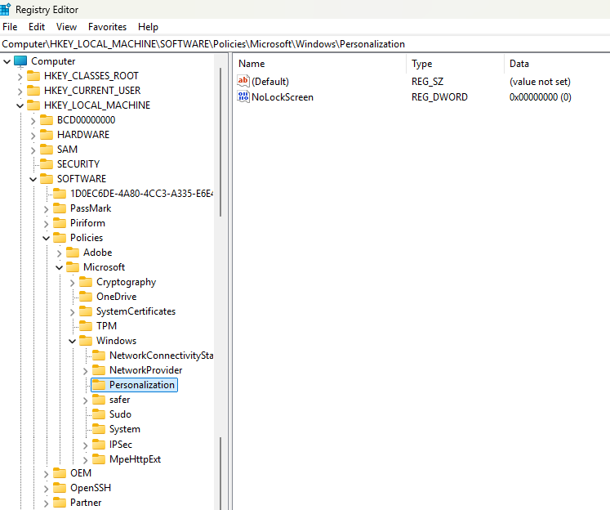
Miss out the Lock
Screen
Notes:
Miss out the Lock Screen
****** Highlight the path
****** Path to go, Value to Show. Value 0 to keep, 1 to miss out.
In the Pro version of windows, you can set this up in Settings. Not shown in Windows Home, but you can do it via the registry as shown here.

Slide 16
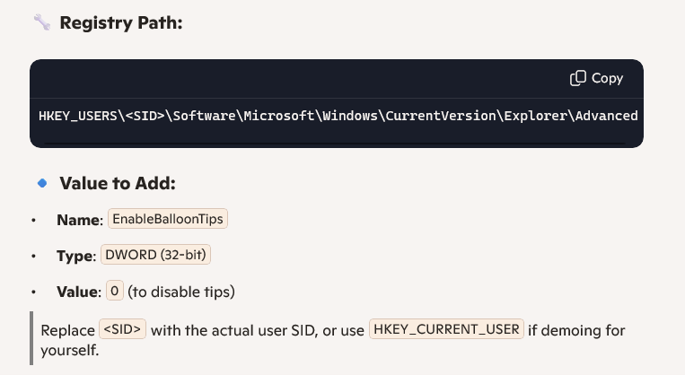
Disable Taskbar Balloon Tips
These are the little pop-up notifications like “You have unused icons on your desktop” or “New hardware detected.” You can disable them via Registry—great for users who prefer a quieter experience.

Slide 17
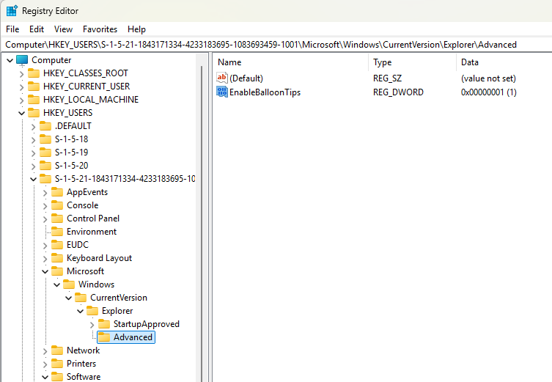

Disable Balloon Tips
Note that there are a number of users on this computer, we are changing this for only one of them
Notes:
4 users on this PC
***** Highlight the path
***** Path to Go, Value to Show. 1 to show, 0 to disable

Slide 18
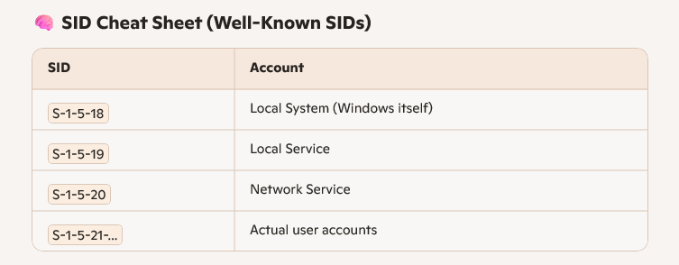
Identifying a user profile
Notes:
Your username is not identified by Paul, Mike, jenny or Geoff, it’s in the format
S-1-5-21 nnn: SID Security Identifier.

Slide 19
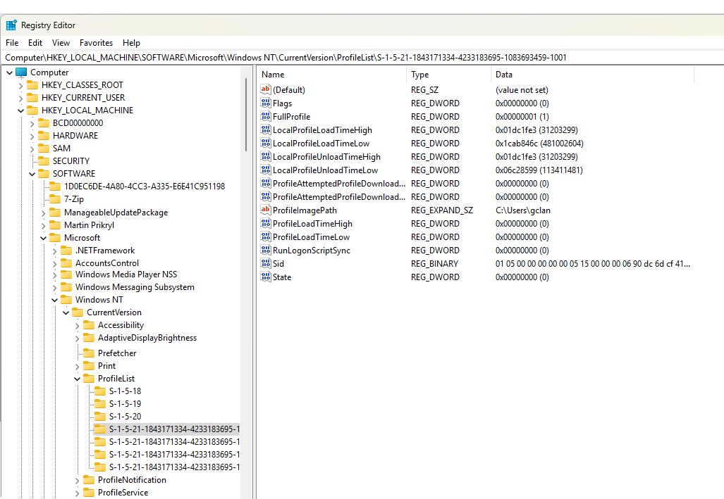
The Users
Notes:
4 Real Accounts

Slide 20
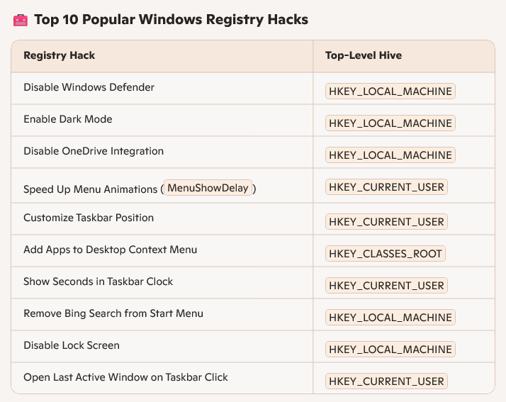
A Top Ten list
• User-level tweaks (HKCU) for personalization
• System-level tweaks (HKLM) for performance and security
• Shell/UI tweaks (HKCR) for context menus and file association

Slide 21

Apple Mac Users
The macOS doesn’t use a central Registry like Windows
Each app has its own .plist file – which stores all its own settings
So no centralized control, all done individually.
Therefore less risk of System-wide corruption
“Power” users often use terminal scripts,
configuration profiles or third-party tools
to achieve deeper tweaks

Slide 22
Conclusion
Understanding the Windows Registry structure is crucial for system configuration and troubleshooting for advanced users.
Do I need to go there?
Examples like managing the default printer demonstrate how registry keys can be responsibly modified.
Registry Structure Importance
Exercise Caution
Most ‘regular’ users will have no need to edit the registry.
Some of us will have a little dabble😊
Practical Registry Applications
Be careful if you do edit, mistakes can upset your PC.
Notes:
Understanding the Windows Registry's structure and function is essential for effective system configuration and troubleshooting. Practical examples, like default printer management, illustrate how registry paths are organized and can be modified responsibly to achieve desired outcomes.

