Slide 1
Understanding VPNs and How to Use Them Effectively
Key insights into secure and private internet access
Notes:
---

Slide 2
Session Highlights
Defining Virtual Private Networks (VPNs)
Practical Uses for a VPN
When a VPN Is Not Necessary
The 'Trust Shift' Paradigm in VPN Usage
Comparing VPN Types: Browser Extensions, Antivirus Bundles, and Standalone Solutions
Assessing VPN Necessity: Savvy Users Versus Everyday Needs
Demonstration: Observing IP Address Changes with a VPN
Notes:
Defining Virtual Private Networks (VPNs)
Practical Use Cases for a VPN
When a VPN Is Not Necessary
The 'Trust Shift' Paradigm in VPN Usage
Comparing VPN Types: Browser Extensions, Antivirus Bundles, and Standalone Solutions
Assessing VPN Necessity: Savvy Users Versus Everyday Needs
Demonstration: Observing IP Address Changes with a VPN

Slide 3
Defining Virtual Private Networks (VPNs)
Notes:
What Is a VPN and How Does It Work, Basic VPN Concepts: Encryption and Tunneling, Common Terminology and Components

Slide 4
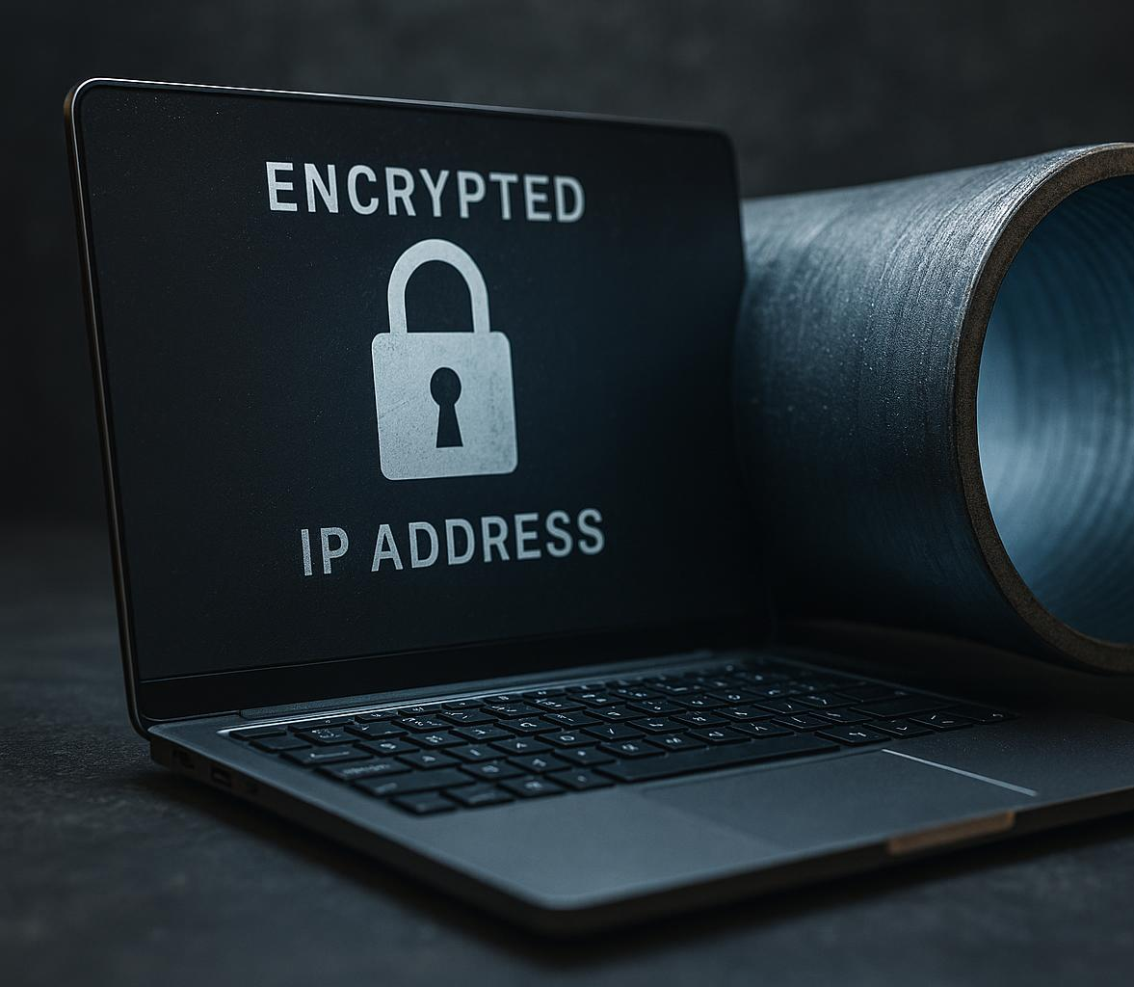
What Is a VPN and How Does It Work?
Secure Encrypted Tunnel
  A VPN establishes a secure, encrypted tunnel to protect data from interception during internet use.
IP Address Masking
  VPN masks the user's IP address to enhance privacy and prevent tracking online.
Bypassing Censorship
  VPN reroutes traffic through intermediary servers to bypass censorship and access restricted content.
Global VPN Usage
  Over 30% of internet users in regions like Asia and Europe use VPNs to protect their online activities.
Notes:
---
A VPN creates a secure, encrypted tunnel between your device and the internet, masking your IP address and protecting data from interception. Globally, VPN usage has surged with over 30% of internet users in regions like Asia and Europe employing VPNs as of 2023. This technology is critical in safeguarding communications over public Wi-Fi or bypassing censorship by rerouting traffic through intermediary servers in different locations.
Image source: AI-generated

Slide 5

Basic VPN Concepts: Encryption and Tunneling
Data Encryption
  Encryption transforms readable data into coded text, ensuring protection from unauthorized access during transmission.
Tunneling Protocols
  Tunneling protocols like OpenVPN, IKEv2, and WireGuard encapsulate data for secure passage through the internet.
Protocol Performance
  WireGuard offers superior speeds and strong encryption, affecting VPN provider adoption trends since 2021.
Notes:
---
Encryption converts readable data into coded text, preventing unauthorized access, while tunneling protocols encapsulate this data for secure passage through the internet. Common protocols include OpenVPN, IKEv2, and WireGuard, each balancing speed and security differently. Research shows WireGuard often offers superior speeds with robust encryption, influencing provider adoption trends since 2021.
A tunnelling protocol is simply the method a VPN uses to wrap, encrypt, and transport your data from your device to the VPN server.
Think of it like:
• The type of envelope your data is put into
• The way it’s sealed
• The postal route it takes
Different protocols = different envelopes, seals, and delivery speeds
They determine:
• Security (how strong the encryption is)
• Speed (how efficiently data moves)
• Stability (how well it handles bad networks)
• Compatibility (what devices it works on)
This is why VPNs often let you choose a protocol.
Image source: AI-generated

Slide 6
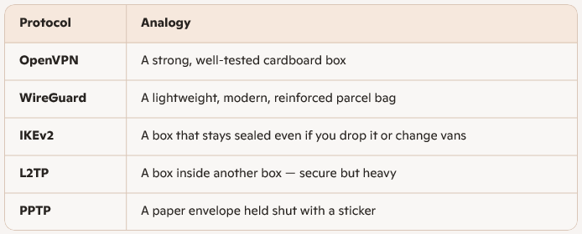
Analogy of Tunnelling Protocols:
Imagine sending a parcel
Notes:
1. OpenVPN
The workhorse. Reliable. Secure. Well‑tested.
• Open‑source (so widely audited)
• Very secure
• Works on almost everything
• Slightly slower than newer protocols
Good for: general use, security‑focused users, older devices.
2. WireGuard
The modern, fast, elegant one.
• Much faster than OpenVPN
• Uses modern cryptography
• Very small codebase (easier to audit)
• Becoming the default for many VPNs
Good for: speed, streaming, gaming, modern devices.
5. PPTP
The dinosaur. Avoid.
• Very fast
• Very insecure
• Broken encryption
Good for: nothing in 2026 except nostalgia.

Slide 7
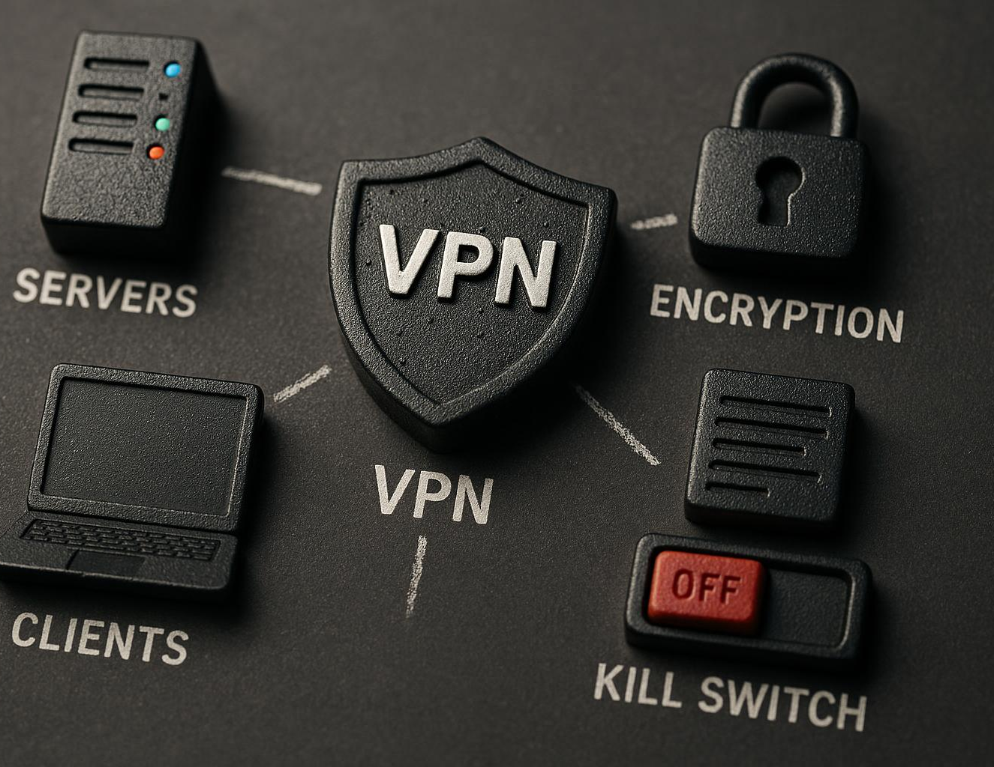
Common Terminology and Components
VPN Terminologies
  Key terms like server, client, protocol, encryption, and kill switch are essential to understand VPNs effectively.
VPN Servers and Clients
  VPN servers act as intermediaries, while clients are user devices connecting securely to these servers.
Kill Switch Feature
  The kill switch automatically blocks internet access if VPN disconnects, protecting user privacy.
Notes:
---
Key VPN terminologies include 'server,' 'client,' 'protocol,' 'encryption,' and 'kill switch.' Understanding these is crucial to effectively selecting and using VPN services. Components like VPN servers act as intermediaries, while clients are the user's devices connecting to these servers. A 'kill switch' feature automatically cuts internet access if the VPN disconnects, ensuring user privacy is maintained.
Image source: AI-generated

Slide 8
Practical Uses for a VPN
Notes:
Securing Your Connection on Untrusted Networks, Hiding Online Activity From Your ISP, Bypassing Geo-Restrictions and Appearing in Other Countries

Slide 9
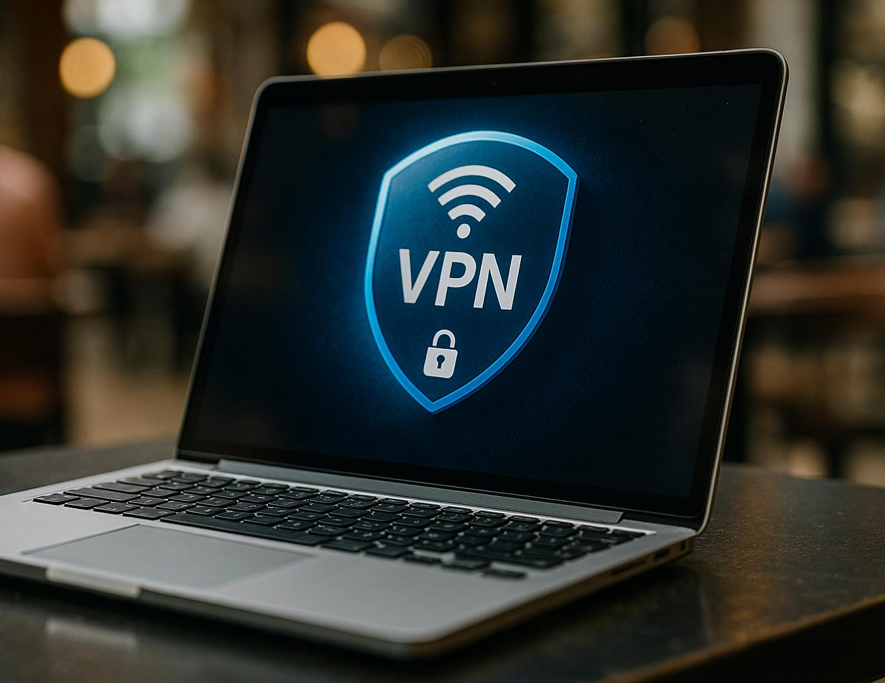
Securing Your Connection on Untrusted Networks
Cyberattack Risks on Public Wi-Fi
  Over 60% of consumer cyberattacks happen on unsecured Wi-Fi networks, exposing sensitive data to hackers.
VPN Data Encryption
  VPNs encrypt data on public hotspots, protecting passwords and personal details from cyber threats effectively.
User Confidence with VPNs
  Users report feeling 70% more secure using VPNs in cafes, airports, and hotels with untrusted networks.
Notes:
---
Over 60% of cyberattacks on consumers occur over unsecured Wi-Fi networks. VPNs effectively encrypt data on public hotspots, shielding sensitive information such as passwords and personal details from hackers exploiting these vulnerable connections. Surveys indicate users feel 70% more secure using VPNs in cafes, airports, or hotels.
On a shared public network, attackers can:
• Try to intercept unencrypted traffic
• Set up fake hotspots (“Evil Twin” attacks)
• Try to snoop on device names, services, or shared folders
• Probe for vulnerabilities
Even with HTTPS everywhere, there’s still value in isolating yourself from the local network.

Slide 10
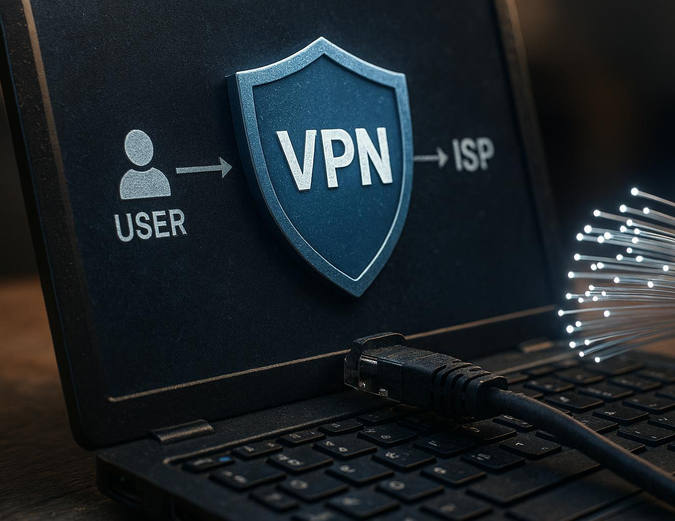
Hiding Online Activity From Your ISP
ISP Monitoring Practices
  Internet service providers log user activity and may sell anonymized browsing data to third parties.
VPN Benefits
  A VPN masks the user's true IP address and encrypts internet traffic to protect online privacy.
Increasing VPN Usage
  In regions with high ISP surveillance, VPN usage rises by up to 50%, demonstrating growing privacy concerns.
Notes:
---
ISPs traditionally log user activity and may sell anonymized browsing data. Using a VPN masks your true IP and encrypts traffic, preventing ISPs from monitoring or throttling your activities. In markets with high ISP surveillance, VPN usage increases by up to 50%, reflecting growing privacy concerns.
But….. The VPN itself may log your user activity. Who do you trust the most?
Image source: AI-generated

Slide 11
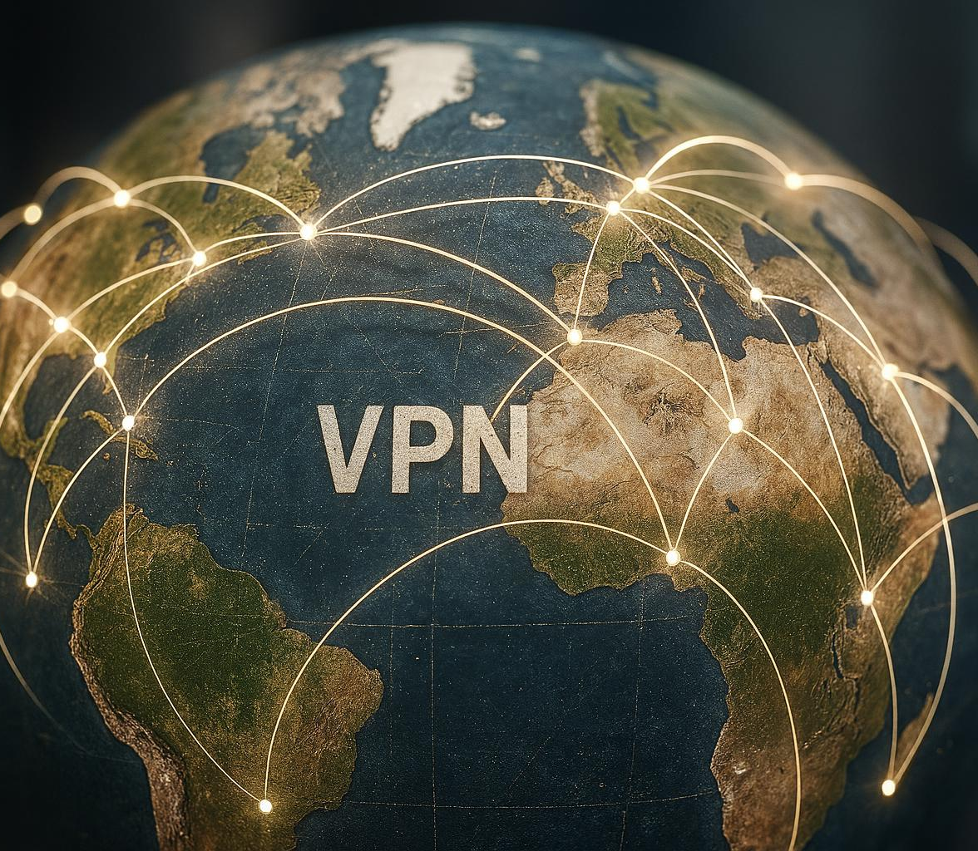
Bypassing Geo-Restrictions and Appearing in Other Countries
VPN Traffic Routing
  VPNs route user traffic through servers in allowed regions to bypass geo-restrictions effectively.
Importance in Censored Regions
  VPNs are crucial in areas with media censorship or exclusive licensing to unlock restricted services.
Primary VPN Use Cases
  Over 40% of VPN users use it for streaming and accessing international content.
Notes:
---
VPNs enable users to access content blocked in their country by routing traffic through servers in permitted regions. Over 40% of VPN users cite streaming and international content access as primary motivations. This is particularly important in regions with media censorship or exclusive service licenses.
Image source: AI-generated

Slide 12
When a VPN Is Not Necessary
Notes:
Online Banking, Shopping, and HTTPS-Enabled Sites, Using Your Own Home Network, Risks of Using Unreliable or 'Sketchy' VPN Providers

Slide 13
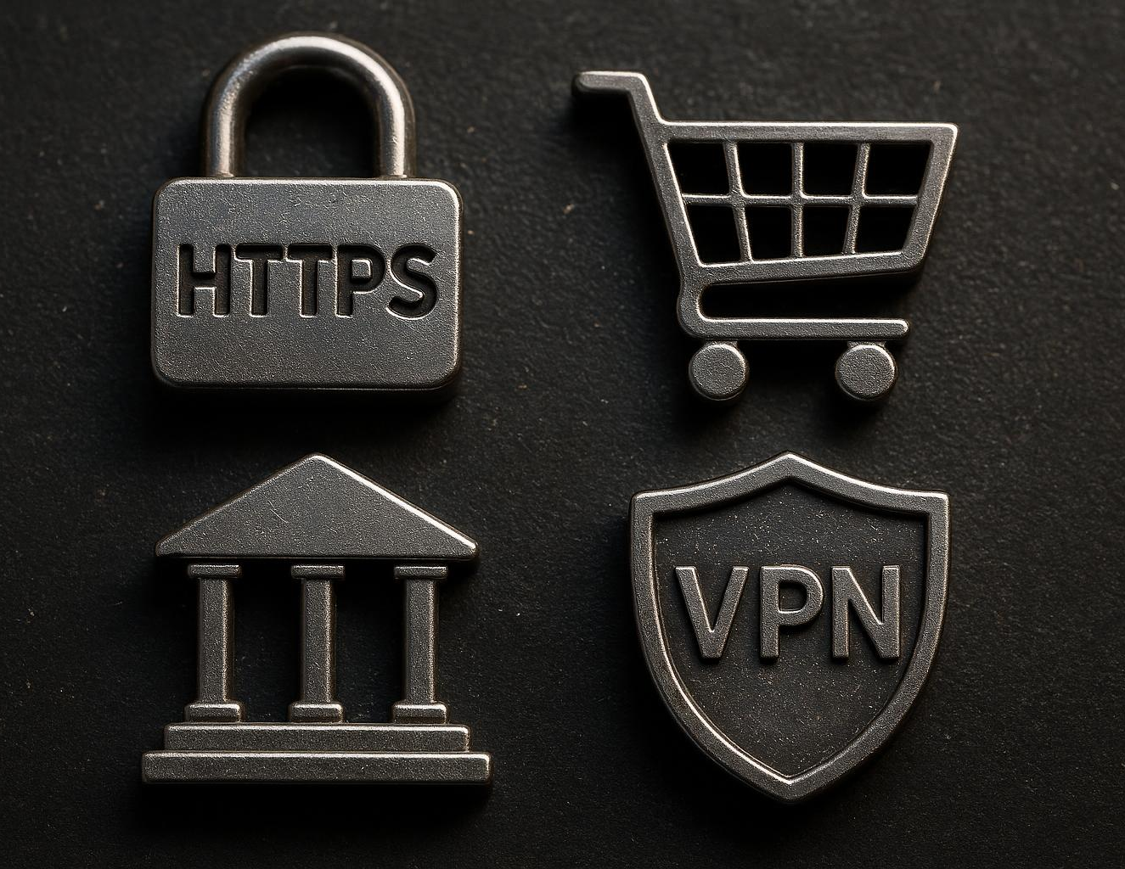
Online Banking, Shopping, and HTTPS-Enabled Sites
HTTPS Encryption Security
  HTTPS encryption ensures secure data transmission for online banking and shopping, protecting sensitive user information.
Multifactor Authentication
  Multifactor authentication adds an extra layer of security by verifying user identity beyond passwords.
VPN Privacy Role
  VPNs enhance privacy by hiding browsing metadata, though not essential with strong encryption and trusted certificates.
Notes:
---
HTTPS encryption and multifactor authentication provide strong security for banking and e-commerce, usually making VPNs redundant in these scenarios. However, a VPN can add privacy by hiding browsing metadata, but it is not essential if sites employ robust encryption and trusted certificates.
“Most websites use HTTPS these days, which already encrypts your passwords, banking details, and everything you see on the page. A VPN doesn’t make that encryption stronger — it just hides the metadata, like which sites you visited and when, how long you stayed, and the rough amount of data transferred. So it adds privacy, but it isn’t essential for security if the site itself is properly encrypted.”
“…but it is not essential if sites employ robust encryption and trusted certificates.”
This refers to HTTPS, which almost every legitimate site uses today.
When a site uses HTTPS:
• The content of your communication is already encrypted
• Your password, card details, messages, etc. are protected
• Even on hotel Wi‑Fi, someone can’t read what you’re doing
What HTTPS protects:
• The actual data you send and receive
• Login details
• Payment information
• Page content
What HTTPS does not hide:
• The domain name (e.g., “bbc.co.uk”)
• The fact you visited it
• The time and amount of data
That’s the bit a VPN hides.
So your sentence is saying:
“HTTPS already protects the important stuff. A VPN adds extra privacy, but it’s not essential for security.”
Image source: AI-generated

Slide 14
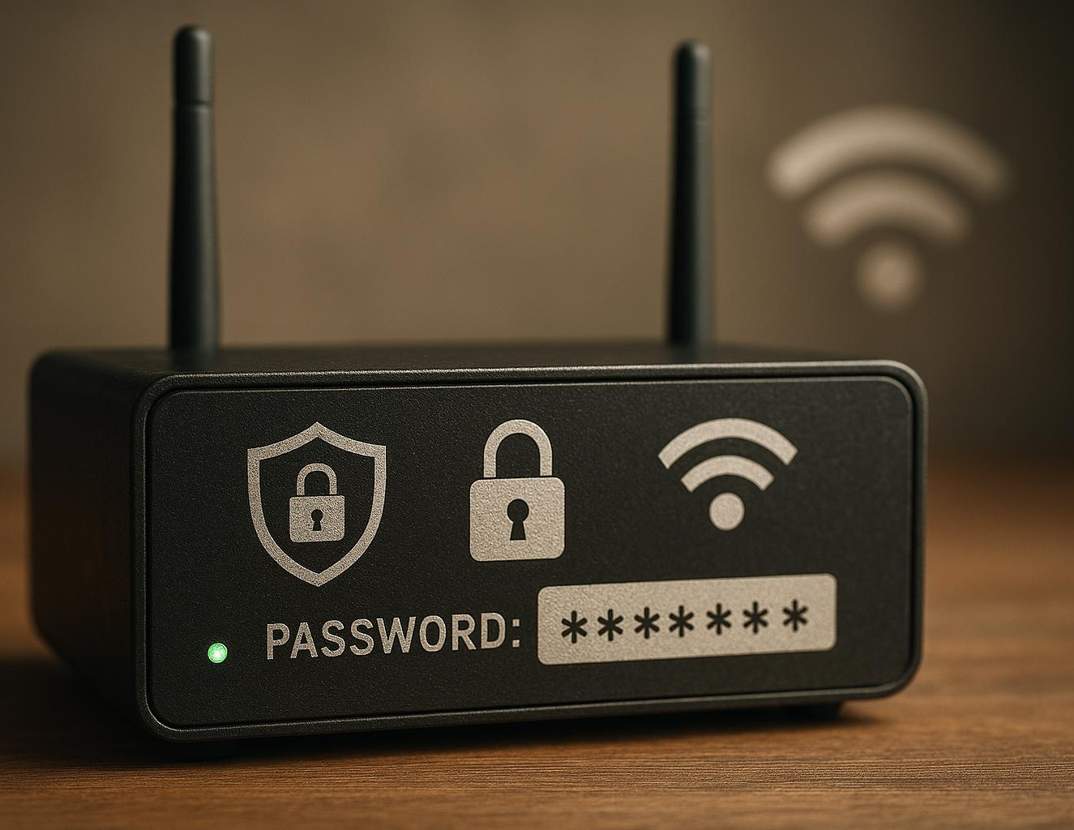
Using Your Own Home Network
Trusted Home Network
  Properly secured home networks with WPA3 and strong passwords provide a safe environment.
Reduced VPN Necessity
  VPNs are less critical on trusted home networks compared to public hotspots.
Lower Risk of Compromise
  Home routers are less frequently compromised than public Wi-Fi hotspots.
Notes:
---
Home networks, if properly secured with modern encryption (WPA3) and strong passwords, offer trusted environments where VPNs are less critical. According to cybersecurity studies, compromised home routers are less common than public hotspots, reducing VPN necessity in these settings.
Image source: AI-generated

Slide 15
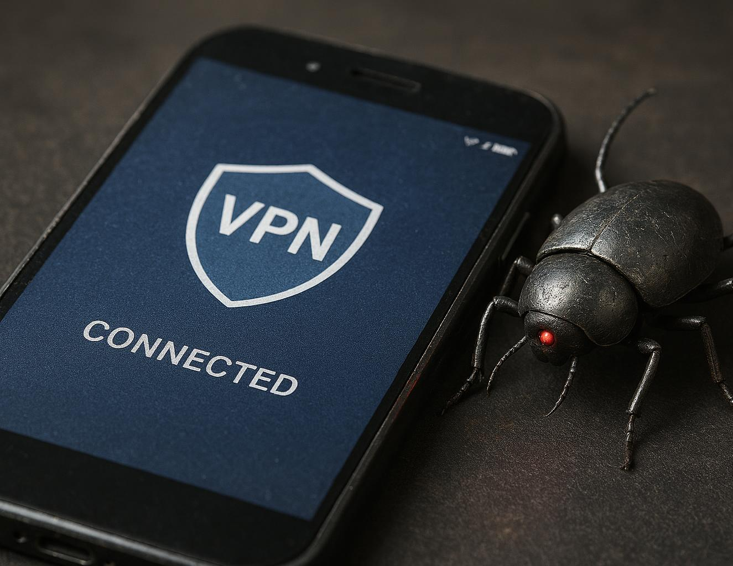
Risks of Using Unreliable or 'Sketchy' VPN Providers
Privacy Risks
  Some VPNs log user data or inject ads, undermining user privacy and security.
Encryption Weaknesses
  Around 30% of free VPNs have insufficient encryption, exposing users to data interception.
Untrustworthy Providers
  Using less reputable VPN providers shifts trust to entities with questionable privacy policies.
Notes:
---
Not all VPNs protect privacy equally; some free or lesser-known providers log user data or inject ads, ironically compromising security. Evaluations reveal up to 30% of tested free VPNs have insufficient encryption or questionable privacy policies, highlighting the risk of 'trust shift' to untrustworthy providers.
Image source: AI-generated

Slide 16
The 'Trust Shift' Paradigm in VPN Usage
Notes:
Who You Trust without a VPN: ISP and Websites,
Who You Trust with a VPN: VPN Provider and Websites, Evaluating Trust: ISP versus VPN Provider

Slide 17

Who You Trust without a VPN: ISP and Websites
Data Tracking by ISP
  ISPs can track and log user data such as browsing habits and geographic location without VPN protection.
Website Data Logging
  Visited websites collect and record user information, which can compromise privacy without VPN shielding.
Legal Data Retention
  Certain countries enforce laws requiring ISPs to retain user data for extended periods, increasing privacy risks.
Privacy Vulnerabilities
  Visible data to ISPs and websites leads to privacy vulnerabilities and potential misuse of personal information.
Notes:
---
Without a VPN, your ISP and visited websites can track and log your data, including browsing habits and location. Regulatory environments vary globally, with some countries requiring ISPs to retain data for months. This visibility creates privacy vulnerabilities and potential misuse of personal information.
Image source: AI-generated

Slide 18

Who You Trust with a VPN: VPN Provider and Websites
Shifted Trust Model
  Using a VPN shifts trust from the ISP to the VPN provider who manages connection logs and anonymity.
Importance of Transparency
  VPN providers with no-log policies and independent audits are crucial to maintaining user privacy and trust.
Increasing User Concerns
  VPN user concern about provider transparency has increased 25% in the past five years according to surveys.
Notes:
---
Using a VPN shifts trust from the ISP to the VPN provider, which then controls connection logs and user anonymity. Transparent providers with no-log policies and independent audits are critical to ensure privacy. Consumer trust surveys show a 25% increase in VPN user concern about provider transparency in the past five years.
Image source: AI-generated

Slide 19
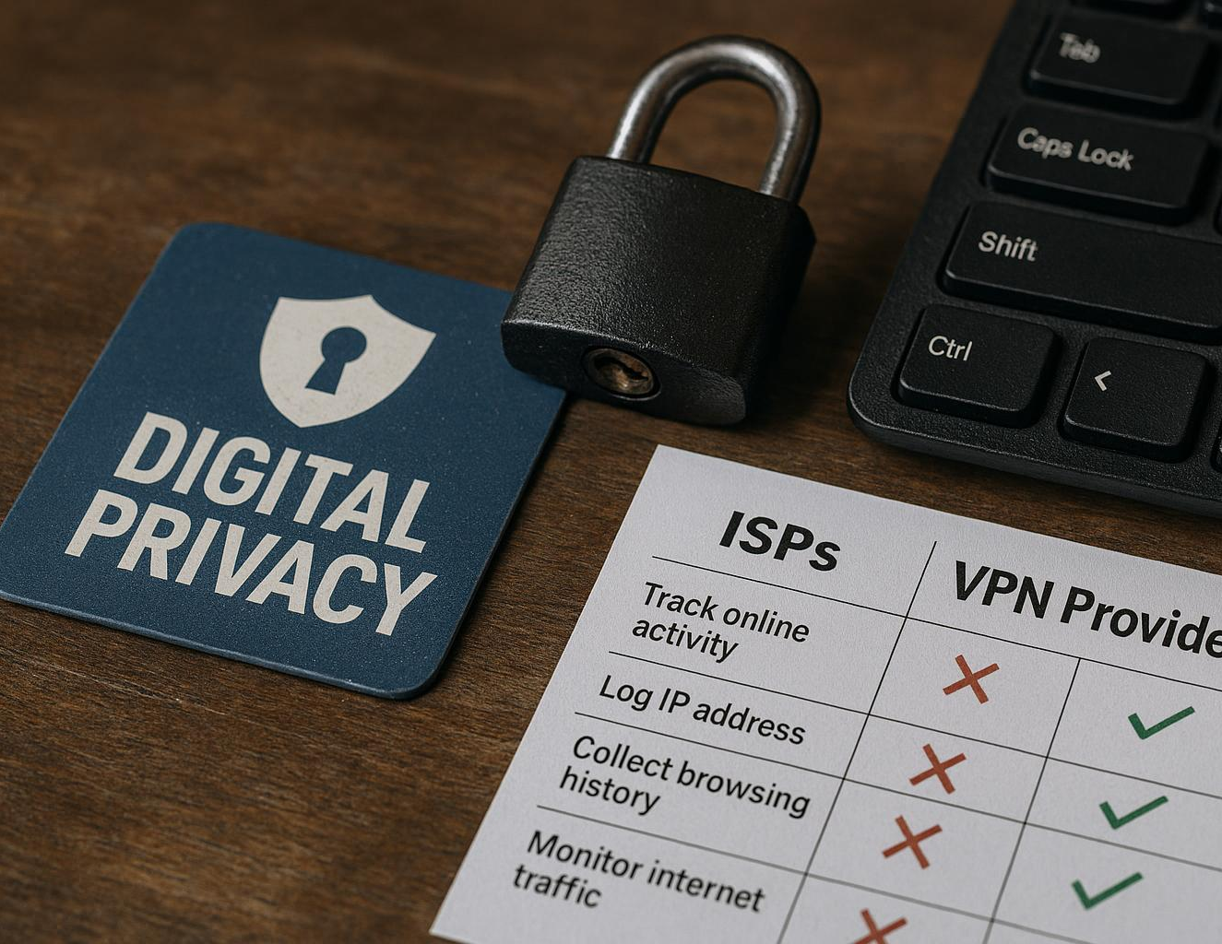
Evaluating Trust: ISP versus VPN Provider
Trust Factors in Evaluation
  Key trust factors include jurisdiction, logging policies, and history of data breaches affecting ISPs and VPN providers.
Privacy-Friendly VPNs
  VPNs operating in privacy-friendly countries often provide superior anonymity and better protection for users.
Comparative Matrix Insights
  A comparative matrix of top VPN providers clearly shows differences in trust factors and user privacy features.
Notes:
---
When evaluating trust, consider jurisdiction, logging policies, and history of data breaches for ISPs versus VPN providers. Studies indicate that VPNs based in privacy-friendly countries generally offer better user anonymity. A comparative matrix of top VPN providers illustrates these crucial trust factors decisively.
What “Privacy‑Friendly Country” Really Means
A “privacy‑friendly” country is one that has strong privacy laws, strict limits on government surveillance, and clear protections for user data. In other words:
Privacy‑friendly = strict, protective, regulated
Not slack.
Not laissez‑faire.
Not “anything goes”.
It means the country is hot on privacy, not relaxed about it.
The opposite: “14 Eyes” countries
Countries with extensive intelligence‑sharing agreements (UK, US, Australia, Canada, etc.) are often called “surveillance‑heavy”.
This doesn’t mean they’re bad — it just means:
• They have broader powers to compel companies to provide data
• They may have mandatory data‑retention laws
• VPNs based there may be subject to more oversight
Image source: AI-generated

Slide 20
Comparing VPN Types: Browser Extensions, Antivirus Bundles, and Standalone Solutions
Notes:
Features of Browser-Based VPNs, Overview of Antivirus-Bundled VPNs, Analysis of Standalone VPN Services (E.g., Nord, Mullvad) with Comparison Table

Slide 21
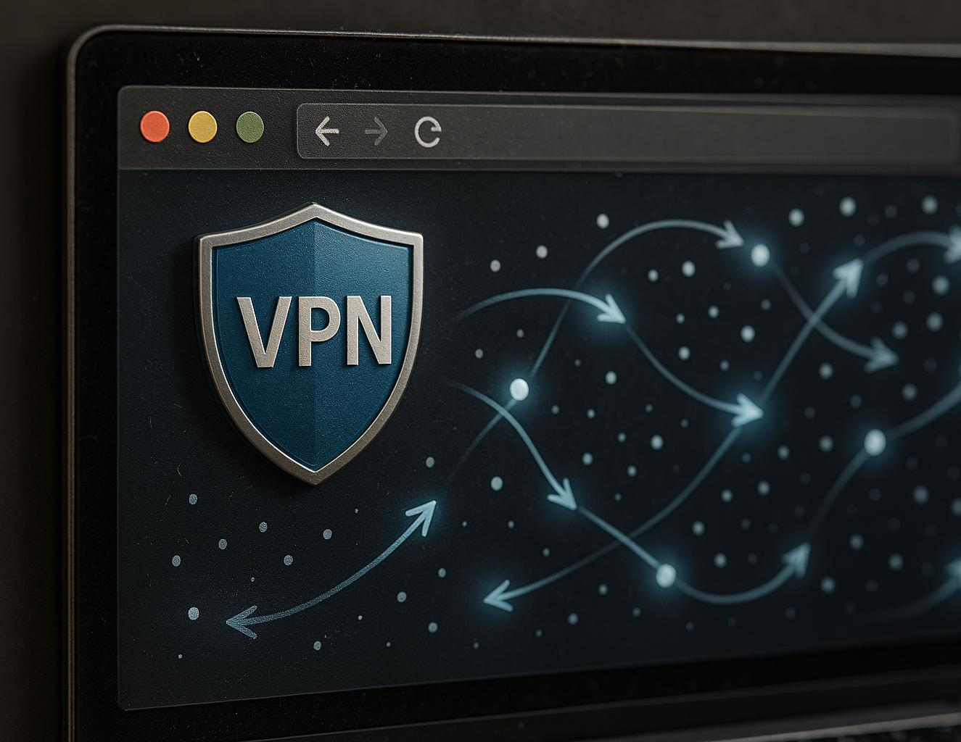
Features of Browser-Based VPNs
Selective Traffic Routing
  Browser VPN extensions route only web traffic, leaving other applications unprotected from network exposure.
Ease of Use and Efficiency
  These VPNs offer user-friendly interfaces with lower resource consumption, ideal for casual browsing.
Limited Security Features
  Browser VPNs often lack strong encryption and robust privacy policies compared to full VPN clients.
Notes:
---
Browser VPN extensions typically only route web traffic, leaving other apps unprotected, but offer ease of use and less resource consumption. They are ideal for casual web browsing but may lack strong encryption and privacy policies compared to full VPN clients.
• Email apps like Outlook, Windows Mail, or Thunderbird
• Cloud sync tools such as OneDrive, Dropbox, and Google Drive
• Messaging and calling apps like WhatsApp Desktop, Skype, Zoom, and Teams
• Streaming apps such as the BBC iPlayer app or Netflix app
• Software updates from Windows Update or the Microsoft Store
• Game launchers like Steam or the Xbox app
• Any specialist software that connects directly to the internet
So the key point is: a browser VPN protects the browser — nothing else.
Some Browser based VPNs:
Opera: Offers a free, unlimited, and no-log "browser VPN" (technically a secure proxy) that is integrated directly into the browser. It also provides a premium Opera VPN Pro for device-wide protection.
Brave: Features a paid service called Brave Firewall + VPN. Unlike most competitors, this protects the entire device, not just the browser, and uses the secure WireGuard protocol.
Microsoft Edge: Includes Microsoft Edge Secure Network, a Cloudflare-powered service. It typically offers a free monthly data limit (e.g., 5GB) and requires a Microsoft account login.
Aloha Browser: Primarily a mobile browser (Android/iOS) that includes a free, unlimited VPN. Its Premium version allows for country selection and device-wide "Always On" protection.
Epic Privacy Browser: Provides a free, built-in encrypted proxy with servers in multiple countries. It automatically clears all browsing traces upon closing the app.
Avast Secure Browser: Includes an integrated Avast SecureLine VPN that can secure the whole device, though full features often require a paid subscription.
UR Browser: A privacy-focused browser that includes a built-in VPN provided by OVPN, a known no-logs provider.
Apple +10
Image source: AI-generated

Slide 22
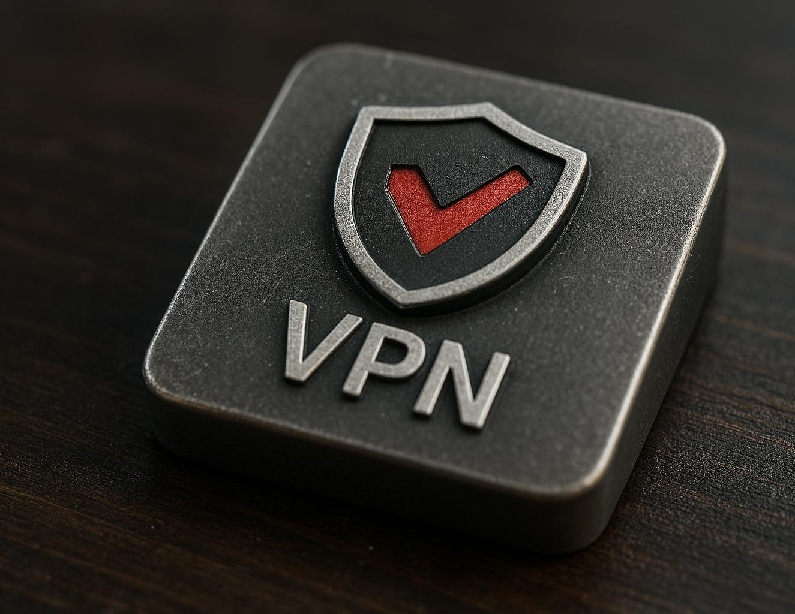
Overview of Antivirus-Bundled VPNs
Convenient Security Packages
  Antivirus suites bundling VPNs offer convenient all-in-one security solutions for users seeking combined protection.
Limitations of Bundled VPNs
  Bundled VPNs often face limitations in speed, server selection, and data allowance compared to standalone VPN services.
User Satisfaction and Reviews
  Industry reviews show mixed user satisfaction due to VPN constraints despite benefits of integration with antivirus.
Notes:
---
Antivirus suites bundling VPNs provide convenient all-in-one security packages. However, bundled VPNs often have limitations on speed, server selection, and data allowance compared to standalone services. Industry reviews point to mixed user satisfaction due to these constraints despite integration benefits.
Image source: AI-generated

Slide 23
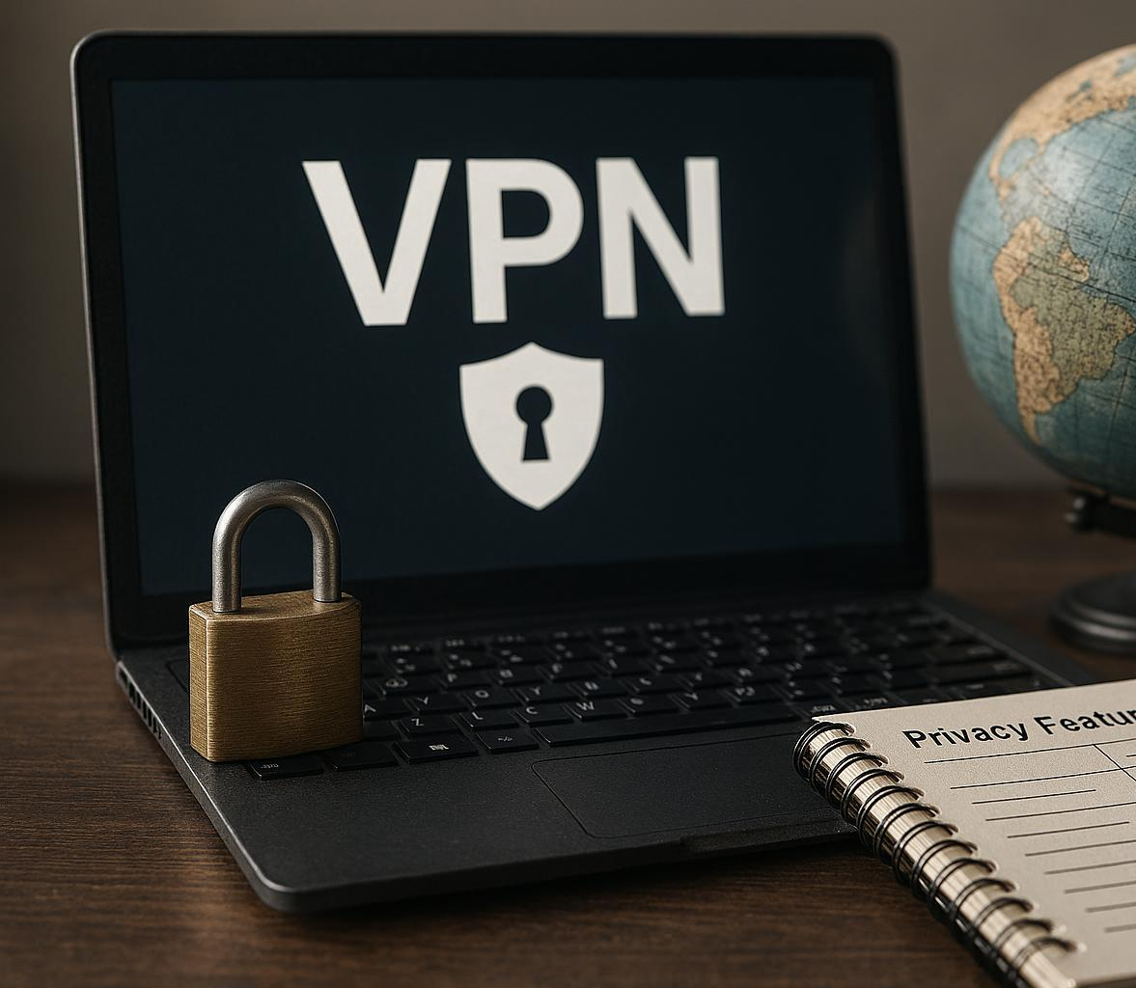
Overview of Standalone VPN Services
(E.g., Nord, Mullvad)
Strong Security Features
  Standalone VPN services provide robust security measures including encryption and multi-hop connections for enhanced privacy.
Extensive Server Networks
  Large server networks ensure better connectivity and faster speeds across multiple global locations.
Privacy and No-Log Policies
  VPN providers implement strict no-log policies to protect user anonymity and data privacy.
Comparative Features Table
  Comparison tables help users evaluate speed, cost, server count, and privacy features for informed decisions.
Notes:
---
Standalone VPN services usually offer the strongest security, extensive server networks, and advanced privacy features like no-log policies and multi-hop connections. A comparative table detailing speed, server count, privacy policies, and costs helps users select the best option tailored to their needs.
Image source: AI-generated

Slide 24
Assessing VPN Necessity: Savvy Users Versus Everyday Needs
Notes:
VPNs for Advanced, Security-Conscious Users, Benefits for Average Users and Club Members, Summary: VPN as a Tool, Not a Necessity

Slide 25

VPNs for Advanced, Security-Conscious Users
Advanced Security Features
  Obfuscation, kill switches, and privacy protocols enhance VPN security for advanced users facing complex threats.
Higher Adoption by IT Professionals
  IT professionals are 60% more likely to use premium VPNs compared to general consumers, reflecting elevated security needs.
Privacy-Centric Protocol Support
  Support for privacy-focused VPN protocols ensures stronger anonymity and protection of user data.
Notes:
---
Advanced users benefit from VPNs with features like obfuscation, kill switches, and support for privacy-centric protocols due to heightened threat models. Studies indicate IT professionals have a 60% higher likelihood of using premium VPN services than general consumers.
Image source: AI-generated

Slide 26

Benefits for Average Users and Club Members
Public Wi-Fi Security
  VPNs provide users peace of mind by securing their connections over public
  Wi-Fi networks.
Access to Region-Locked Content
  VPNs enable users to bypass geographic restrictions and access region-locked content easily.
Improved Online Privacy
  Around 45% of users believe VPNs enhance their overall online privacy and security.
Notes:
---
For many average users, VPNs offer peace of mind when using public Wi-Fi and enable access to region-locked content with minimal technical effort. User surveys reveal that around 45% feel VPNs improve their general online privacy, though not deemed mandatory daily.
Image source: AI-generated

Slide 27

Summary: VPN as a Tool, Not a Necessity
VPN as Privacy Tool
  VPNs offer privacy by encrypting internet traffic and masking user identity effectively.
Dependence on Individual Needs
  The necessity of VPNs varies depending on user risk tolerance and type of online activity.
Part of Cybersecurity Layers
  VPNs represent one layer within a broader, comprehensive cybersecurity strategy for balanced protection.
Notes:
---
VPNs are valuable privacy and security tools but are not universally necessary for everyone. Their usefulness depends on individual risk tolerance, activity type, and trust in service providers. Recognising VPNs as one layer in a comprehensive cybersecurity approach is essential for balanced usage decisions.
Image source: AI-generated

Slide 28
Demonstration: Observing IP Address Changes with a VPN
Notes:
Checking Your Public IP Address without a VPN, Activating a VPN and Noting IP Address Change, Interpreting the Results and Understanding Implications

Slide 29
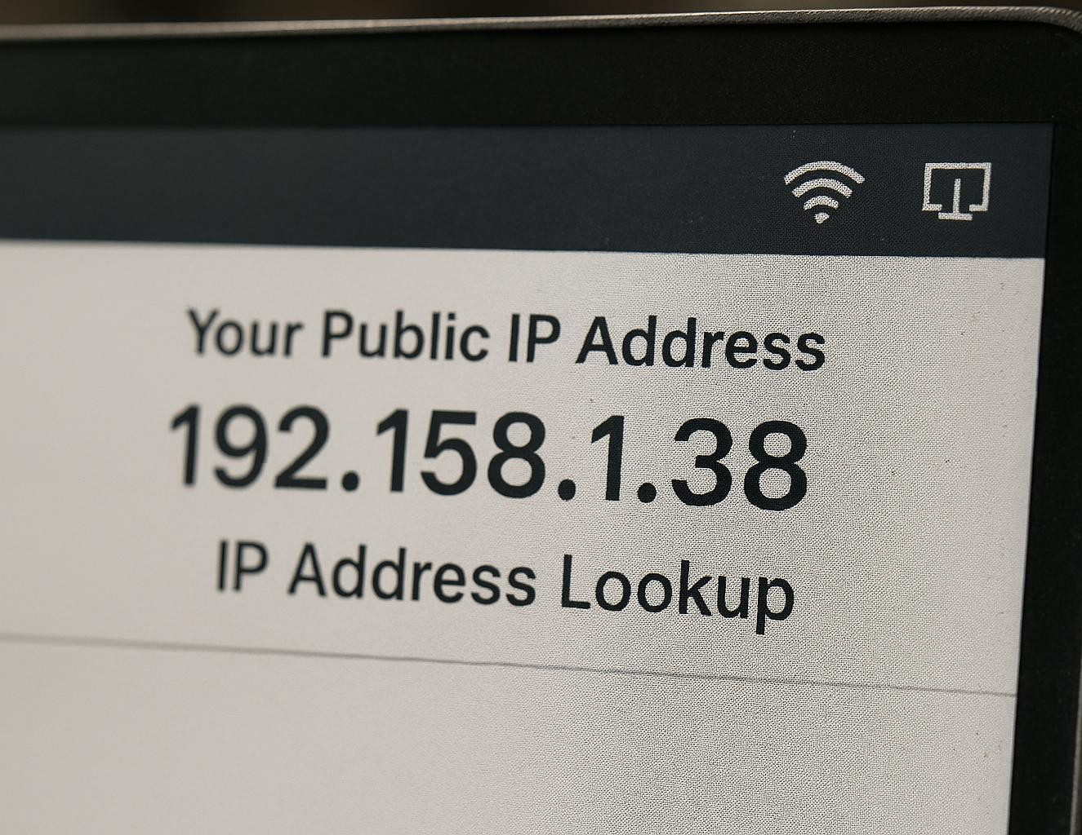
Checking Your Public IP Address without a VPN
Public IP Address Identification
  A public IP address reveals a user's approximate location and Internet Service Provider by default.
IP Lookup Tools
  Online tools provide instant access to public IP information, enhancing transparency for users.
Baseline for VPN Masking
  Knowing your default public IP is essential to understanding how VPNs protect privacy by masking it.
Notes:
---
A user's public IP address identifies their approximate location and ISP. Tools such as 'whatismyipaddress.com' reveal this info instantly. Understanding your default IP is the baseline for recognizing how VPNs mask identity.
Image source: AI-generated

Slide 30
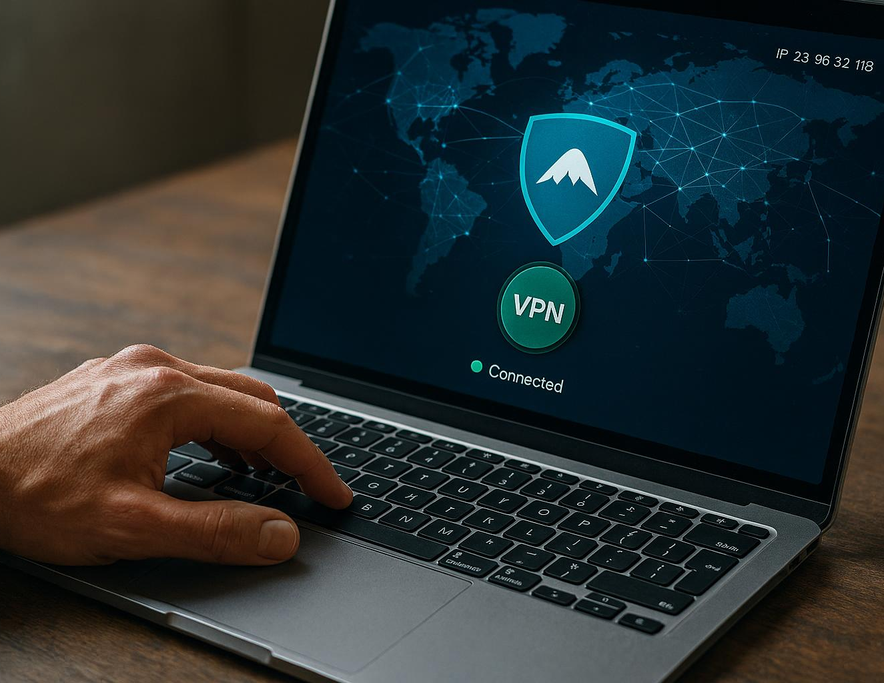
Activating a VPN and Noting IP Address Change
IP Address Change
  Activating a VPN changes your IP address to that of the VPN server, hiding your real location.
Impact on Speed and Latency
  VPN activation may slightly affect internet speed and increase latency temporarily.
Traffic Rerouting and Privacy
  Comparing IPs before and after VPN use shows traffic rerouting and enhanced privacy protection.
Notes:
---
Upon VPN activation, your IP should switch to the VPN server's location, obscuring your real geographic location. Speed and latency may be affected briefly. Comparing pre- and post-activation IPs shows clear evidence of traffic rerouting and potential privacy enhancement.
Image source: AI-generated

Slide 31

Interpreting the Results and Understanding Implications
VPN IP Change Confirmation
  A changed IP address shows that VPNs effectively reroute internet traffic to new locations.
Privacy Protection Benefits
  VPNs enhance user privacy by masking original IP addresses, helping to secure online identity.
Access and Location Trade-offs
  Location mismatches from VPN use may trigger access restrictions or flags on some online services.
Notes:
---
Seeing the changed IP confirms that VPNs reroute internet traffic, which can protect privacy but may raise flags with some services due to location mismatches. Users should understand both privacy benefits and access trade-offs that come with this IP modification.
Image source: AI-generated

Slide 32
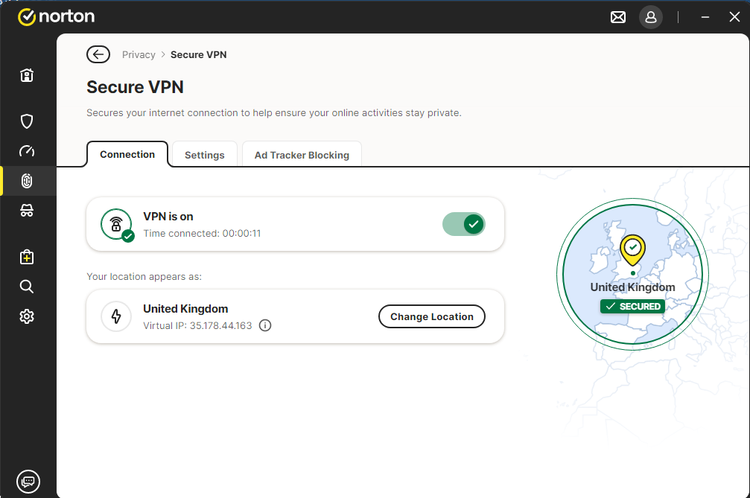
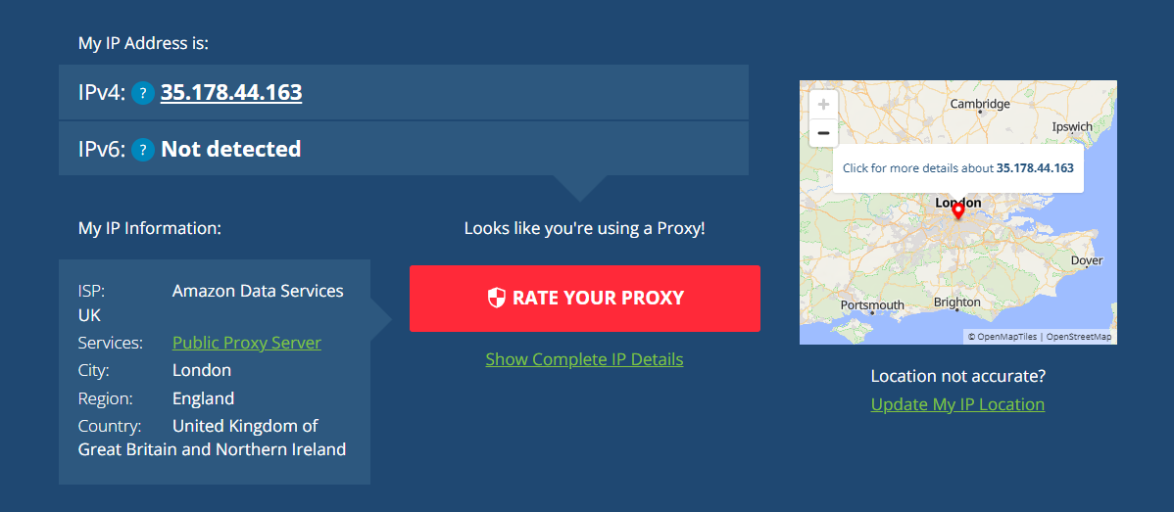
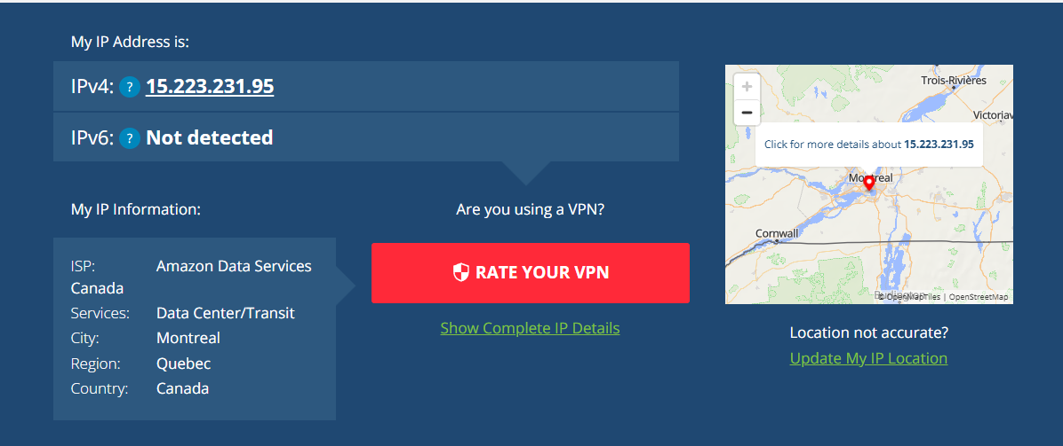
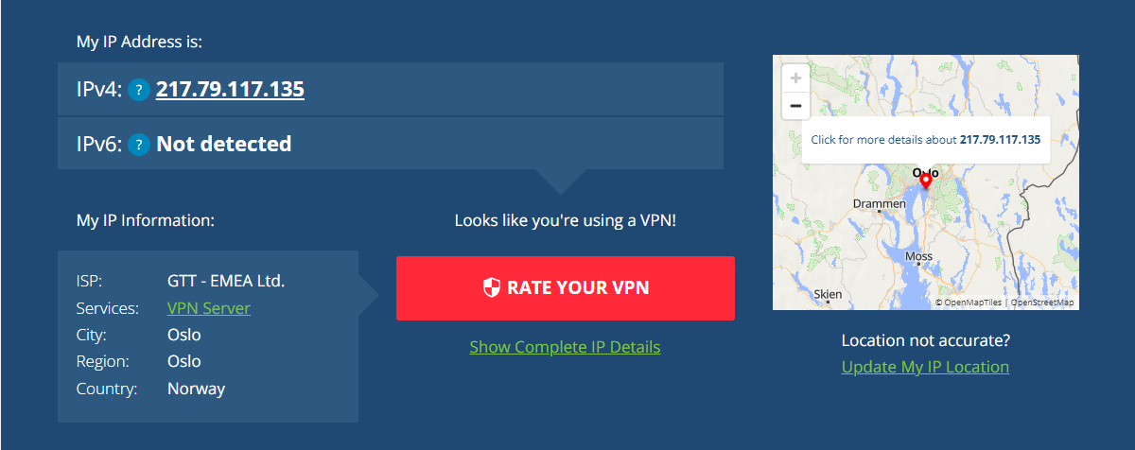
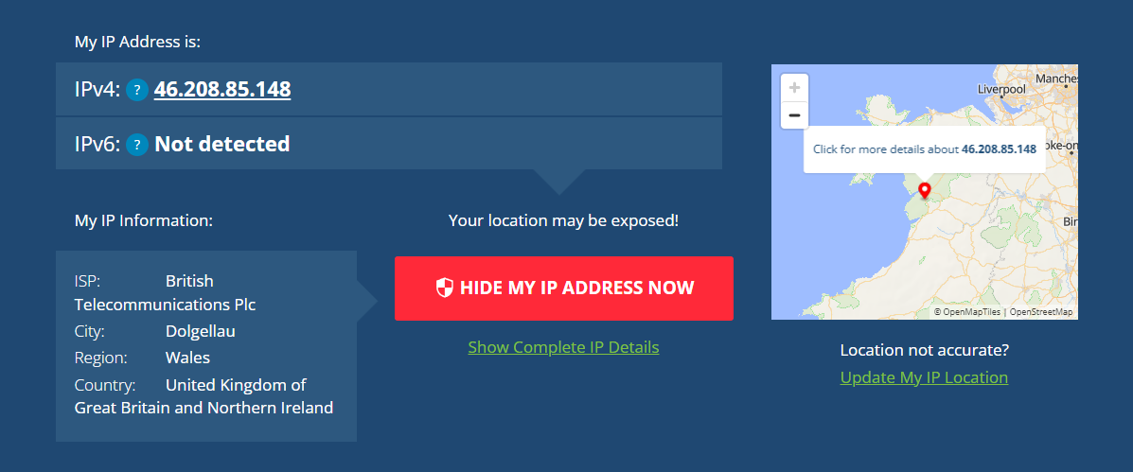
Notes:
Default IP address without a VPN
*************
Norton VPN select the ‘fastest’
*************
London
*************
Canada
*************
Norway
*************

Slide 33
Conclusion: Harnessing VPNs Wisely for Enhanced Online Privacy
Understanding VPN Technology
Grasping how VPNs work helps users make informed privacy and security decisions.
Benefits and Limitations
VPNs enhance privacy and security but have usage limits and require trust in providers.
Choosing the Right VPN
Selecting VPN solutions that balance security, convenience, and trust ensures effective use.
Notes:
In summary, understanding VPN technology, its practical uses, and limitations empowers users to make informed decisions about when and how to use VPNs effectively. While VPNs enhance privacy and security in many scenarios, they are not always necessary and require trust in providers. Choose VPN solutions that fit your needs, balancing security, convenience, and trust.

