Slide 1

Domestic Printers: Types, History, Modern Trends, and the Rise of 3D Printing
Exploring printer evolution and innovative printing technologies
Notes:
---

Slide 2
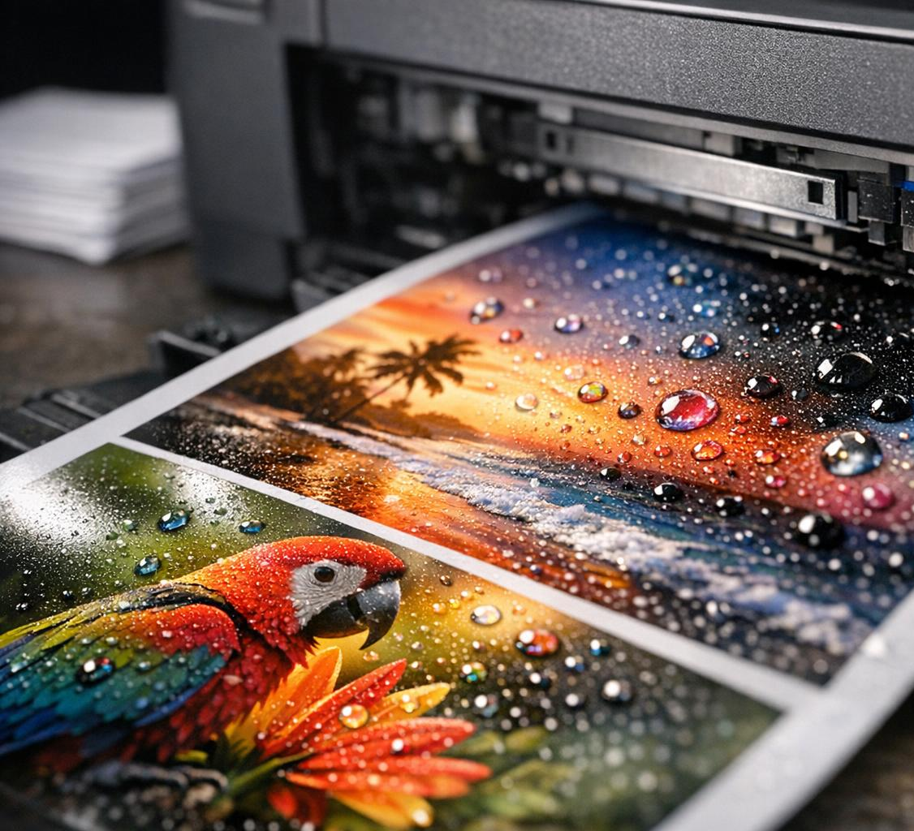
Today’s Topics
The History and Evolution of Domestic Printers
Types of Domestic Printers: Features, Advantages, and Disadvantages
Inkjets clogging.
Printing From Mobile Devices: Connectivity and User Experience
Understanding Printer Software Bloat
New Trends and Innovations in Domestic Printing
Exploring 3D Printers for Home Use
Notes:
The History and Evolution of Domestic Printers
Types of Domestic Printers: Features, Advantages, and Disadvantages
Printing From Mobile Devices: Connectivity and User Experience
Understanding Printer Software Bloat
New Trends and Innovations in Domestic Printing
Exploring 3D Printers for Home Use

Slide 3
The History and Evolution of Domestic Printers
Notes:
Early Home Printing Solutions and Dot Matrix Printers, Transition to Inkjet and Laser Technologies, Recent Innovations in Domestic Printing

Slide 4
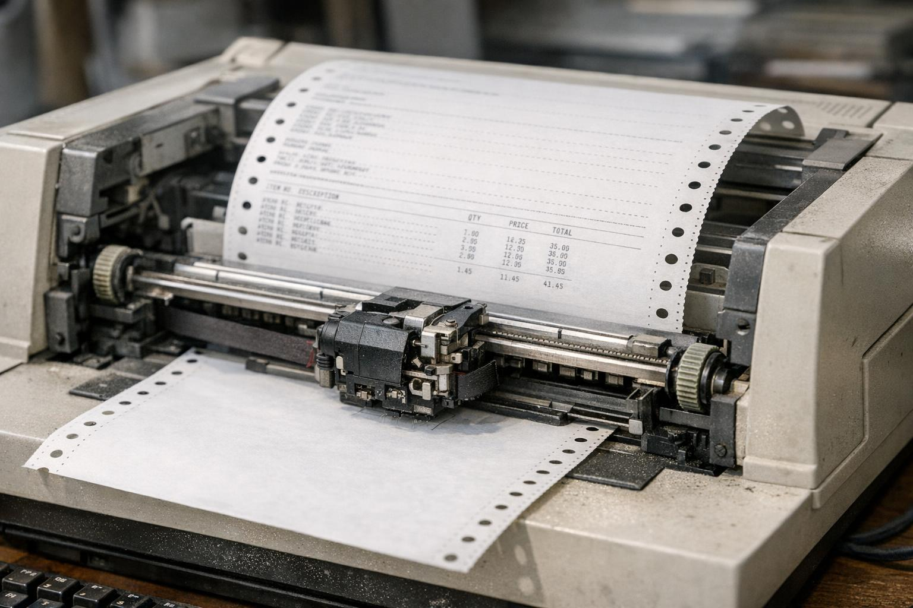
Early Home Printing Solutions and Dot Matrix Printers
Affordable Home Printing
  Dot matrix printers provided the first affordable printing option for home users during the 1970s and 1980s.
Printing Mechanism
  These printers used pins striking an ink-soaked ribbon to form characters on paper, allowing multi-part form printing.
Advantages and Limitations
  Known for durability and continuous feed printing but had low resolution and noisy operation.
Notes:
---
Dot matrix printers, emerging in the 1970s and 1980s, were the first affordable home printing solutions. They operate by striking an ink-soaked ribbon with pins to form characters, and were prized for their low cost and ability to print multi-part forms. However, they suffered from low resolution and noisy operation. Early home users valued dot matrix printers for their durability and ability to print in continuous feed formats, useful for business and home use before inkjet technology matured.
Image source: AI-generated

Slide 5
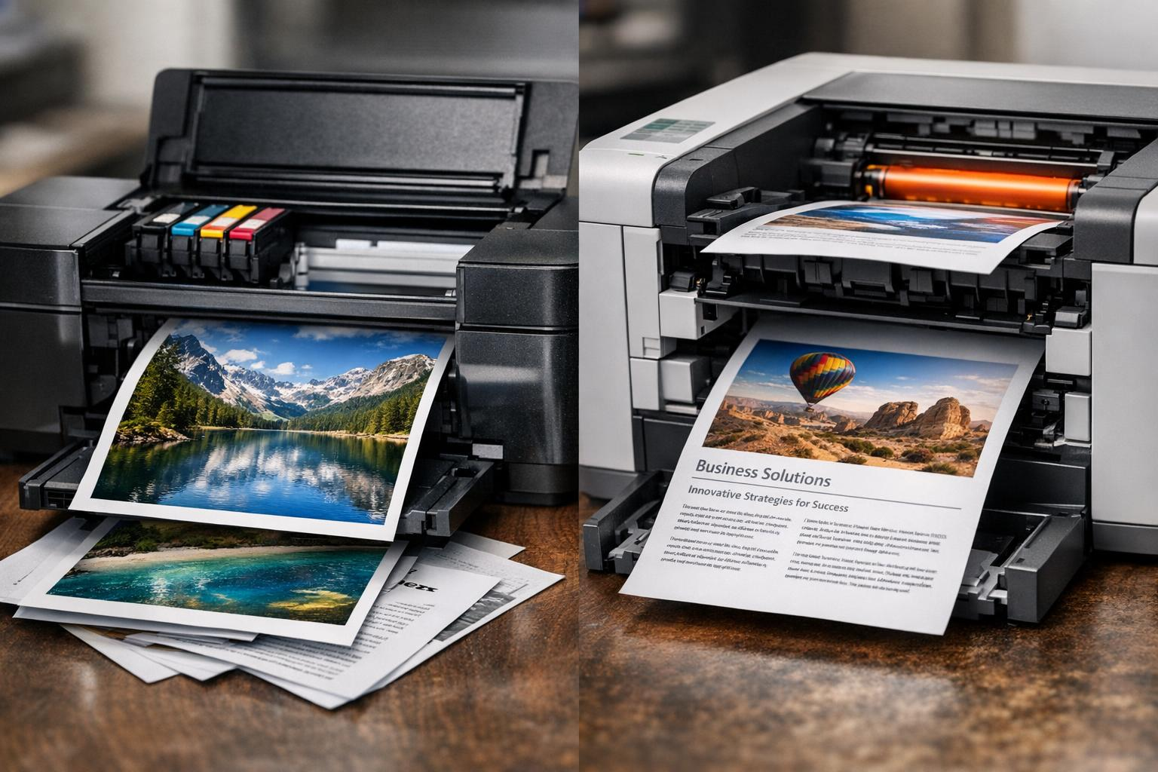
Transition to Inkjet and Laser Technologies
Inkjet Printing Technology
  Inkjet printers produce high-quality color photos using tiny ink droplets at affordable prices.
Laser Printing Advantages
  Laser printers offer fast print speeds and sharp text using toner-based technology for high-volume printing.
Printing Technology Evolution
  Transition to inkjet and laser printers improved print quality, speed, and cost efficiency for home use.
Notes:
---
Starting in the late 1980s and 1990s, inkjet and laser printers revolutionized home printing. Inkjet printers offer high-quality photo prints and color capabilities at affordable prices, utilizing microscopic ink droplets. Laser printers provide faster print speeds and sharper text with toner-based technology, emerging as dominant for high-volume black-and-white printing. The transition reflected advances in print quality, speed, and cost efficiency, driven by demand for better image reproduction and less noisy operation.
Image source: AI-generated

Slide 6
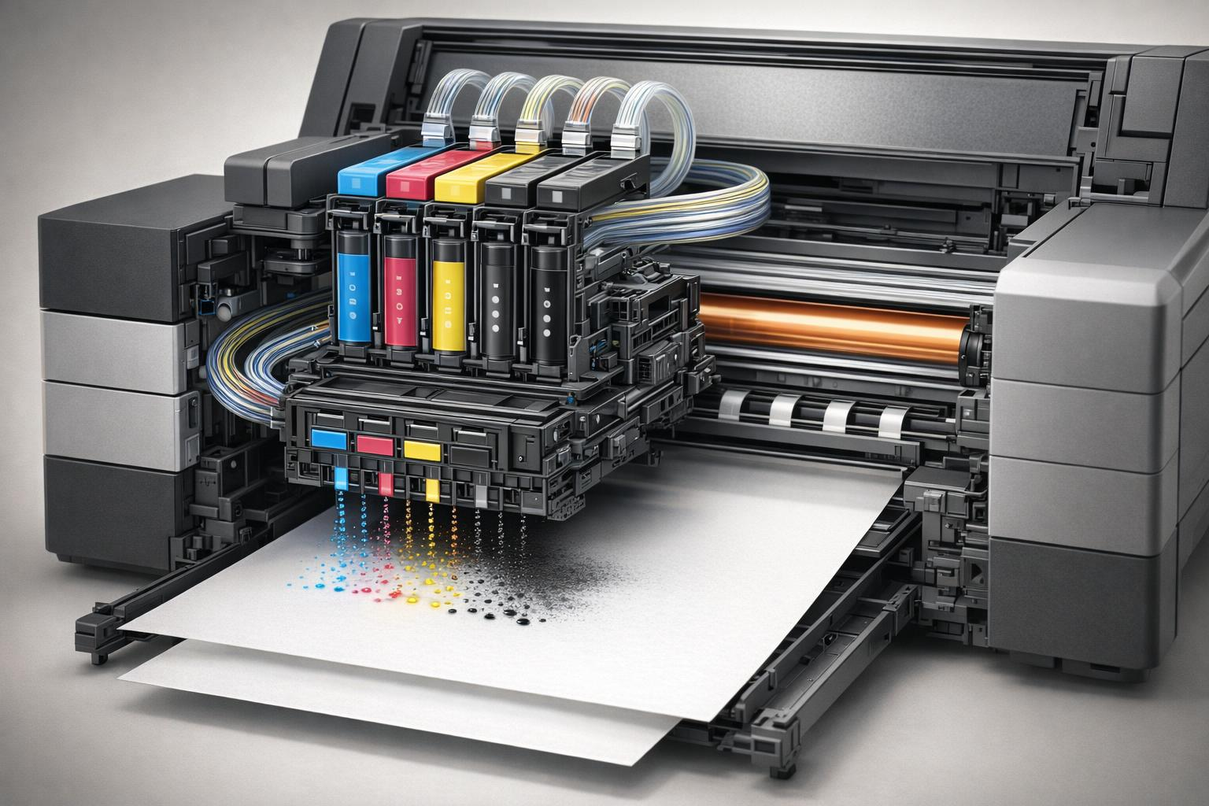
How an Inkjet Printer Works
Inkjet Printing Technology
  Inkjet printers produce high-quality colour photos using tiny ink droplets at affordable prices.

Slide 7
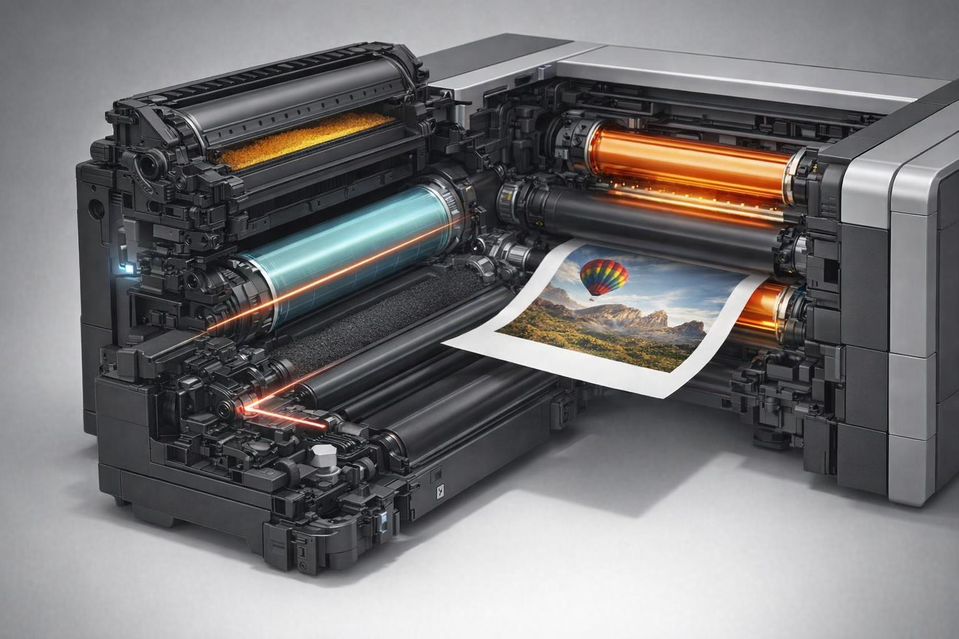
How a Toner-based Printer
(A laser printer) Works
Laser Printing Technology
  A toner‑based printer (a laser printer) works by using static electricity, light, and heat to place and fuse a fine powder (toner) onto paper.
  What is Toner?
  Toner is a dry powder, not a liquid:
  Pigments – colours
  Polymers – tiny plastic particles that melt to bond to the paper.
  Additives – Help the powder flow and hold an electrostatic charge
  The Process:
  Charge the drum to give an electrostatic charge.
  The Laser draws the image.
  Toner sticks to the charged areas
A roller transfers it to the paper
The Fuser Unit melts the toner to the paper
Notes:
Laser printers don’t spray ink. Instead, they draw your page using a laser beam onto a rotating metal drum coated with a photosensitive material.
Here’s the sequence:
Step 1 — Charge the drum
A corona wire or roller gives the drum a uniform electrostatic charge.
Step 2 — Laser draws the image
A laser beam scans across the drum, discharging the areas where the text or image should be.
This creates an invisible electrostatic pattern — a “map” of your page.
Step 3 — Toner sticks to the charged areas
Because toner particles are charged, they are attracted to the discharged parts of the drum that form the image.
Step 4 — Transfer to paper
The drum rolls against the paper, and a transfer roller gives the paper the opposite charge, pulling the toner onto it.
Step 5 — Fusing (the magic moment)
The paper passes through a fuser unit — two hot rollers that melt the toner’s plastic polymers.
The melted toner bonds permanently to the paper, creating a smudge‑proof print.

Slide 8
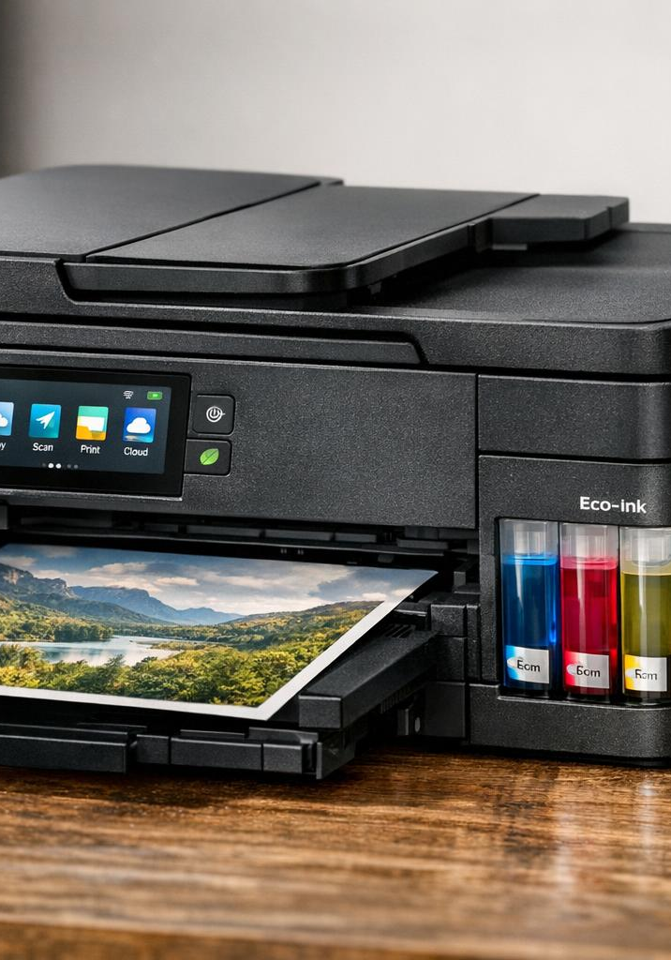
Recent Innovations in Domestic Printing
Wireless and Smart Connectivity
  Smart printers now support wireless connectivity and mobile printing, enhancing convenience and accessibility for users.
Eco-Friendly Ink Systems
  Eco-friendly ink systems reduce environmental impact while maintaining high print quality and efficiency.
Advanced Printing Features
  Automatic duplex printing and higher resolution have become standard, improving output quality and operational efficiency.
AI and IoT Integration
  AI and IoT technologies optimize printer maintenance and print management for smarter operation.
Notes:
---
Recent advances include wireless connectivity, compact multifunction capabilities, and eco-friendly ink systems. Smart printers enable mobile device printing and cloud connectivity, improving user convenience. Additionally, automatic duplex printing and higher resolution have become standard, enhancing both efficiency and output quality. The incorporation of AI and IoT technologies is also emerging to optimize maintenance and print management.
Image source: AI-generated

Slide 9
Types of Domestic Printers: Features, Advantages, and Disadvantages
Notes:
Inkjet and Bubblejet Printers: Pros, Cons, and Typical Use Cases, Laser Printers: Advantages, Drawbacks, and Cost Comparisons, Other Types: Thermal, Solid Ink, and Multifunction Printers

Slide 10
Inkjet and Bubblejet Printers: Pros, Cons, and Typical Use Cases
High-Quality Colour Output
  Inkjet printers produce vibrant, high-resolution color images by spraying tiny ink droplets onto paper.
Cost and Efficiency Trade-offs
  These printers have low initial costs but slower speeds and higher ink costs per page compared to alternatives.
Common Use Cases
  Ideal for photo printing, home offices, and small-scale documents requiring accurate colour fidelity.
Notes:
---
Inkjet and bubblejet printers excel in producing high-quality color images and photos, using small ink droplets sprayed onto paper. While initial costs are low and they offer great color range, drawbacks include slower printing speeds and higher per-page ink costs. Common use cases are photo printing, home offices, and small-scale document printing where color fidelity is important.
Image source: AI-generated

Slide 11
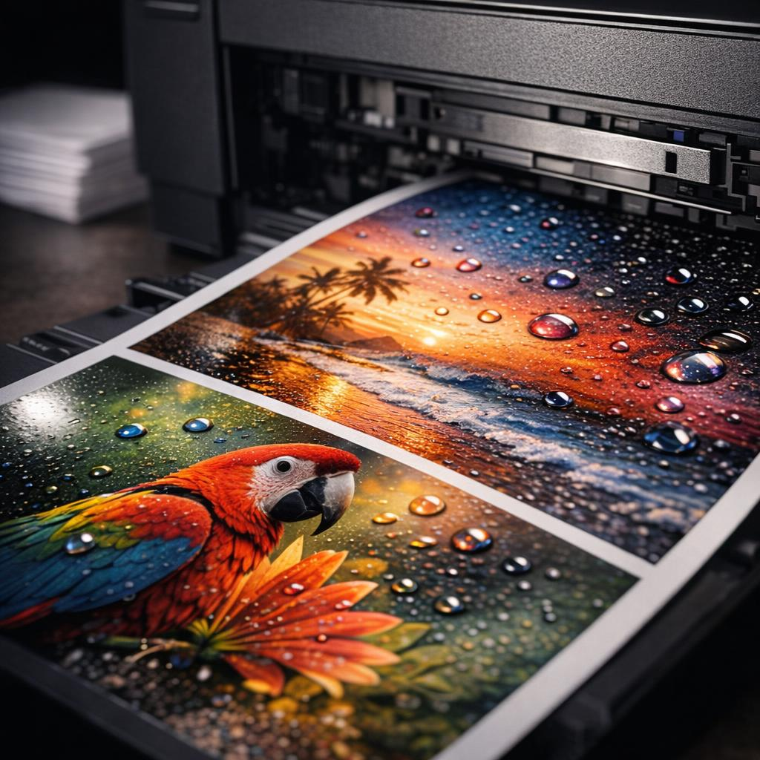
The controversial
“You must use our ink” problem
Printer manufacturers may limit the use of third‑party ink for three main reasons:
Protecting revenue,
Controlling Print Quality
Firmware based security to block non-OEM cartridges
Notes:
Printer manufacturers limit the use of third‑party ink for three main reasons: protecting revenue, controlling print quality, and using firmware‑based security systems that lock out non‑OEM cartridges. The practice is controversial, and recent reporting makes it very clear why it happens and why it frustrates users.
🔐 1. Digital “lock‑ins” to protect their business model
Most printer companies sell printers cheaply and make their profit on ink.
This is the classic “razor and blades” model.
HP’s “Dynamic Security” system is the best‑known example: firmware checks the cartridge’s chip and blocks printing if the cartridge isn’t genuine. HP openly states that the system is designed to “protect HP’s innovations and intellectual property” and maintain the “integrity” of their printing systems.
In other words:
Cheap printer, expensive ink — and they want to keep it that way.
🎨 2. Quality control (the official justification)
Manufacturers argue that third‑party cartridges may:
clog printheads
leak
produce poor colour accuracy
damage the printer
HP claims Dynamic Security protects customers from “counterfeit and third‑party ink cartridges that do not contain an original HP security chip”.
Whether this is always true is debated, but it’s the official line.
💼 3. Firmware updates that deliberately disable third‑party ink
Some printers receive automatic firmware updates that suddenly stop accepting compatible cartridges that previously worked.
This practice has been criticised by consumer groups and trade bodies.
For example, the International Imaging Technology Council highlighted that HP firmware updates can “brick” third‑party ink and toner, and that this conflicts with sustainability standards such as EPEAT 2.0.
This is why many users disable automatic updates.
🧩 4. Authentication chips and DRM
Many cartridges contain microchips that:
identify the cartridge
report ink levels
authenticate the brand
Third‑party manufacturers must clone these chips, and firmware updates often break compatibility.
This is essentially DRM (Digital Rights Management) applied to ink.
💸 5. Financial incentive: OEM ink is far more profitable
Consumer groups such as Which? have repeatedly pointed out that blocking third‑party ink forces customers to buy the manufacturer’s own cartridges, which are often significantly more expensive.
PCWorld notes that many consumers are “outraged” that they cannot choose cheaper ink.
⚖️ 6. Why this is controversial
Users feel they should be free to use any ink in a printer they own.
Some updates have disabled printers without warning.
Class‑action lawsuits have been filed over these restrictions.
Sustainability groups argue that blocking remanufactured cartridges increases waste.
Ars Technica reports that new sustainability standards (EPEAT 2.0) explicitly discourage firmware that blocks third‑party supplies.

Slide 12
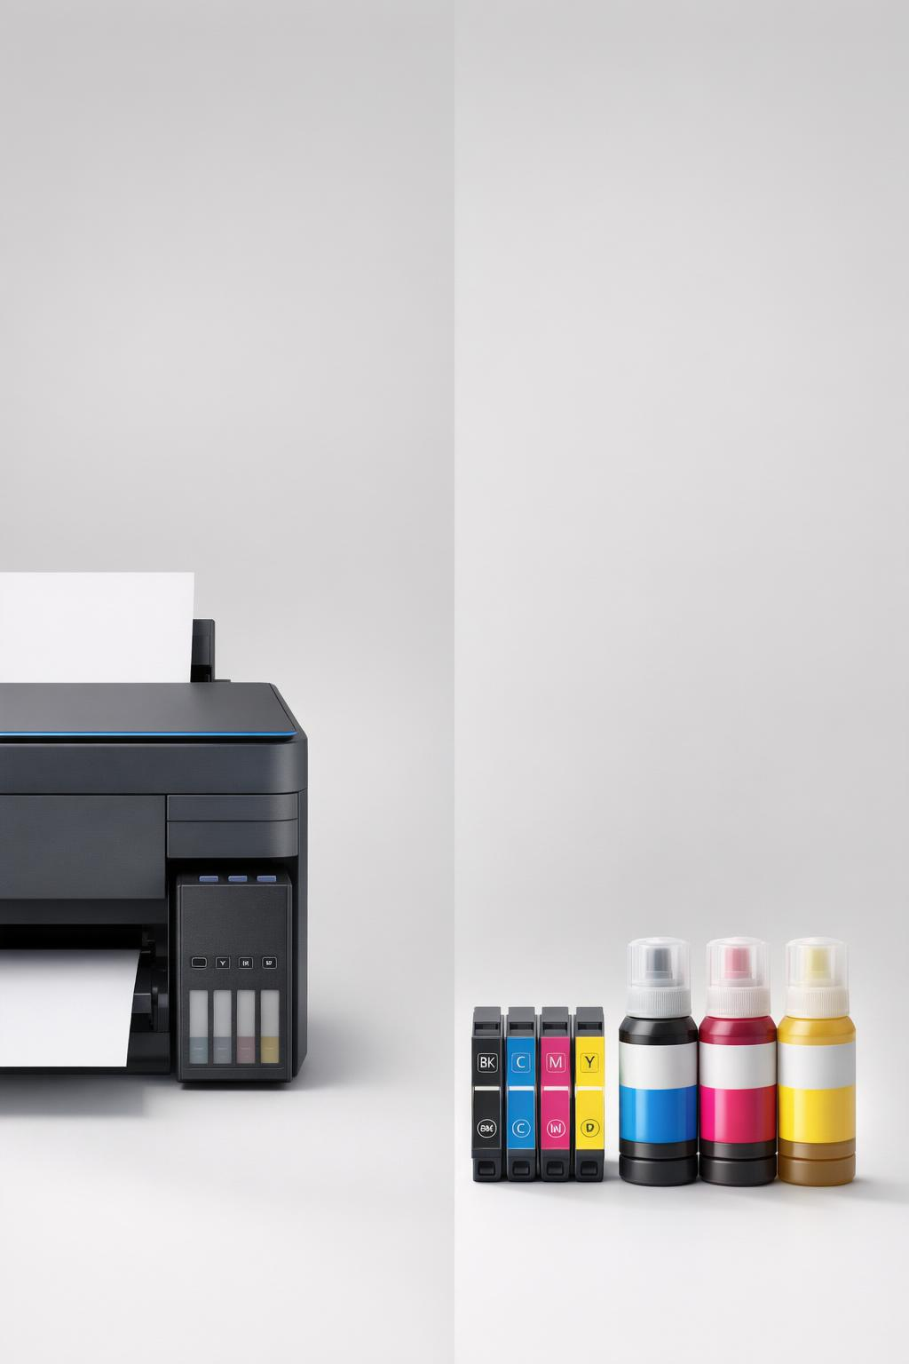
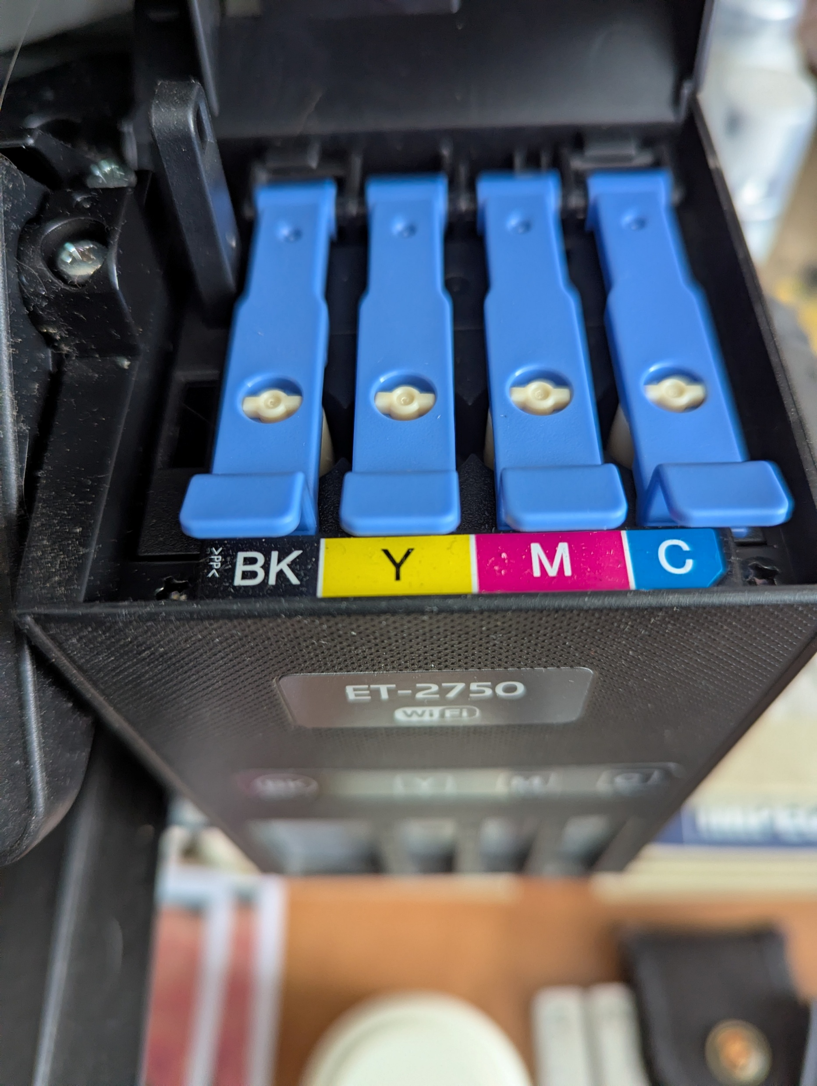
Cheap printer –
Expensive Ink.
All the Major printer manufactures
now offer “Extended Tank.” systems
A much larger ink reservoir
60 – 140ml
Compared with 3 – 12ml for a ‘standard’ cartridge
“Up to 3 years of ink”
Notes:
Ink Costs
Yes — all major brands now offer refillable tank printers. They don’t always use the same name, but the concept is identical: large refillable reservoirs instead of cartridges.
Epson – EcoTank
• The original and most widely known system
• Uses 65–140 ml bottles depending on model
• Marketed as “up to 3 years of ink included”
Canon – MegaTank
• Found in PIXMA G‑series printers
• Similar bottle sizes: typically 60–135 ml
• Very low running costs
HP – Smart Tank
• HP’s answer to EcoTank
• Bottles typically 70–135 ml
• Sold with “up to 3 years of ink” bundles
Brother – InkBenefit Tank / TankBenefit
• Less common in the UK but available
• Uses refill bottles around 45–100 ml
I bought my current Printer in April 2020 – 6 years ago. £230. It came with a second set of ink bottles.
Since then I’ve only had to purchase 3 more bottles – Cost £27.00 Feb 2024.
Printer has printed 6286 pages.

Slide 13
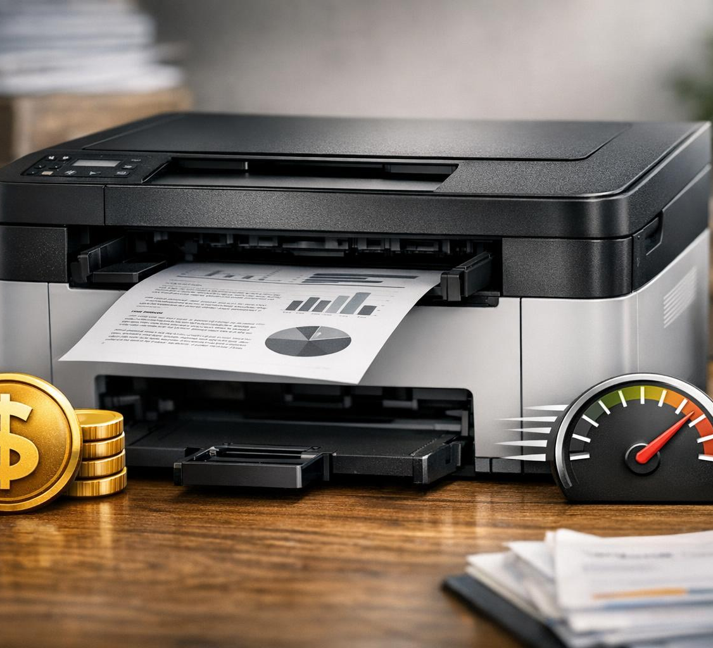
Laser Printers: Advantages, Drawbacks, and Cost Comparisons
High-Speed and Crisp Output
  Laser printers provide fast printing speeds and sharp text quality, ideal for high-volume monochrome printing needs.
Cost Considerations
  Laser printers have higher upfront costs and colour models feature more expensive consumables compared to inkjets.
Maintenance and Suitability
  Laser printers require less frequent maintenance but it is more complex, suited for home offices and students with high print volumes.
Notes:
---
Laser printers are favored for their high-speed printing, crisp text output, and low cost per printed page, especially in monochrome models. Their upfront cost tends to be higher than inkjets, and color laser printers still come with higher consumable prices. They are best suited for users with high volume text printing needs, such as home offices and student use. Maintenance is generally less frequent but can be more complex.
Image source: AI-generated

Slide 14
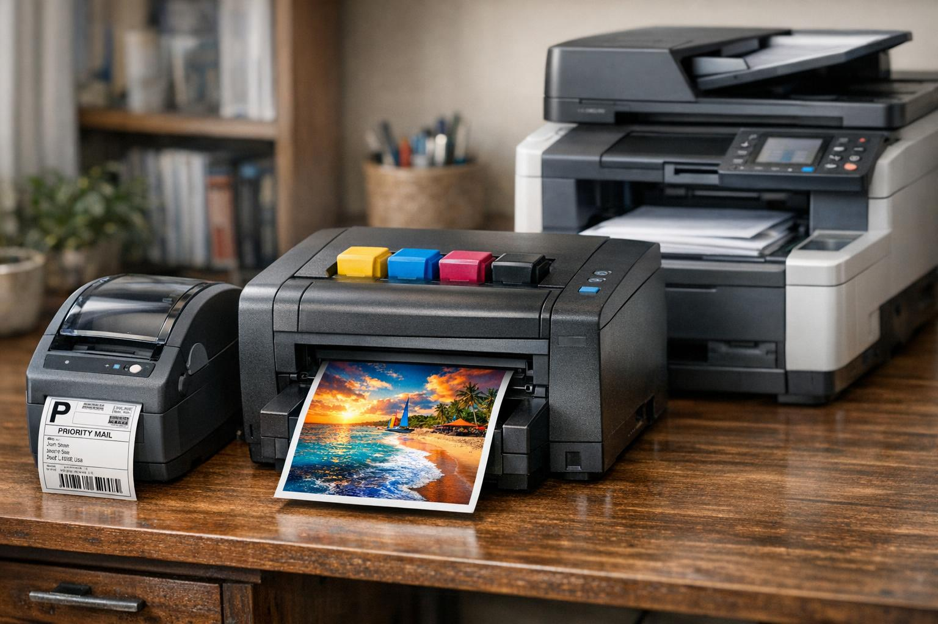
Other Types: Thermal, Solid Ink, and Multifunction Printers
Thermal Printers
  Thermal printers excel in fast and reliable label and receipt printing, though they have limited color and media options.
Solid Ink Printers
  Solid ink printers provide vibrant colors and generate less waste but are less common due to higher costs and limited availability.
Multifunction Printers
  Multifunction printers combine printing, scanning, copying, and faxing, ideal for saving space and enhancing home office productivity.
Notes:
---
Thermal printers find niche uses in label and receipt printing, valued for speed and reliability but limited in color and media versatility. Solid ink printers offer vibrant colors and less waste but remain less prevalent due to cost and availability. Multifunction printers combine printing, scanning, copying, and sometimes faxing, catering to home office convenience and saving space with integrated functionalities.
A solid ink printer is a type of colour printer that uses waxy, crayon‑like blocks of ink instead of liquid ink or powdered toner. The printer melts these blocks during operation and jets the molten ink onto the page, where it quickly cools and solidifies.
🧩 What makes it different?
Ink form — Instead of cartridges, it uses solid sticks, pucks, or pearls of coloured wax.
Printing process — The printer melts the ink and applies it in a way similar to offset printing.
Heated printhead — Because the ink must be melted, the printer needs time to warm up.
🎨 Why people like them
Excellent colour quality — Very vivid, saturated colours, great for graphics and photos.
Consistent on cheap paper — The waxy layer sits on top of the paper, so even low‑quality stock looks good.
Eco‑friendly — No bulky cartridges; just the small wax blocks and minimal packaging.
Good for intermittent use — The ink doesn’t “dry out” like inkjet cartridges.
🐢 Downsides to consider
Warm‑up time — They need to melt the ink before printing, so first‑page time is slower.
Less common today — Mostly associated with Xerox; fewer models available now.
Running cost quirks — Ink sticks can be pricey, though they last a long time.
🧭 In one sentence
A solid ink printer is a melt‑and‑print colour machine that produces rich, vibrant output using wax‑based ink blocks instead of cartridges.
If you want, I can compare solid ink printers with laser or inkjet models to help you decide which suits a particular use case.
Image source: AI-generated

Slide 15
The
“I don’t print often
→ it clogs
→ cleaning wastes ink
→ printing becomes expensive
→ I print even less.” issue

Slide 16
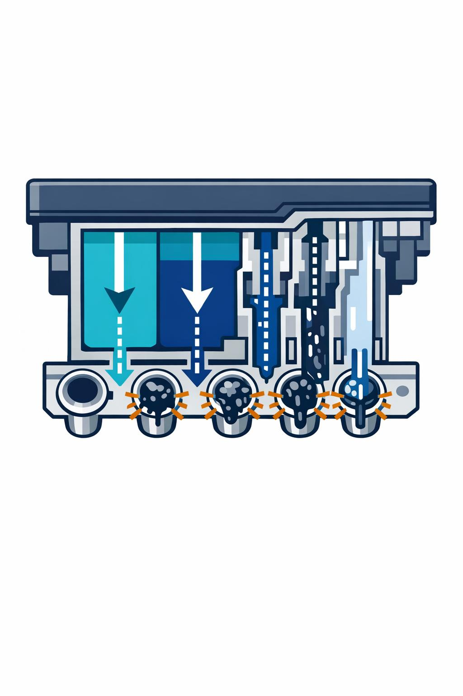
Inkjet Printers and the Clogging problem
Inkjet printers clog because the ink is water‑based and the nozzles are microscopic.
If the printer sits unused, the water evaporates and leaves dried pigment behind.
Inkjet printheads have nozzles thinner than a human hair. They fire droplets measured in picolitres. That’s brilliant for photo quality… but terrible for long idle periods.
The ink at the nozzle dries slowly.
Pigment or dye particles solidify.
The next time you print, the head tries to fire ink through a partially blocked channel.
You get streaks, missing lines, colour shifts.
The necessary cleaning cycle uses a lot of ink.

Slide 17
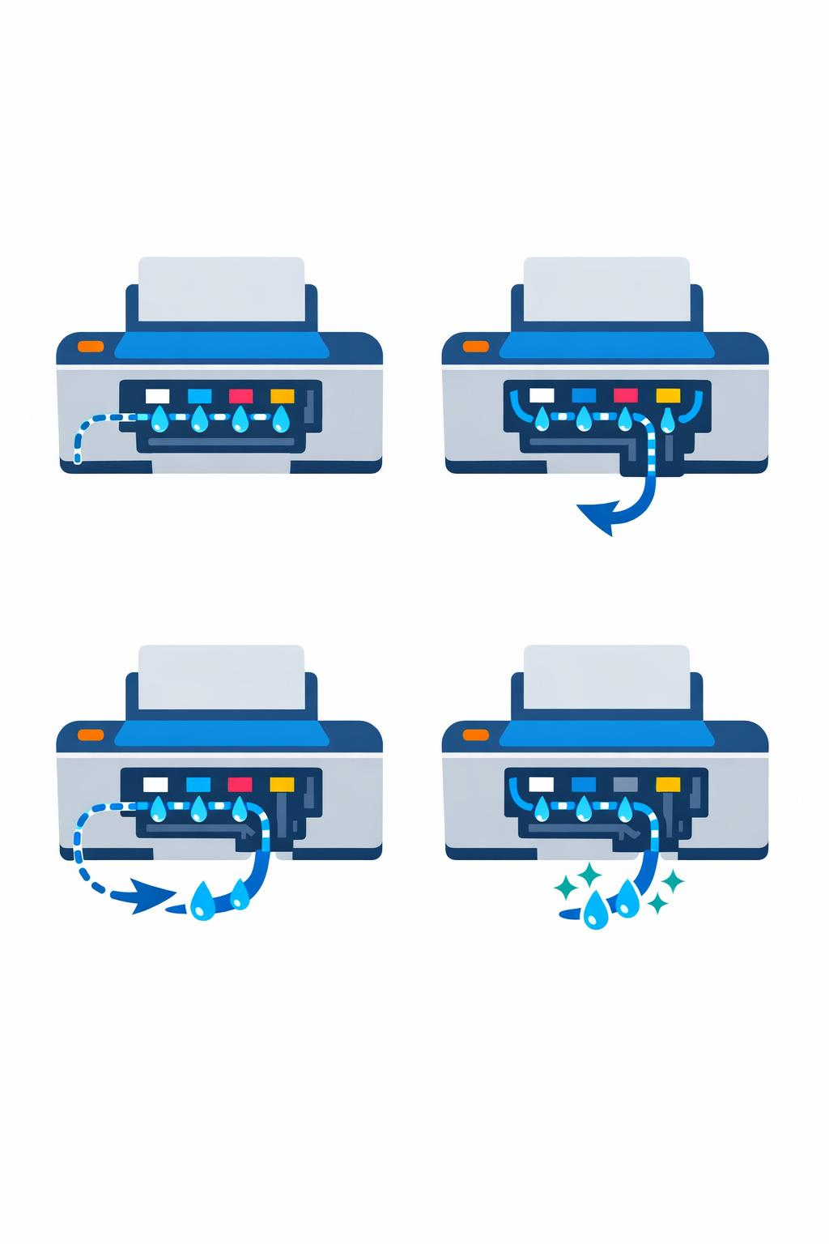
Some Printers are worse than others
Printhead Type
Fixed Printhead (Canon, Epson EcoTank & Some Brother)
Higher quality
More prone to clogging as the head never gets replaced
Cartridge-integrated heads (HP Deskjet, some Canon)
Lower quality
But every cartridge gives you a new printhead
Much less clogging

Slide 18
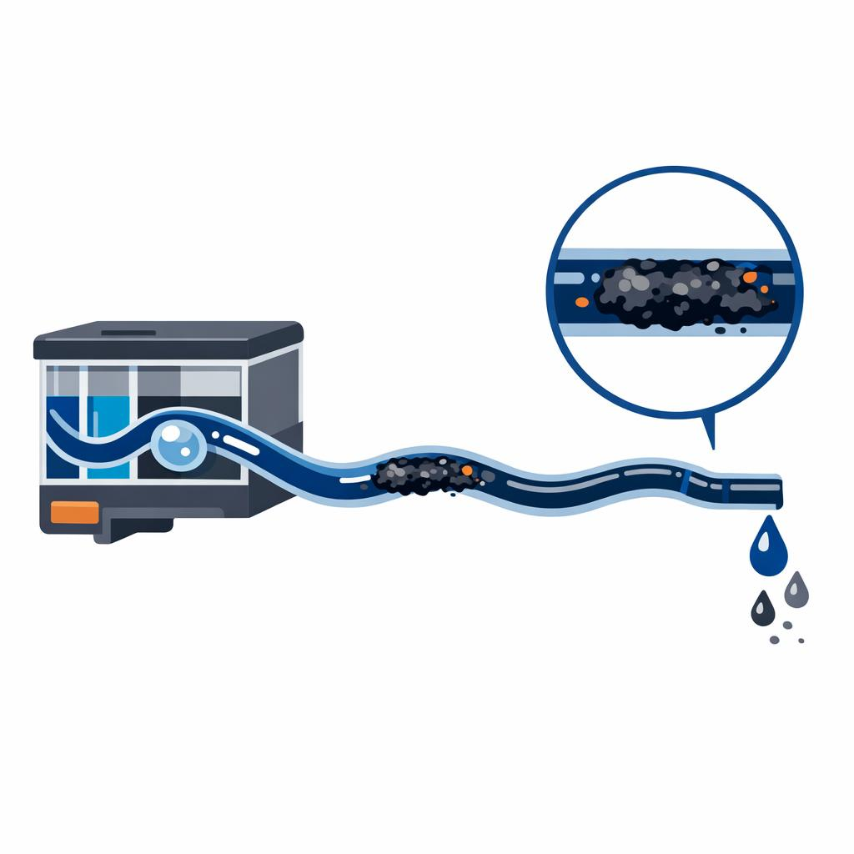
Some Printers are worse than others
Ink Chemistry
Pigment Inks dry faster = more clogging risk
Dye Inks stay liquid longer = less clogging
Environment
Warm dry rooms accelerate evaporation
Printers near radiators or sunny windows clog more
Dust accumulates around the nozzles

Slide 19

Why Cleaning feels wasteful
A Cleaning cycle:
Forces ink through the nozzles at high pressure
Flushes dried ink into a waste ink pad
Can use 5 – 20ml of ink per cycle
Eco tank users see the ink level drop….😒

Slide 20

Practical advice for occasional users
Print a test page once every 1 – 2 weeks
Keep the printer in a stable, not-too-dry environment
Turn the Printer off using it’s power button
If you print very rarely, consider a laser printer
Notes:
✔ Print a small test page once every 1–2 weeks
A simple colour bar page keeps the nozzles wet.
✔ Keep the printer in a stable, not-too-dry environment
Avoid radiators, sunny windows, or airing cupboards.
✔ Turn the printer off using its power button
This parks the printhead in a sealed “capping station” to slow evaporation.
✔ If you print very rarely, consider a laser printer
Toner doesn’t dry out.
For text‑heavy, occasional use, a mono laser is unbeatable.

Slide 21
Printing From Mobile Devices: Connectivity and User Experience
Notes:
Wireless Printing Technologies (Wi-Fi, Bluetooth, AirPrint, Etc.), Mobile and Tablet Printing Apps and Integration, Common Challenges and Solutions for Mobile Printing

Slide 22
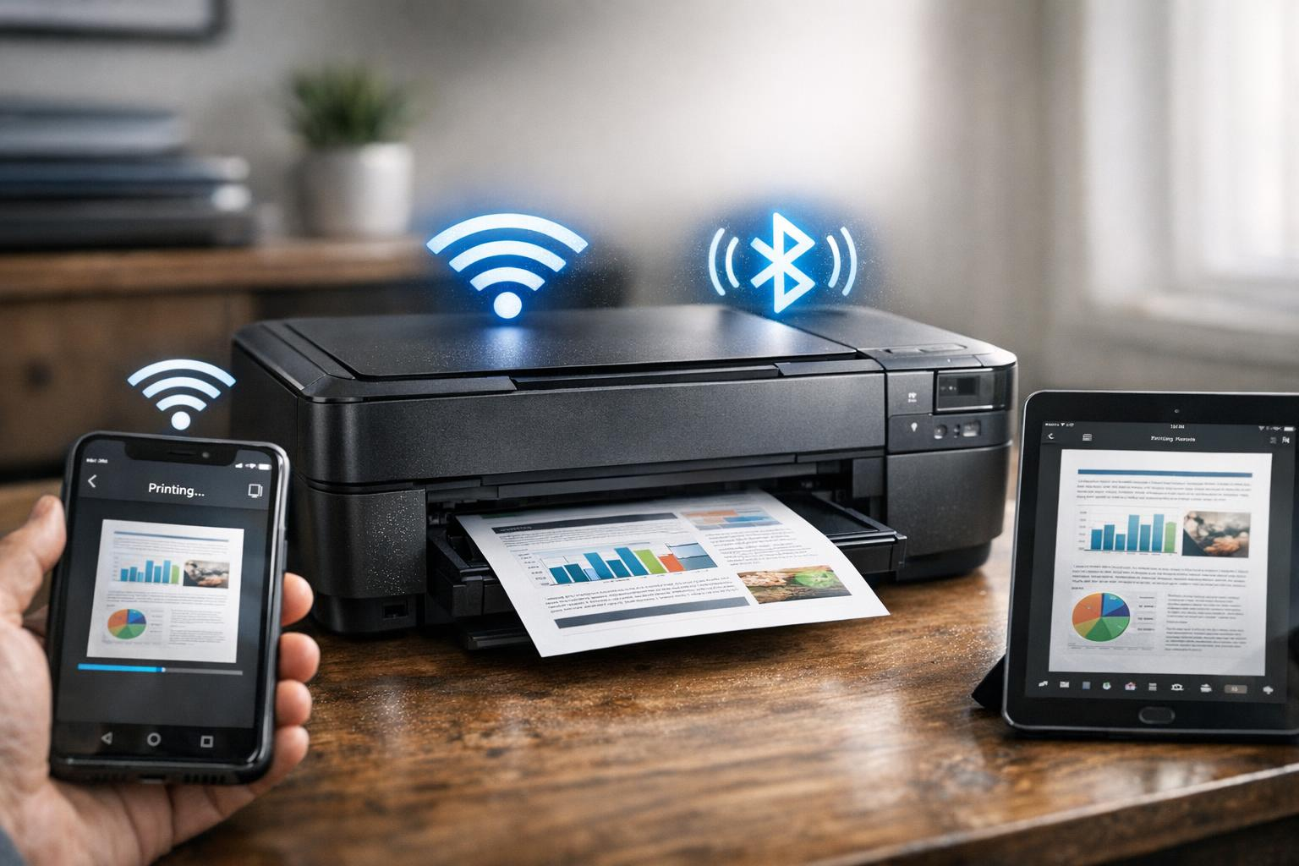
Wireless Printing Technologies (Wi-Fi, Bluetooth, AirPrint, Etc.)
Wi-Fi Printing
  Wi-Fi printing enables network-wide access, allowing multiple devices to print without cables from anywhere within range.
Bluetooth Printing
  Bluetooth offers quick pairing for direct printing from smartphones and tablets without requiring a network connection.
Proprietary Protocols
  Protocols like AirPrint provide seamless integration with iOS devices for easy and hassle-free wireless printing.
Notes:
---
Wireless printing technologies have greatly enhanced user convenience by enabling direct printing from smartphones and tablets without cables. Wi-Fi printing supports network-wide access, Bluetooth offers quick pairing, and proprietary protocols like Apple’s AirPrint facilitate seamless iOS integration. These technologies collectively reduce setup complexity and expand printing accessibility.
Image source: AI-generated

Slide 23
Mobile and Tablet Printing Apps and Integration
User-Friendly Mobile Apps
  Printing apps offer intuitive interfaces optimized for mobile devices enabling easy print job management.
Cloud Storage Access
  Apps integrate cloud storage services allowing users to print files directly from cloud platforms.
Platform Integration
  Integration with print platforms and ecosystems improves compatibility and enhances print functionalities.
Notes:
---
Mobile printing apps by printer manufacturers and third parties provide user-friendly interfaces, cloud storage access, and advanced print settings optimized for mobile devices. Integration with platforms like Google Cloud Print (now deprecated) and proprietary ecosystems accelerates adoption, while updates and features continue to improve functionality and compatibility.
Image source: AI-generated

Slide 24
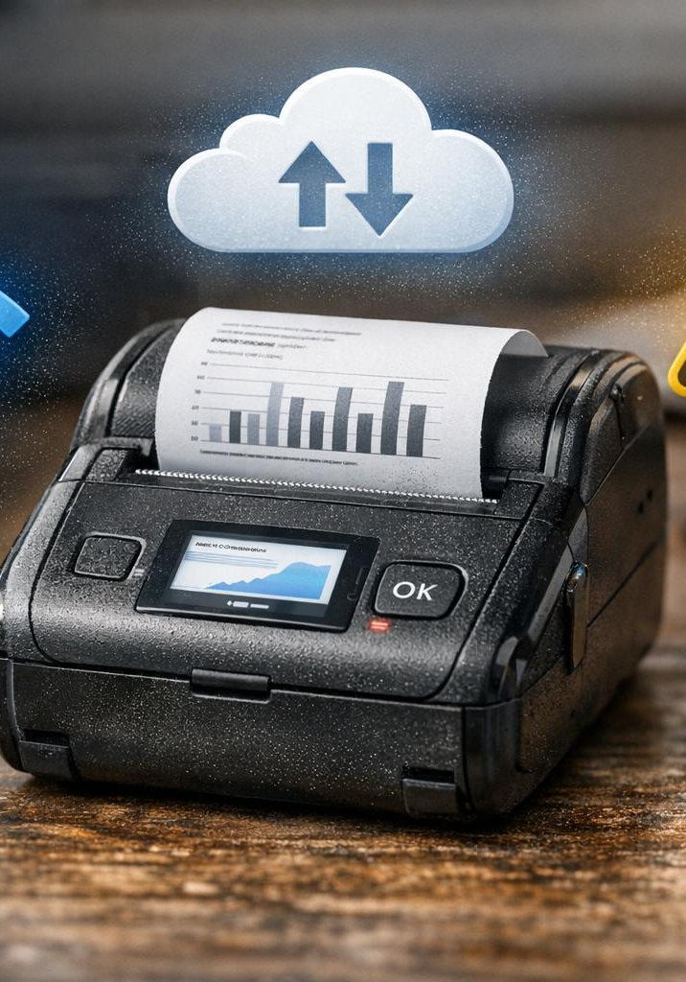
Common Challenges and Solutions for Mobile Printing
Device Compatibility Issues
  Mobile printing faces device compatibility challenges that affect seamless printing across diverse platforms and OS.
Network Connection Problems
  Network issues such as weak Wi-Fi or connection drops can disrupt mobile printing processes.
Use of Standard Protocols
  Adopting standard protocols and updating firmware help improve compatibility and reliability of mobile printing.
Cloud-Based Printing Solutions
  Cloud printing services enhance accessibility and allow printing from various devices remotely.
Notes:
---
Challenges with mobile printing include device compatibility issues, network connection problems, driver availability, and formatting errors. Solutions involve adopting standard protocols, updating firmware, using cloud-based printing services, and ensuring app compatibility. User education and troubleshooting support have also improved significantly to address common pain points.
Image source: AI-generated

Slide 25
Understanding Printer Software Bloat
Notes:
What Is Printer Software Bloat?, Effects of Unnecessary Software on Performance and Security, Best Practices for Installing and Managing Printer Drivers

Slide 26
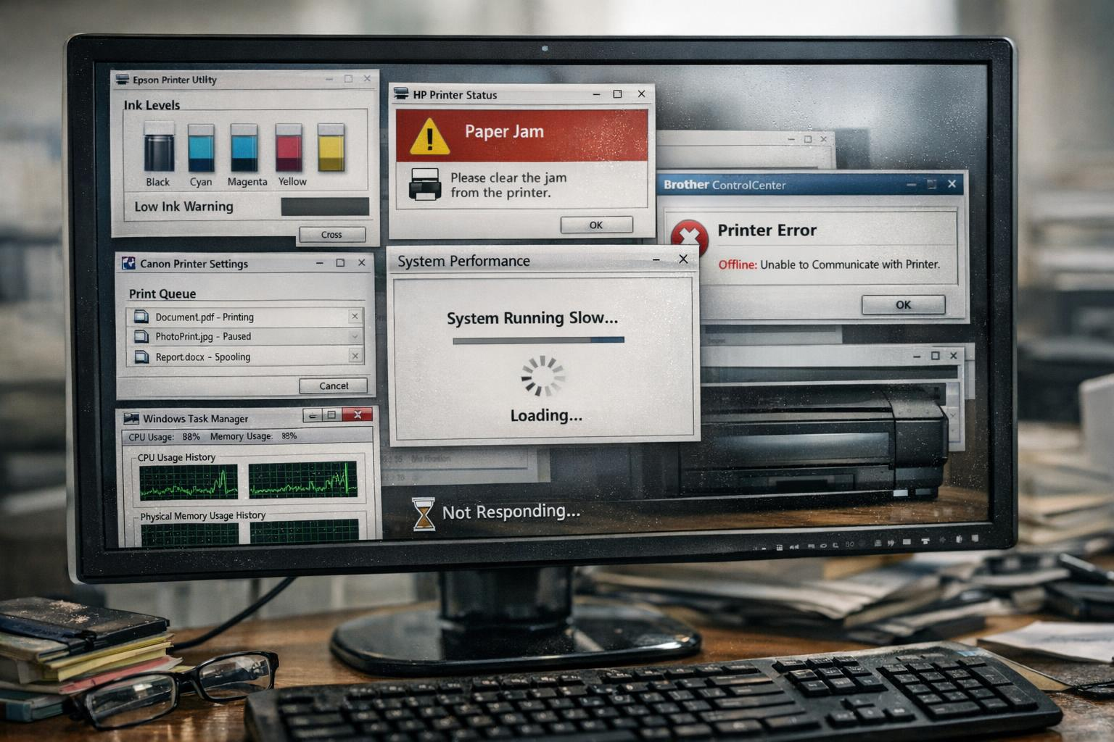
What Is Printer Software Bloat?
Definition of Software Bloat
  Printer software bloat includes excess bundled apps, drivers, and utilities beyond core printing needs.
Impact on System Performance
  Excess software consumes system resources, slows down computer performance, and complicates installation.
Security Risks
  Unnecessary bundled software increases potential security vulnerabilities and attack surfaces on computers.
User Experience Issues
  Users often receive more software than needed, leading to confusion and software conflicts.
Notes:
---
Printer software bloat refers to excessive or unnecessary bundled applications, drivers, and utilities that come with printers, often consuming system resources and complicating installation. This bloat can slow down computers, cause conflicts, and increase the attack surface for security vulnerabilities. Users often receive more software than needed for core printing functions.
Image source: AI-generated
Very often the Windows Driver will be all that you need. Try that first.

Slide 27

Effects of Unnecessary Software on Performance and Security
System Performance Degradation
  Excess software slows system responsiveness and increases boot times, negatively impacting user experience.
Driver Conflicts
  Multiple software installations can cause driver conflicts that disrupt hardware functionality and stability.
Security Vulnerabilities
  Unused or outdated software may contain vulnerabilities that cyber attackers exploit to compromise system security.
User Awareness Importance
  Many users are unaware of risks posed by unnecessary software, highlighting need for streamlined installations.
Notes:
---
Excess software can degrade system responsiveness, lead to slower boot times, and cause driver conflicts. From a security standpoint, unused or outdated printer software may harbor vulnerabilities that malicious actors can exploit. Reports indicate that many users remain unaware of these risks, underlining the importance of streamlined software installations.
Image source: AI-generated

Slide 28
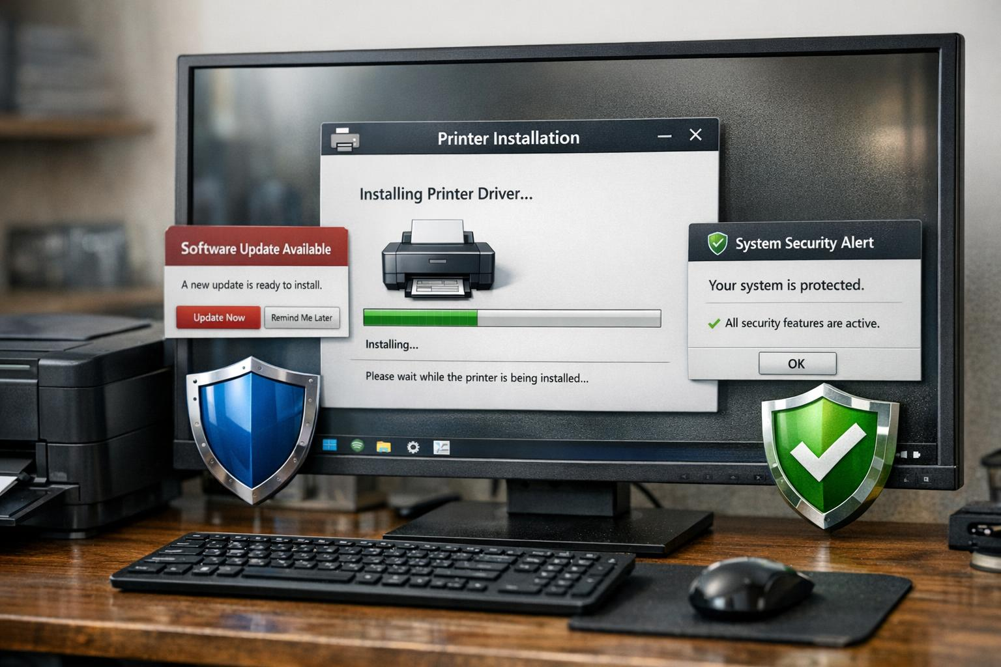
Best Practices for Installing and Managing Printer Drivers
Install Official Drivers Only
  Install printer drivers only from official manufacturer websites to avoid unwanted software and toolbars.
Keep Drivers Updated
  Regularly update printer drivers to enhance performance and maintain compatibility with operating systems.
Use Universal Print Drivers
  Utilize universal print drivers when possible to reduce complexity and simplify management of multiple printers.
Enhance Security with Minimal Installation
  Minimize driver installation to limit security exposure and configure printers with native OS drivers for basic needs.
Notes:
---
Experts recommend installing only necessary drivers from manufacturer websites, avoiding bundled toolbars or third-party software. Regular updates and using universal print drivers where available reduces complexity. For security, minimal installations limit exposure, and configuring printers with native OS drivers often suffices for basic functionality.
Image source: AI-generated

Slide 29
New Trends and Innovations in Domestic Printing
Notes:
Eco-Friendly and Low-Cost Printer Models, Smart Printers and Voice Assistant Integration, Advancements in Printing Speed, Quality, and Materials

Slide 30
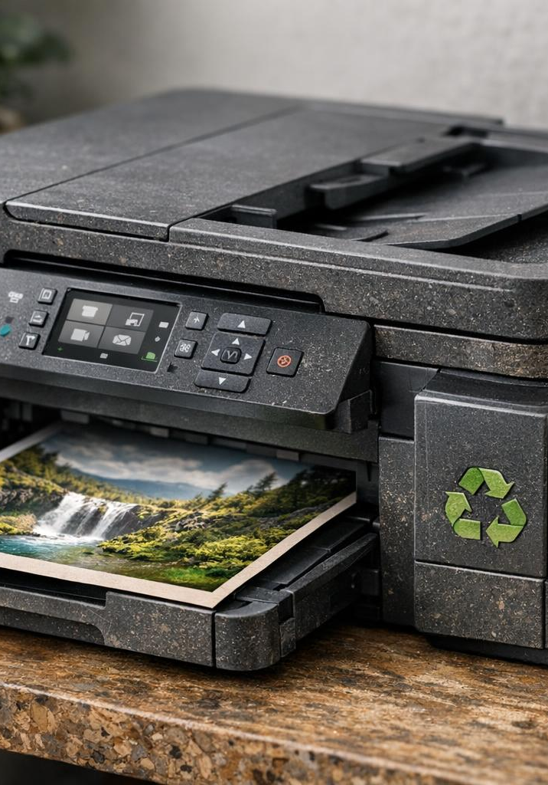
Eco-Friendly and Low-Cost Printer Models
Energy Efficiency
  These printers consume less power, conserving energy to minimize environmental impact and reduce electricity costs.
Reduced Waste Cartridges
  Printers use refillable ink tanks and reduce disposable cartridges to cut down on plastic waste.
Sustainable Materials
  Incorporating recycled and biodegradable materials lowers the ecological footprint of printer manufacturing.
Cost Savings
  Long-lasting ink supplies and efficient designs help consumers save money over time.
Notes:
---
Consumer demand for sustainable products has driven manufacturers to develop energy-efficient printers with reduced waste cartridges and use of recycled materials. Models now focus on low power consumption, refillable ink tanks, and biodegradable components. These printers help reduce environmental impact while offering cost savings through longer-lasting ink supplies.
Image source: AI-generated

Slide 31
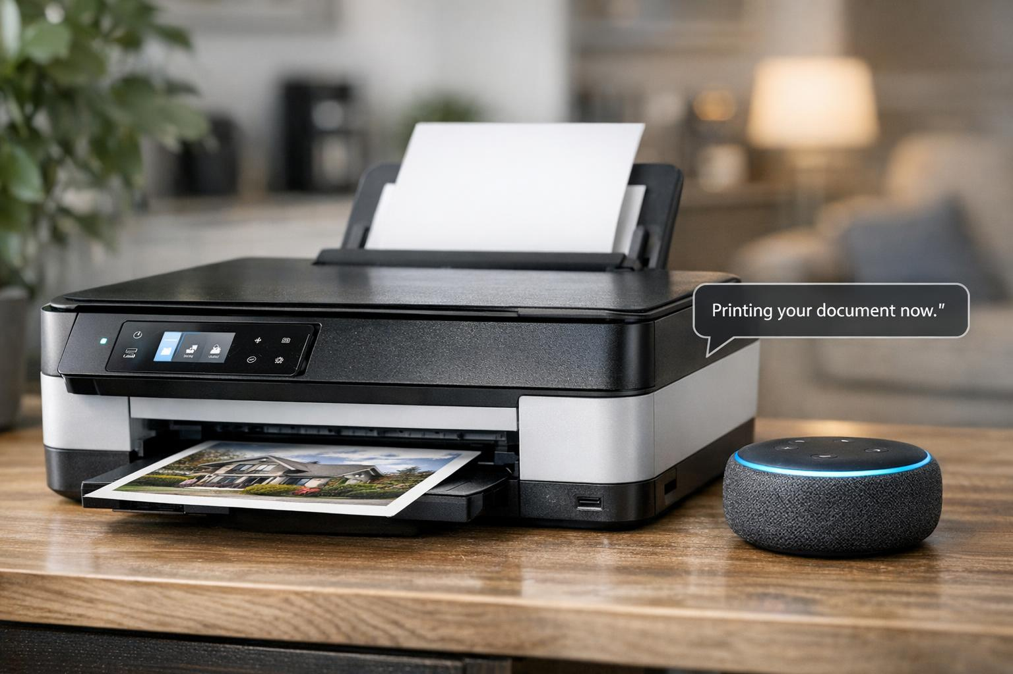
Smart Printers and Voice Assistant Integration
Wireless Connectivity
  Smart printers use Wi-Fi and Bluetooth to enable seamless wireless communication and cloud access.
Voice Assistant Control
  Integration with voice assistants allows hands-free commands for printing and device management.
Enhanced User Convenience
  Users can check ink levels and troubleshoot using voice commands, improving smart home integration.
Notes:
---
The rise of smart printers integrates Wi-Fi, Bluetooth, and cloud access to connect with voice assistants like Amazon Alexa and Google Assistant. Users can command printing, check ink levels, and troubleshoot hands-free. These features enhance convenience and fit well into smart home ecosystems, reflecting a key growth area in printer technology.
Image source: AI-generated

Slide 32
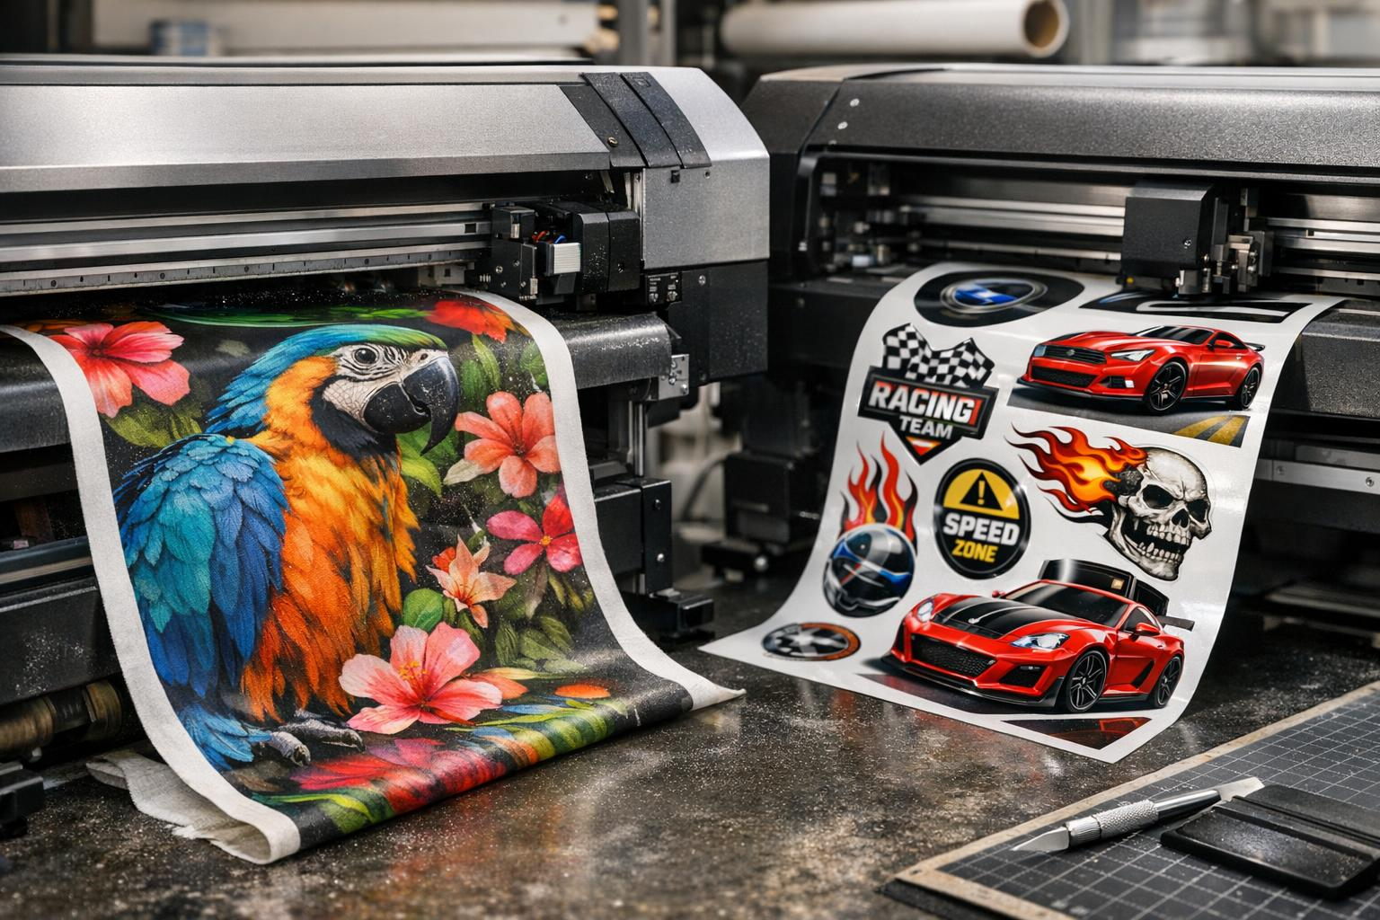
Advancements in Printing Speed, Quality, and Materials
Faster Printing Processors
  Modern printers feature faster processors that significantly decrease print times for efficient output.
Enhanced Print Quality
  Higher DPI resolutions enable photo-realistic prints with improved colour vibrancy and sharpness.
Diverse Printing Materials
  New ink formulations and expanded material compatibility support fabrics, decals, and flexible media printing.
Notes:
---
Technological advances include faster processors in printers, higher DPI resolutions for photo-realistic prints, and new ink formulations that improve color vibrancy and durability. Materials for specialty printing such as fabrics, decals, and flexible media have expanded, supported by evolving hardware capabilities. These improvements cater to creative users and small businesses.
Image source: AI-generated

Slide 33
Exploring 3D Printers for Home Use
Notes:
Pricing and Accessibility of 3D Printers, Types of Plastics and Materials for Home 3D Printing, Popular 3D Design Software and Commonly Printed Objects

Slide 34
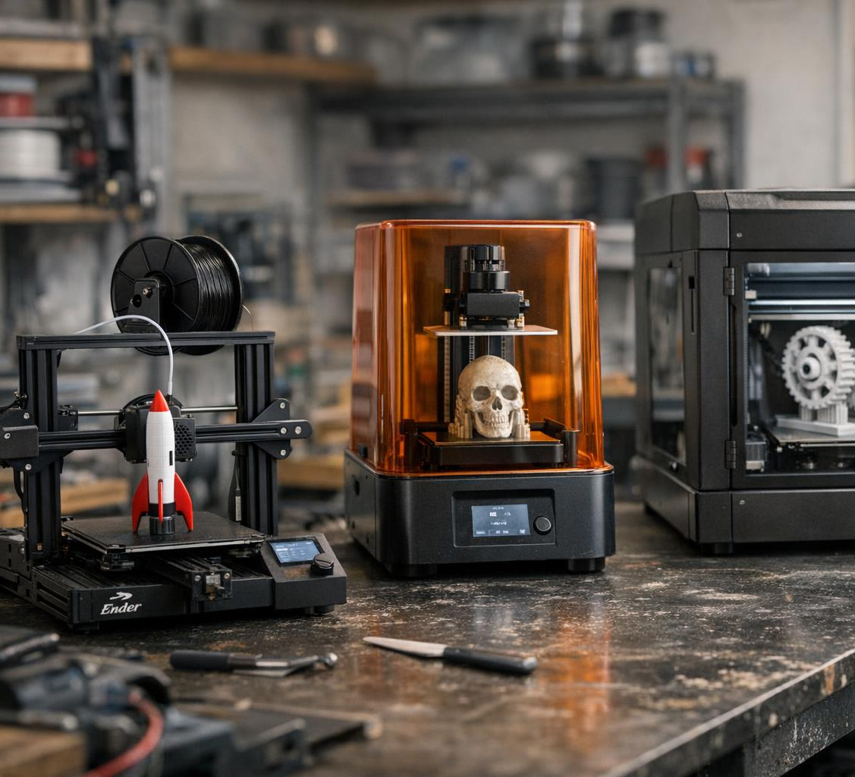
Pricing and Accessibility of 3D Printers
Affordable Entry-Level Printers
  Entry-level 3D printers cost between £170 - £400, making them accessible to beginners and hobbyists.
Keen Hobbyist Models
  Mid-range printers priced between £400 - £800 offer better precision and larger build volumes.
  Professional Hobbyist
  £1,000 - £2,500
Growth of Maker Culture
  Rising DIY and maker culture awareness has increased accessibility and adoption of 3D printing technology.
Notes:
---
The cost of home 3D printers has decreased significantly over the past decade, with entry-level models available for under $300. Mid-range printers offer better precision and larger build volumes for $1,000 to $2,000. This price drop combined with increased DIY and maker culture awareness has made 3D printing more accessible to hobbyists and educators.
Image source: AI-generated

Slide 35
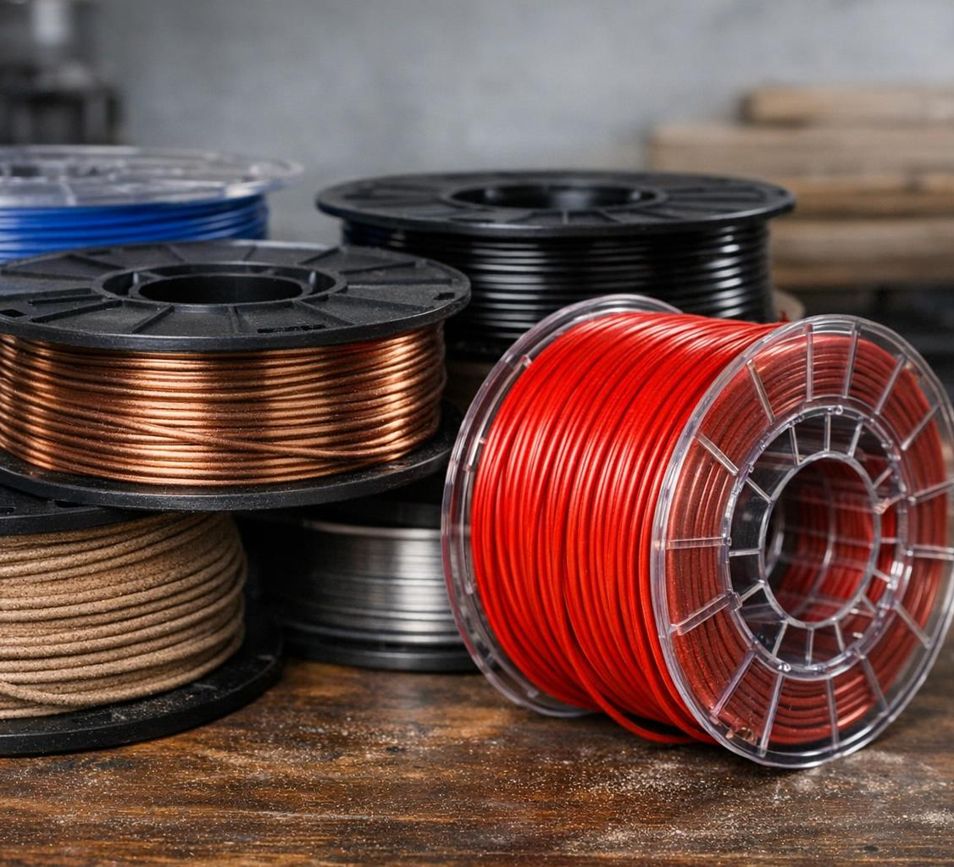
Types of Plastics and Materials for Home 3D Printing
Common Filament Types
  PLA is biodegradable and user-friendly, ABS offers durability and heat resistance, while PETG balances strength with flexibility.
Specialty Filaments
  Wood, metal infused, and flexible TPU filaments provide unique textures and creative printing options for home use.
Material Impact on Printing
  Choosing the right filament affects print durability, surface finish, and maintenance needs of the 3D printer.
Notes:
---
Common home 3D printer materials include PLA (biodegradable and easy to print), ABS (durable, heat-resistant), and PETG (combination of strength and flexibility). Specialty filaments like wood, metal infused, and flexible TPU offer expanded creative possibilities. Material choice impacts print durability, finish, and printer maintenance requirements.
Filament cost: PLA £9 - £20 per kilo
PETG £12 - £25 per kilo
Speciality £25 - £80 per kilo
Running costs – electricity about 20p per hour
Image source: AI-generated

Slide 36
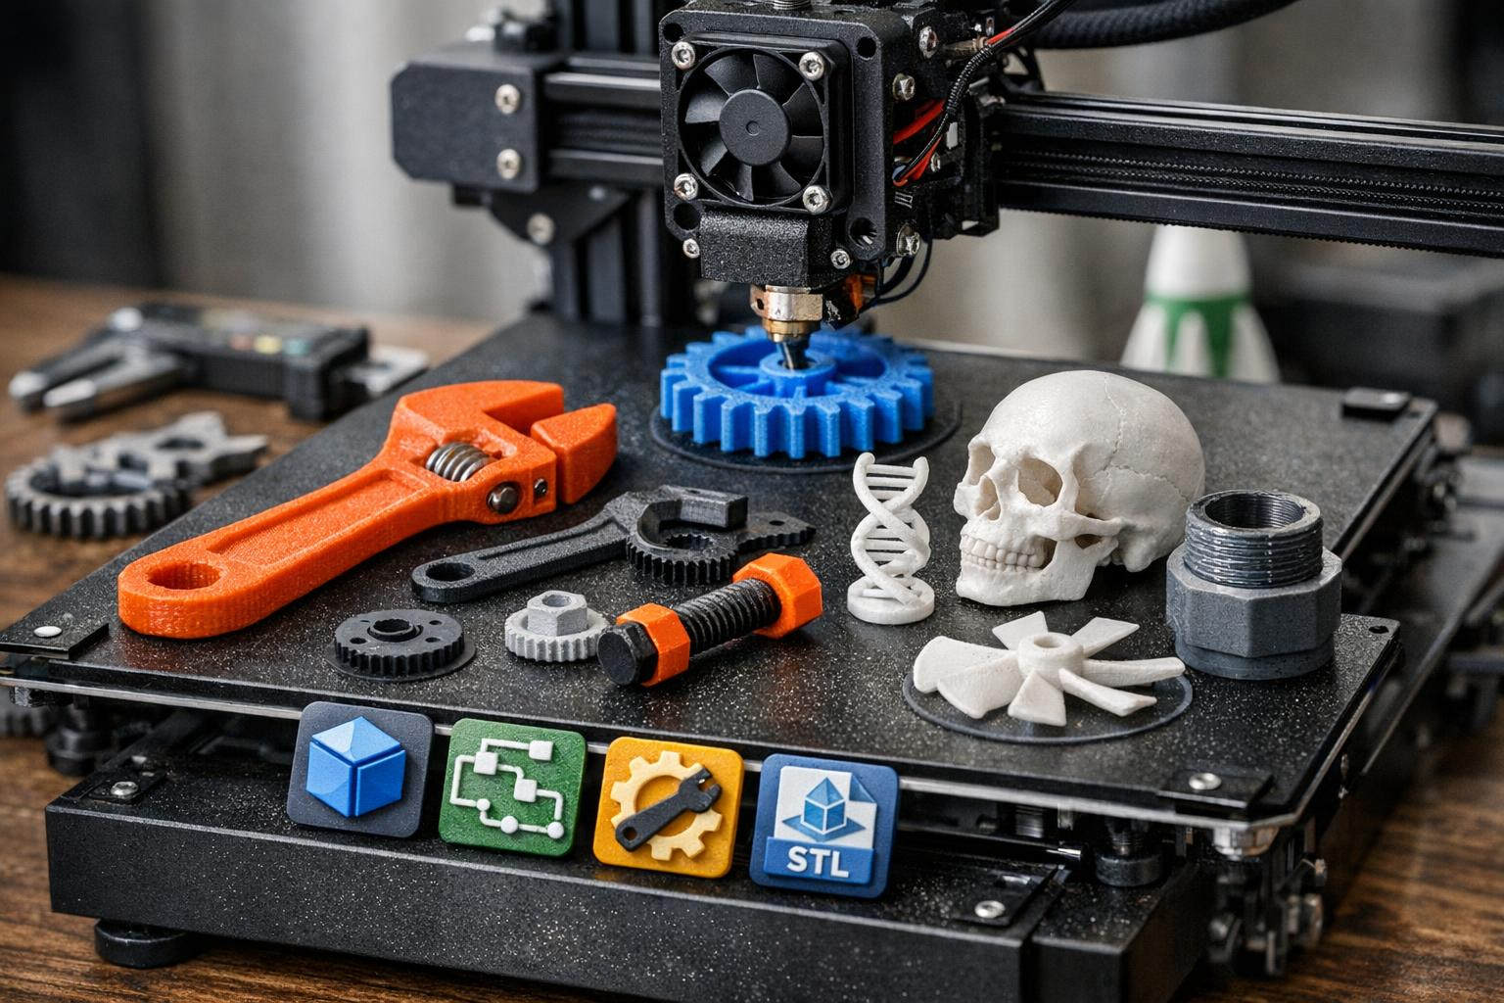
Popular 3D Design Software and Commonly Printed Objects
User-Friendly 3D Software
  Free and professional 3D design software options empower users of all skill levels to create designs.
Common Printed Objects
  Household tools, replacement parts, educational models, and miniatures are typical objects printed at home.
Online Design Repositories
  Online platforms offer extensive libraries of pre-made 3D designs, making printing accessible for beginners.
Tinkercad
Thingiverse
Notes:
---
User-friendly 3D design software ranges from free options like Tinkercad (runs in a browser) and Ultimaker Cura to professional solutions like Fusion 360. Common home-printed objects include household tools, replacement parts, educational models, and miniatures. Online repositories such as Thingiverse provide vast libraries of pre-made designs, lowering barriers for beginners.
3D Design - Tinkercad
Then you need some slicing software to convert the design into printer instructions: eg PrusaSlicer
“What software do you need to design 3D prints?”
• Beginner: Tinkercad, Microsoft 3D Builder
• Intermediate: Fusion 360, Onshape, SketchUp
• Advanced: Blender, FreeCAD, SolidWorks
• Plus a slicer: Cura, PrusaSlicer, Bambu Studio
Check out thingiverse.com for lots of free designs
Image source: AI-generated

Slide 37
Conclusion: Embracing the Evolution and Innovation in Domestic Printing
History of Domestic Printing
From early dot matrix printers to modern 3D printing, domestic printers have evolved significantly over time.
Modern Printing Trends
Mobile printing and software advancements enhance user convenience and connectivity in home printing setups.
Eco-friendly Innovations
Sustainable printing solutions focus on reducing waste and energy consumption to protect the environment.
Better quality inks
Notes:
This presentation highlighted the rich history and diverse types of domestic printers, from early dot matrix models to advanced 3D printing technology. We explored modern trends such as mobile printing connectivity, software considerations, and eco-friendly innovations. As printing technology continues to evolve, it offers exciting possibilities for home users to enhance convenience, efficiency, and creativity.

