Slide 1
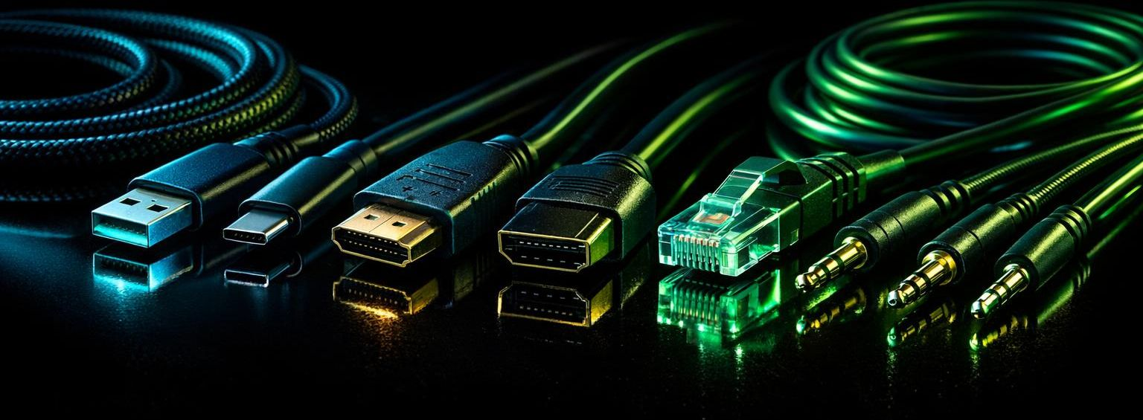
THE COMPLETE GUIDE TO
Technical Cables
Computer Club | 2026
From SCART to USB4: Everything you need to know

Slide 2
What We Will Cover
01
A Nod to the Past
SCART, Parallel, Serial & PS/2
02
The USB Revolution
Standards from 1.0 to USB4
03
Colour Codes & Connectors
Why ports have different colours
04
Backward Compatibility
Can USB 1 cables work on USB4?
05
Video Cables
HDMI & DisplayPort explained
06
Audio Cables
3.5mm, Optical & XLR
07
Bandwidth Explained
What it means in plain English
08
Charging Speed Mystery
Why some cables charge faster
09
Gold Plated Contacts
Worth the money or marketing hype?
10
Myths Busted
Common cable misconceptions
2 / 24

Slide 3
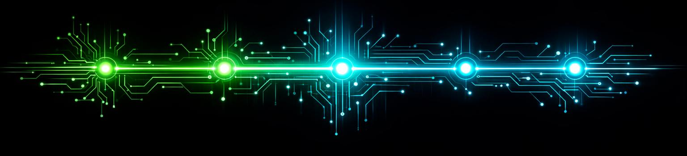
The Evolution of Cables
1970s
1977
1987
1996
2003
2006
2012
2014
2019
Serial & Parallel Ports
SCART Standard
PS/2 Ports
USB 1.0
HDMI 1.0
DisplayPort 1.0
Lightning
USB-C
USB4
3 / 24
Notes:
1970’s With the IBM Computer
1987 PS 2. Fun fact: PS/2 stands for "Personal System/2" — IBM's 1987 PC line
1996 USB Universal Serial Bus
2003 HDMI High-Definition Multimedia Interface. The "Multimedia" part is key — it carries both video and audio over a single cable, which was a big deal when it launched in 2003 replacing the mess of separate audio and video cables people had before.
2012. Apple Lightning. “Lightning” was chosen to emphasise the connector’s speed and versatility, positioning it as a fast, modern, and user‑friendly upgrade.
Apple didn’t originally own the trademark. They acquired the “Lightning” name from Harley‑Davidson in 2012, receiving a partial transfer of the trademark so both companies could continue using it in their respective domains.

Slide 4
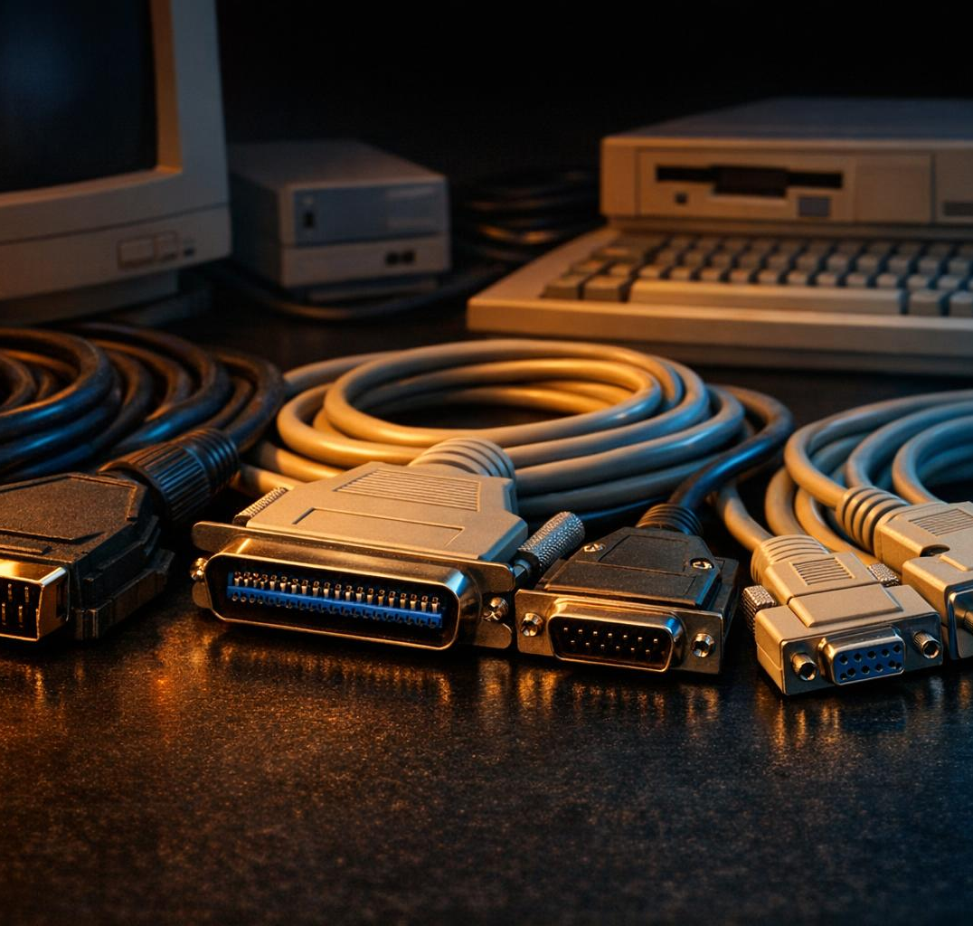
A Nod to the Past: SCART
SCART (Syndicat des Constructeurs d'Appareils Radiorécepteurs et Téléviseurs)
Introduced in France in 1977
21-pin connector carrying audio AND video
Supported Composite, RGB, and S-Video
Dominated European AV equipment for 30+ years
The massive connector that everyone loved to hate
Eventually superseded by HDMI in the 2000s
4 / 24

Slide 5
A Nod to the Past: Parallel & Serial
Parallel Port (DB-25)
Serial Port (RS-232)
Sent multiple bits simultaneously
Speed: up to 150 KB/s
Primarily used for printers
25-pin connector (bulky!)
Also used for scanners & file transfers
Sent data one bit at a time
Speed: 110 to 115,200 bps
Used DB-25 or DE-9 connectors
Connected mice, modems, printers
Essential for dial-up internet
Still used in industrial equipment today!
5 / 24
Notes:
DB-25 and DE-9 refer to the physical connector shape and pin count. The "D" comes from the D-shaped metal shield around the pins (it literally looks like a letter D on its side). The number is how many pins it has.
Parallel ports always used a DB-25 (female on the PC)
Serial ports started with DB-25 but later switched to the smaller DE-9 (9-pin) connector to save space — that's the one most people remember from the back of 90s PCs
So the same physical connector type was used for two completely different purposes, which was part of the chaos that USB was designed to fix!
VGA Cables you would have used on your old monitors were DE-15. Three rows of 5 pins. Analogue video only no audio. (You always needed a separate audio lead as well)

Slide 6
Remember PS/2?
IBM introduced PS/2 ports in 1987 as the standard for keyboards and mice.
Green Port = Mouse
Mini-DIN-6 connector
No hot-swapping allowed!
Could damage hardware if plugged in while powered on
Purple Port = Keyboard
Same Mini-DIN-6 connector
Reduced clutter vs older DIN
Still found on gaming keyboards for lower latency
PS/2 stands for "Personal System/2" — IBM's 1987 PC line
6 / 24

Slide 7
Enter USB: The Universal Standard
Universal Serial Bus — designed in 1996 to replace the chaos of serial, parallel, PS/2, and proprietary connectors with one universal standard.
1994
1996
30+
1
Development began
USB 1.0 released
Years of evolution
Cable to rule them all
Compaq, DEC, IBM, Intel,
Microsoft, NEC & Nortel
12 Mbps full speed
1.5 Mbps low speed
From 12 Mbps to
80 Gbps (USB4 v2)
USB-C is becoming
the universal connector
7 / 24

Slide 8
USB 1.0, 1.1 & 2.0
USB 1.0 (1996)
USB 1.1 (1998)
USB 2.0 (2000)
12 Mbps full speed
1.5 Mbps low speed
First USB standard ever
Limited device support
Type-A and Type-B only
Not widely adopted
Same speeds as 1.0
Bug fixes & improvements
Apple iMac G3 was key
Mass adoption began
Killed legacy ports on Mac
The real USB launch
480 Mbps — 40x faster!
"Hi-Speed USB" branding
Backward compatible
Became the universal standard
Dominated for over a decade
Still used for keyboards/mice
8 / 24

Slide 9
USB 3.0, 3.1 & 3.2
The naming got confusing — USB-IF kept rebranding older standards under new names!
Original Name | Later Renamed To | Speed | Marketing Name
USB 3.0 | USB 3.1 Gen 1 → USB 3.2 Gen 1 | 5 Gbps | SuperSpeed USB
USB 3.1 | USB 3.1 Gen 2 → USB 3.2 Gen 2 | 10 Gbps | SuperSpeed USB 10Gbps
USB 3.2 | USB 3.2 Gen 2x2 | 20 Gbps | SuperSpeed USB 20Gbps
The key takeaway: USB 3.0 was renamed TWICE! Always check the actual speed, not the version number.
9 / 24
Notes:
USB‑IF = USB Implementers Forum — the non‑profit organisation that sets the rules, tests the cables, and keeps the whole USB ecosystem behaving itself.

Slide 10
USB 4: The Future Is Here
40
80
Gbps
Gbps
USB4 Version 1.0 (2019)
USB4 Version 2.0 (2022)
Based on Thunderbolt 3 protocol
Doubles bandwidth with new signaling
USB-C connector only — no more Type-A or Type-B
Tunnels PCIe and DisplayPort protocols
Up to 240W power delivery (can charge laptops!)
Backward compatible with all previous USB versions
10 / 24
Notes:
PCIe stands for Peripheral Component Interconnect Express.
PCIe replaced older standards such as PCI, PCI‑X and AGP.
It uses high‑speed serial, point‑to‑point links, not a shared parallel bus.
Each connection is made of lanes (x1, x4, x8, x16), each lane being a pair of differential signals. More lanes = more bandwidth.
It’s used for graphics cards, SSDs (NVMe), network cards, and many other peripherals.
Tunnelling: Wrapping another protocol (like PCIe or DisplayPort) inside USB 4 so it can travel across a USB‑C cable as if it were native. USB 4 doesn’t convert PCIe or DisplayPort into USB — it carries them.
Thunderbolt
Who Developed It
Thunderbolt was originally co-developed by Intel and Apple, first appearing in MacBooks in 2011. Intel has since opened the specification, and it's now widely adopted beyond Apple.
What Uses It
Laptops and desktops — Most premium laptops (MacBooks, Dell XPS, Lenovo ThinkPads, etc.) include Thunderbolt ports. Many desktop motherboards now have them too.
External GPUs (eGPUs) — Thunderbolt's high bandwidth makes it one of the few viable connections for external graphics cards.
High-speed storage — Thunderbolt docks and NVMe enclosures can hit speeds far beyond standard USB, critical for video editors and creative pros.
Docking stations — A single Thunderbolt cable can carry power, display output, data, and networking to a dock, replacing a tangle of cables.
Pro displays — Studio monitors like the Apple Pro Display XDR and LG UltraFine connect via Thunderbolt for video + power over one cable.
Audio/video production gear — Pro audio interfaces and video capture devices use Thunderbolt for its low latency and high throughput.
Key Versions
Thunderbolt 3 — 40 Gbps, USB-C connector (this is what USB4 is based on, as your slide 10 notes)
Thunderbolt 4 — Same 40 Gbps but with stricter minimum requirements (e.g., must support two 4K displays)
Thunderbolt 5 — Up to 80 Gbps (120 Gbps asymmetric), announced 2023, rolling out in newer hardware
The short version: Thunderbolt is the go-to for anyone who needs maximum bandwidth and a single-cable workflow — mostly creative professionals, power users, and enterprise docking setups.

Slide 11
PAM3: How USB4.2 Doubles Speed
3-level Pulse Amplitude Modulation — the sweet spot between NRZ and PAM4
NRZ (PAM2)
USB4 Gen 2/3
PAM3
USB4 v2.0 Gen 4
PAM4
Used in PCIe 6.0
High (+V)
+1 (+250mV)
11 (+3V)
Eye Height: 50% Swing
Eye Height: 33% Swing
Eye Height: 25% Swing
10 (+1V)
0 (0V)
01 (-1V)
Low (-V)
-1 (-250mV)
00 (-3V)
2 signal levels
1 bit per symbol
40 GBaud needed for 40 Gbps
Insertion loss: 49 dB
Too much loss for USB-C cables
3 signal levels
1.57 bits per symbol (11b/7t)
25.6 GBaud for 40 Gbps/lane
Insertion loss: 28 dB
Works with existing USB-C cables
4 signal levels
2 bits per symbol
20 GBaud for 40 Gbps
Insertion loss: 23 dB
Eye too small for 10⁻⁸ BER
11b/7t Encoding Pipeline
11 binary bits → 7 ternary trits (3 voltage levels)
Symbol rate: 25.6 GBaud → 40 Gbps per lane
FEC: Reed-Solomon corrects 12 errors/block
Precoding: Prevents DFE error bursts
Result: BER of 10⁻¹⁹ (vs 10⁻¹² for USB4 Gen3)
Why PAM3 Won
Lower baud rate than NRZ
→ Fits existing USB-C cables
Larger eye opening than PAM4
→ Meets uncoded BER target
2/3 the bandwidth of NRZ
→ Less channel attenuation
11 / 25
Notes:
When a digital signal travels through a cable, the receiver at the other end has to figure out which voltage level was sent. If you overlay thousands of signal transitions on top of each other (like an oscilloscope does), the open spaces between the voltage levels form a diamond or eye-shaped pattern — that's called an eye diagram.
The eye height is the vertical opening of that "eye." It represents how much room the receiver has to correctly distinguish between voltage levels:
Bigger eye = more margin for the receiver to tell levels apart = fewer errors
Smaller eye = levels are closer together = more susceptible to noise and interference
PAM3 has 3 levels, giving a 33% eye — smaller than NRZ but still large enough to hit the error rate target of 10⁻⁸ without heavy error correction
Forward Error Correction. Referenced alongside Reed-Solomon coding, which is a specific FEC technique that corrects up to 12 errors per block in the encoding pipeline.
In general, FEC is a method where redundant data is added to a transmission so the receiver can detect and fix errors without needing retransmission — critical for high-speed signaling like the 25.6 GBaud link described for PAM3.
🔢 NRZ = Non‑Return‑to‑Zero
NRZ is a simple, two‑level signalling method used in older and slower digital interfaces — including earlier USB versions.
It works like this:
Two voltage levels → represent 1 and 0
The signal does not return to zero between bits (hence the name)
One symbol = one bit
Very reliable, very simple, but limited in speed
So:
NRZ = 1 bit per symbol, two voltage levels.
That’s why USB 3.x and USB 4.1 top out at lower speeds — NRZ can only go so fast before noise becomes a problem.
Signalling Voltage Levels Bits per Symbol Used In
NRZ 2 1.0 USB 3.x, USB 4.1
PAM3 3 1.5 USB 4.2
PAM4 4 2.0 Thunderbolt 5, high‑speed Ethernet
Baud Rate
Baud rate = symbols per second.
A symbol is the electrical state sent down the wire. Depending on the signalling method, a symbol may represent:
1 bit (NRZ)
1.5 bits (PAM3)
2 bits (PAM4)

Slide 12
USB Speed: Then vs Now
Gigabytes
11 / 24

Slide 13
Why Are USB Ports Colour Coded?
USB-IF introduced colour coding to help identify port capabilities at a glance:
White
USB 1.x
12 Mbps
Black
USB 2.0
480 Mbps
Blue
USB 3.0
5 Gbps
Teal
USB 3.1
10 Gbps
Red
Always-On / Charging
Varies
Yellow
Always-On / Sleep Charge
Varies
Note: Colour coding is a guideline, not a strict standard. Some manufacturers don't follow it.
12 / 24
Notes:
Red and Yellow are all about POWER, not speed
A red USB port means:
The port can supply power even when the laptop/PC is turned off
It’s designed for charging phones, tablets, headphones, etc.
Data capability varies — the colour does not indicate USB speed
Often labelled as Sleep‑and‑Charge, Always‑On USB, or similar
Think of it as a dedicated charging‑friendly port.
A yellow USB port is similar but slightly different:
It provides power when the computer is in Sleep or Hibernate
Some models also provide power when fully shut down, but not all
Again, the colour does not indicate USB speed
Manufacturers use yellow to show “this port stays alive longer than the others”
So:
Red = always powered
Yellow = powered during sleep/standby (and sometimes off)

Slide 14
USB Connector Types
Type-A
The classic rectangular plug. Found on computers, chargers, and TVs. Keyed — only goes in one way.
Type-B
Square-ish connector for printers, scanners, and external drives. Less common today.
Mini-USB
Smaller version for early cameras and MP3 players. Largely obsolete now.
Micro-USB
Dominated phones for a decade. Still on budget devices. Fragile connector.
Type-C
The future. Reversible, supports USB4, Thunderbolt, DisplayPort, and up to 240W charging.
13 / 24

Slide 15
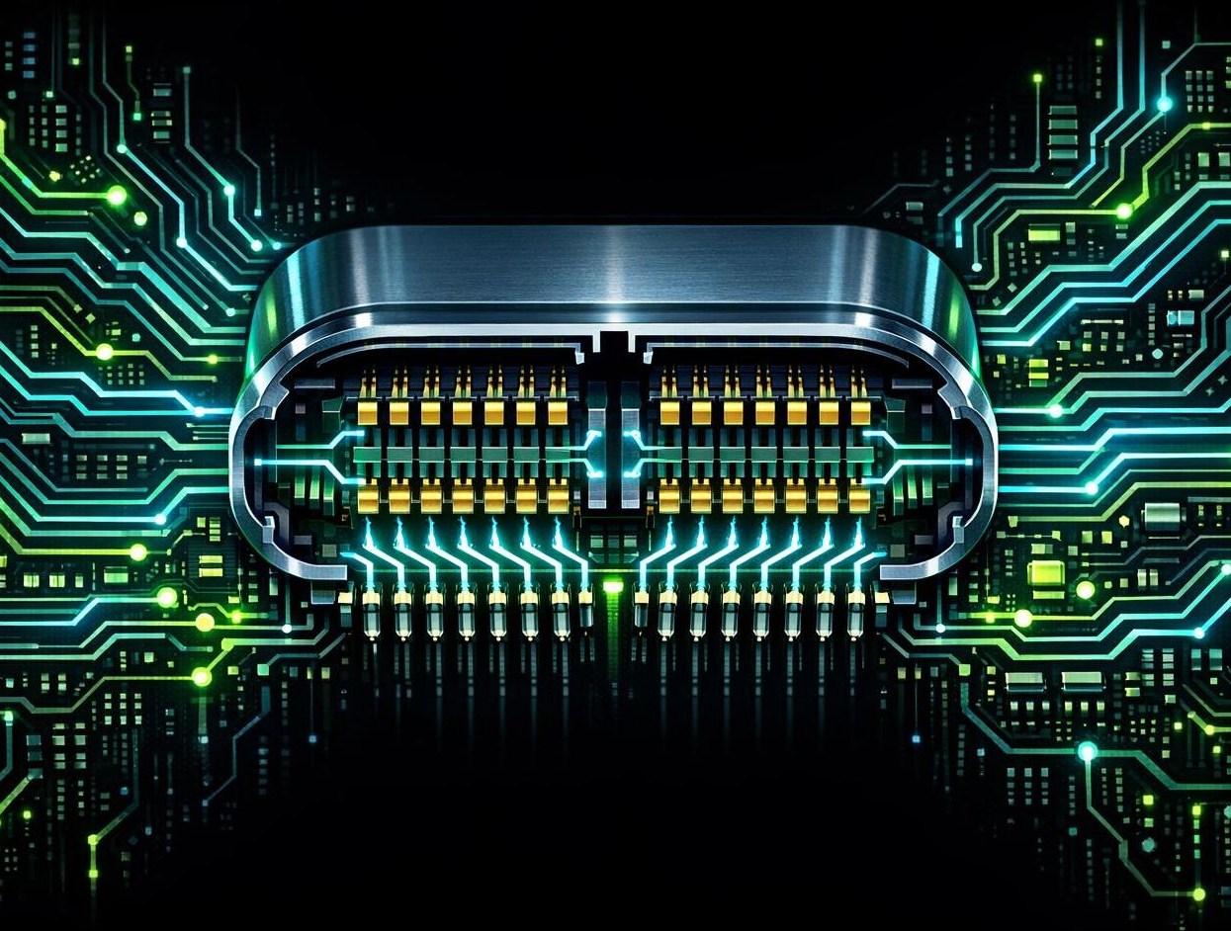
Why Is USB-A One Way
but USB-C Reversible?
USB Type-A
4 pins in a flat rectangular shape
Pins are on ONE side only
Plastic tab prevents wrong insertion
Designed in 1996 — simplicity was the goal
USB Type-C: 24 Symmetrical Pins
24 contact points arranged symmetrically — 12 on each side, mirrored
CC (Configuration Channel) pins detect which way the plug is inserted
The device internally routes signals based on orientation detection
USB 2.0 D+/D− pairs are tied together internally so they work either way
14 / 24
Notes:
A USB‑C connector has two mirrored rows of 12 pins. This is what makes it reversible. The functional groups are:
VBUS (Power): A4, A9, B4, B9 — +5 V to up to 20–48 V with USB‑PD
GND (Ground): A1, A12, B1, B12 — return path for power and signals
USB 2.0 Data: D+ (A6, B7) and D– (A7, B6) — legacy USB 2.0 signalling
SuperSpeed TX/RX pairs:
TX1+/– (A2, A3), TX2+/– (B11, B10)
RX1+/– (B2, B3), RX2+/– (A11, A10) These carry USB 3.x / USB4 high‑speed data.
CC1 / CC2 (Configuration Channel): A5, B5 — orientation detection, role negotiation, and PD communication
SBU1 / SBU2 (Sideband Use): A8, B8 — used for Alternate Modes such as DisplayPort or Thunderbolt
Pin functions (USB 1.x / 2.0)
Pin 1 — VBUS (+5 V): Red wire
Pin 2 — D–: White wire
Pin 3 — D+: Green wire
Pin 4 — GND: Black wire

Slide 16
Can I Use a USB 1 Cable
on a USB4 Device?
YES!
USB is backward compatible — older cables work on newer ports
But you will only get the speed of the SLOWEST link
A USB 2.0 cable on a USB4 port = USB 2.0 speeds (480 Mbps)
The physical connector also matters — you may need an adapter
USB4 requires a USB-C connector, so old Type-A cables need a dongle
Think of it like a motorway: even if the road allows 70 mph, your car might only do 30!
...but with caveats
Pro tip: Check the cable's USB logo — certified cables show their speed rating on the connector
15 / 24

Slide 17

What Is Bandwidth?
Think of bandwidth as the width of a pipe.
A wider pipe carries more water per second
Bandwidth = how much data can flow through a
cable per second
Measured in bits per second (Mbps or Gbps)
Why it matters:
Higher bandwidth = faster file transfers
Higher bandwidth = better video quality (4K, 8K)
Higher bandwidth = more devices on one connection
1 Gbps = 1,000 Mbps = transferring a full HD movie in ~30 seconds
16 / 24

Slide 18
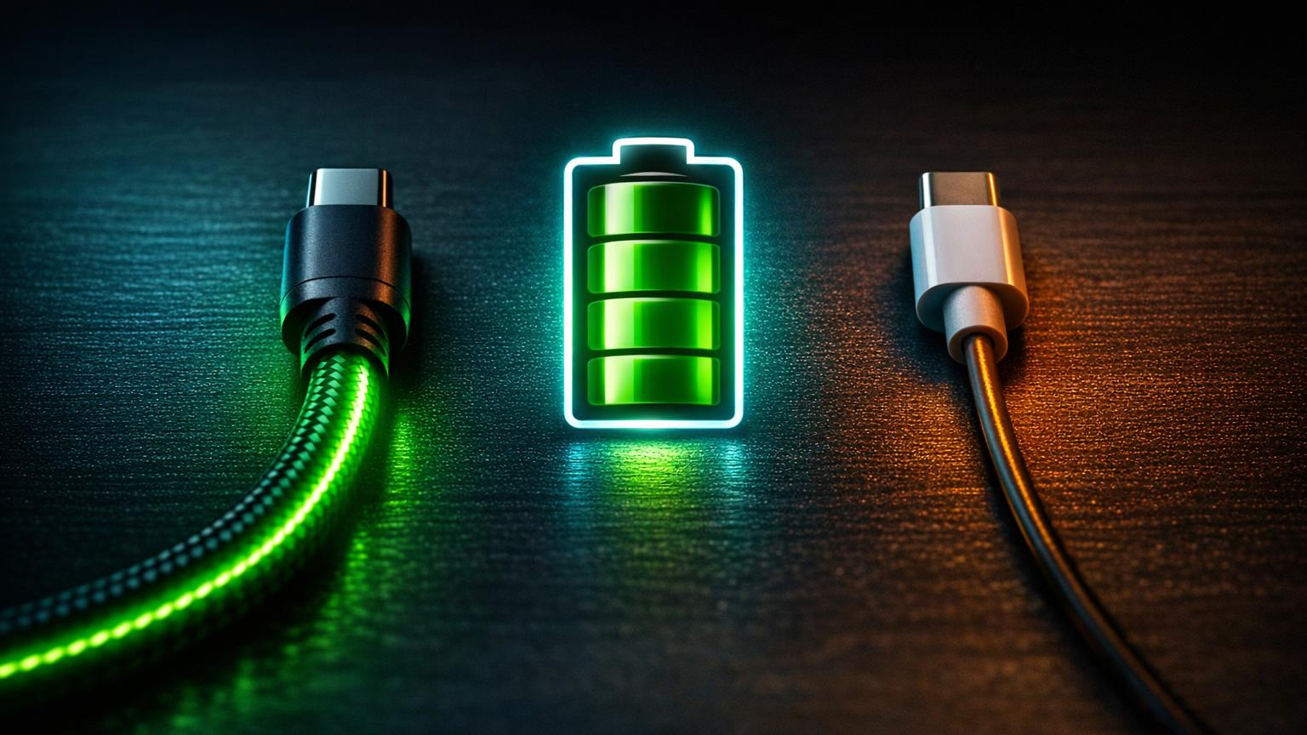
Why Does My Phone Charge
Faster With Some Cables?
Wire Gauge (AWG)
Cable Length
USB Power Delivery
Thicker wires = less resistance = more power
28 AWG (thin): slow charge
24 AWG: standard
20 AWG (thick): fast charge
Longer cable = more resistance = voltage drop
1m cable: minimal loss
2m cable: slight loss
3m+ cable: noticeable slowdown
Smart negotiation between device & charger
USB 2.0: 2.5W (5V, 0.5A)
USB BC 1.2: 7.5W
USB PD: up to 240W!
17 / 24
Notes:
By the way, AWG numbers run backwards —
20 AWG is thicker than 28 AWG. Why?
Because the number originally meant how many times the copper had been drawn through smaller dies. More draws = thinner wire = bigger number. Once you know that, you’ll never forget it.”
Power: V x I 5v x 0.5A = 2.5 Watts
Battery Charging. BC 1.2 allows a USB port to deliver more power than standard USB 2.0, specifically:
USB 2.0: 2.5W (5V, 0.5A)
USB BC 1.2: 7.5W (5V, up to 1.5A)
This was the first time USB ports could charge phones reasonably quickly.
It was used heavily on:
Older Android phones
Power banks
Car chargers
“Fast charge” USB‑A wall plugs
🧠 How BC works (simple version)
BC 1.2 uses a trick:
It short‑circuits the D+ and D– data pins
This tells the phone: “I’m a charging port, not a computer — you can pull more current.”
It’s primitive compared to USB‑PD, but it was a big step forward at the time.

Slide 19
Same Phone, Different Cables
Charging a typical 4,500 mAh smartphone battery from 0 to 100%:
Cheap 3m thin cable
~4–5 hours
5W
Standard USB 2.0 cable
~2–2.5 hours
10W
Quality USB-C PD cable
~1–1.5 hours
25W
Premium USB-C PD 3.1
~30–45 min
65W+
The cable is only ONE factor — the charger wattage and phone's maximum input matter too!
18 / 24
Notes:
Power Delivery PD stands for Power Delivery — it’s the smart fast‑charging system built into USB‑C that lets your phone and charger negotiate higher power safely.
What USB‑PD actually means
USB‑PD is a smart charging system where the charger and device talk to each other and agree on:
How many volts to use (5V, 9V, 15V, 20V… even 48V in PD 3.1)
How many amps to supply (up to 5A with an e‑marked cable)
How much total power to deliver (up to 240W in PD 3.1)
It’s all automatic — no risk of overloading anything.
A cable must support PD to handle:
Higher voltages
Higher currents
Faster charging
Safe negotiation between charger and device
A non‑PD cable will fall back to 5V slow charging, even if the charger and phone support fast charging.

Slide 20
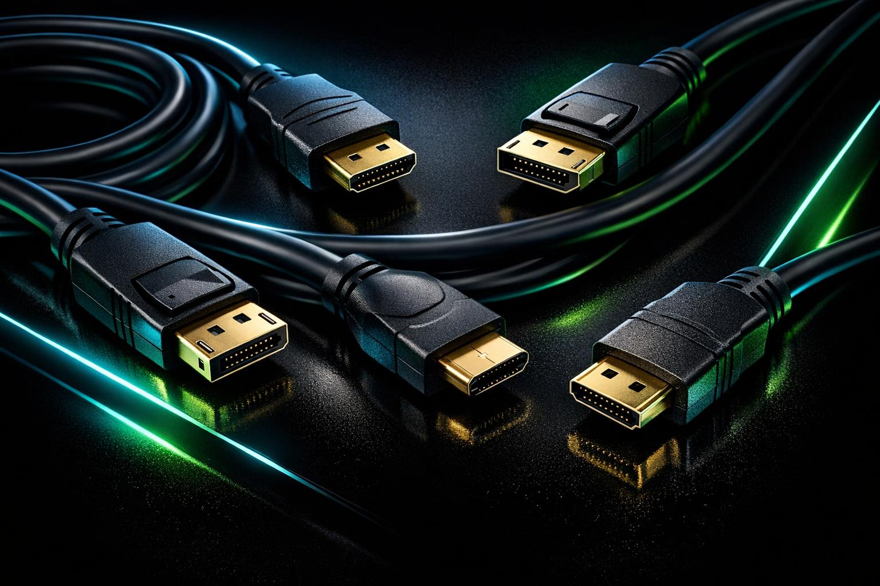
HDMI: Versions & Capabilities
Version | Year | Bandwidth | Max Resolution | Key Feature
1.0 | 2002 | 4.95 Gbps | 1080p @ 60Hz | First digital A/V cable
1.4 | 2009 | 10.2 Gbps | 4K @ 30Hz | First 4K + ARC support
2.0 | 2013 | 18 Gbps | 4K @ 60Hz | HDR + wider colour
2.1 | 2017 | 48 Gbps | 8K @ 60Hz | VRR + eARC + gaming
2.2 | 2025 | 96 Gbps | 10K+ | Latest standard
How to Geek
HDMI replaced SCART, Composite, S-Video, and VGA. Same 19-pin connector since 2002 — backward compatible!
19 / 24
Notes:
HDR — High Dynamic Range
What it does: Expands the range between the darkest blacks and brightest whites, giving richer colour and more detail.
Analogy for your audience:
“HDR is like upgrading from a photo with dull lighting to one where the sun and shadows look real.”
Key point: Requires both an HDR‑capable TV and source (Blu‑ray, console, streaming box). HDMI 2.0 and above support HDR formats such as HDR10, Dolby Vision, and HLG.
VRR — Variable Refresh Rate
What it does: Synchronises the frame rate of the display with the frame rate of the source (e.g. a game console or PC).
Why it matters: Prevents screen tearing and stutter when frame rates fluctuate — smoother motion, especially for gaming.
Analogy:
“VRR is like matching dance steps — the TV and console stay perfectly in rhythm.”
Supported from HDMI 2.1 onward (used by PS5, Xbox Series X, modern GPUs).
eARC — Enhanced Audio Return Channel
What it does: Carries high‑quality audio back from the TV to a soundbar or AV receiver over the same HDMI cable.
Why it matters: Supports full‑bandwidth formats like Dolby Atmos and DTS:X, unlike the older ARC which compressed sound.
Analogy:
“eARC is the upgraded return lane — it sends cinema‑quality sound back to your speakers without extra cables.”

Slide 21
DisplayPort: The Gamer's Choice
DP 1.2
17.28 Gbps
4K @ 60Hz
Multi-Stream Transport (daisy-chain monitors)
DP 1.4
25.92 Gbps
8K @ 60Hz
HDR10, DSC compression, 4K @ 120Hz
DP 2.0
80 Gbps
16K @ 60Hz
Massive bandwidth leap, AR/VR ready
DP 2.1
80 Gbps
16K @ 120Hz
Better USB-C/USB4 compatibility
DisplayPort vs HDMI: DP is preferred for PC gaming (higher refresh rates, FreeSync/G-Sync). HDMI dominates TVs and consoles.
20 / 24
Notes:
Multi‑Stream Transport is a DisplayPort feature that lets one DisplayPort output carry multiple independent video signals at the same time.
In plain English:
MST lets you daisy‑chain monitors — one cable from the PC, then from monitor to monitor.
🔧 What MST actually does
DisplayPort has enough bandwidth to carry more than one video stream. MST splits that bandwidth into separate “lanes” of video:
Stream 1 → Monitor 1
Stream 2 → Monitor 2
Stream 3 → Monitor 3 (if bandwidth allows)
Each monitor pulls out the stream it needs and passes the rest along.
Reduces cable clutter
Lets laptops with only one DP/USB‑C port run multiple screens
Works with docking stations
Enables “video walls” and multi‑monitor setups without a GPU full of ports
MST only works on DisplayPort, not HDMI
Each monitor reduces the available bandwidth, so resolutions may drop if you chain too many

Slide 22
Lightning vs USB-C
Lightning
USB-C
Apple proprietary (2012)
8 pins, reversible design
Max: USB 2.0 speed (480 Mbps)
Max charging: ~20–30W
Robust "male tab" design
Pins on cable (easy to clean port)
Being phased out — iPhone 15+ uses USB-C
Universal open standard (2014)
24 pins, reversible design
Up to USB4: 40 Gbps (83x faster!)
Up to 240W power delivery
Carries video (DP, HDMI alt mode)
EU mandated as standard charger
One cable for phones, laptops, tablets, monitors
21 / 24

Slide 23
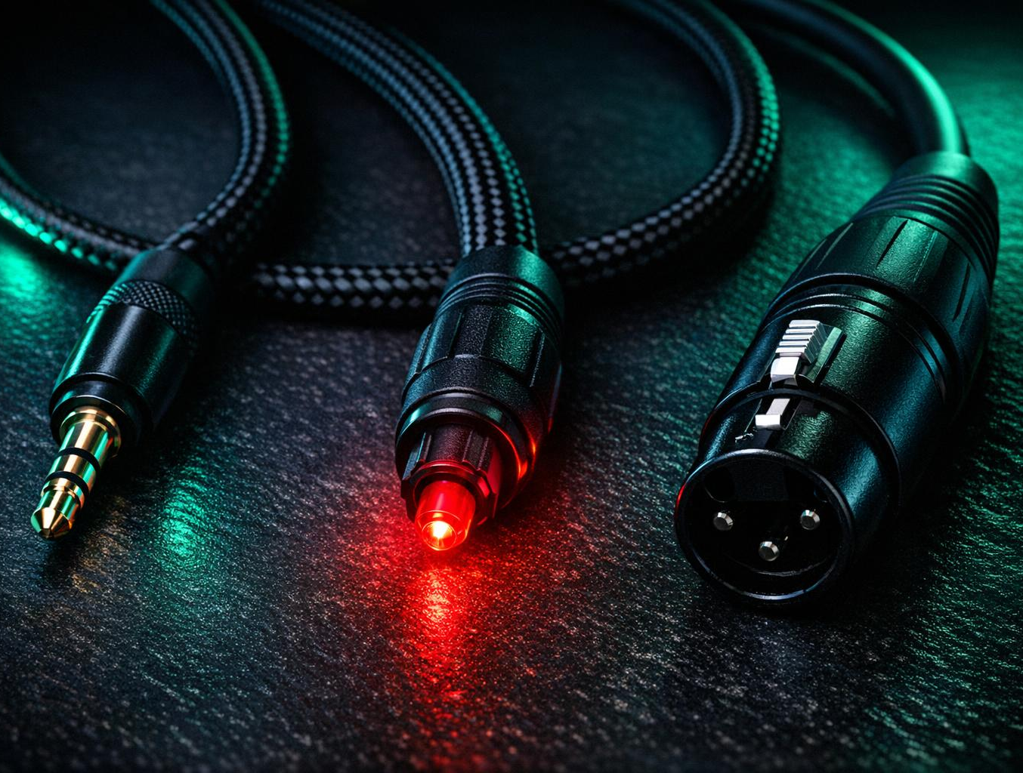
Audio Cables Explained
3.5mm (TRS/TRRS)
The classic headphone jack. TRS = stereo, TRRS adds a microphone. Analogue signal, simple, universal. Found on headphones, speakers, and (some) phones.
Optical / TOSLINK
Fibre optic audio cable created by Toshiba in 1983. Carries digital audio via light pulses (650nm red LED). Immune to electrical interference. Great for TV-to-soundbar connections.
XLR
Professional balanced audio connector developed in the 1950s. 3-pin design cancels noise over long distances. The gold standard for microphones and studio equipment.
RCA / Phono
Developed by RCA in the 1940s. Red = right audio, white = left audio. Unbalanced signal, still common on hi-fi equipment and turntables.
22 / 24
Notes:
Tip — carries the left audio channel
Ring — carries the right audio channel
Sleeve — carries ground (common return path)
TRRS adds a ring for the Microphone channel
XLR The connector was invented by James H. Cannon of Cannon Electric.
The first version was called the X‑series connector.
A later revision added a Latch → XL
Then they added a Rubber insulator around the contacts → XLR
So:
X = original series L = Latch R = Rubber (insulator)
“XLR sounds mysterious, but it’s just the name of Cannon’s old X‑series connector with a latch and a rubber insert. The name stuck, and now it’s the gold standard for microphones.”

Slide 24
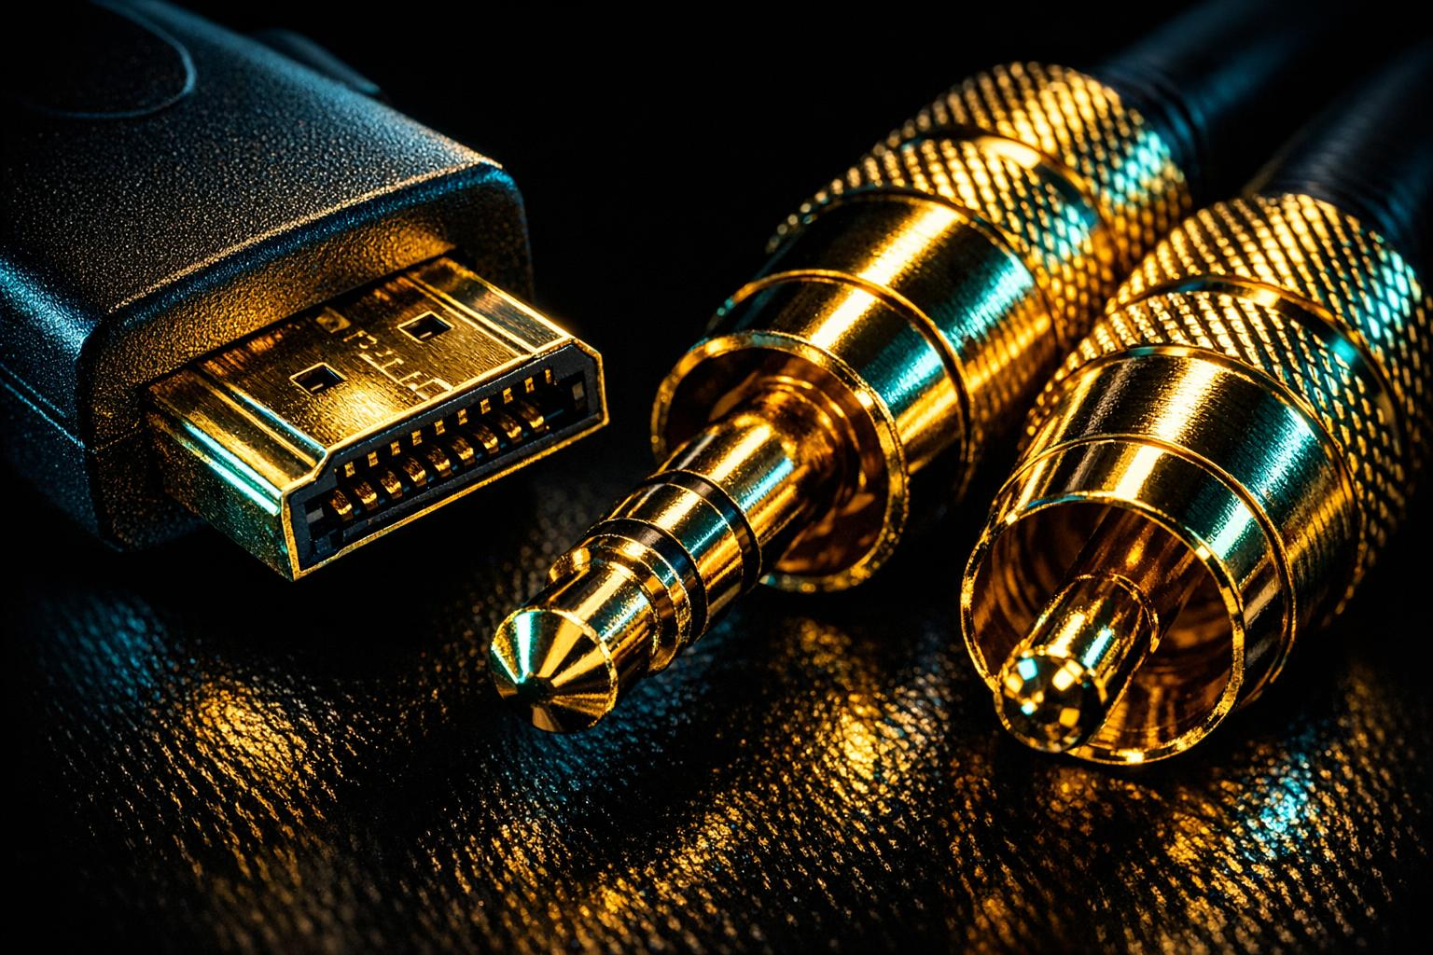
Are Gold Plated Contacts Worth the Extra Money?
The Science
Gold doesn't oxidise — it resists corrosion
But gold is 30% LESS conductive than copper
The plating is microscopically thin (flash gold)
Silver would actually be the best conductor (+5%)
The Verdict
For digital cables (HDMI, USB, optical): NO difference
Digital signals are 1s and 0s — they either arrive or they don't
For analogue audio: marginal benefit in humid environments
For pro equipment plugged/unplugged thousands of times: corrosion resistance helps
Save your money. A £5 HDMI cable performs identically to a £50 gold-plated one.
23 / 24

Slide 25
Cable Myths Busted
"Expensive cables give better picture quality"
Digital is digital. A £5 HDMI cable carries the same 1s and 0s as a £100 one. Either it works or it doesn't — there's no "better" signal.
"Thicker cables are always faster"
Thickness affects power delivery and durability, not data speed. Speed is determined by the USB/HDMI standard the cable supports.
"USB-C means USB 3.0 or faster"
USB-C is just a connector shape! A USB-C cable can carry USB 2.0 (480 Mbps) or USB4 (40 Gbps). Always check the specification.
"All cables that fit will work the same"
A cheap charging-only cable may have no data wires at all. Certified cables guarantee both data and power to specification.
24 / 24

Slide 26
Time for a Quiz
Let's talk cables!
Computer Club | 2026

Slide 27
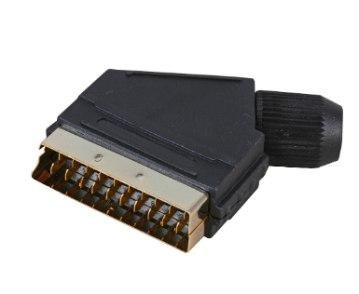
Scart Connector

Slide 28
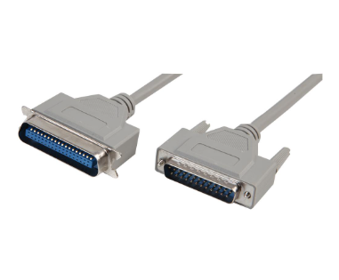
Parallel Port Connector

Slide 29
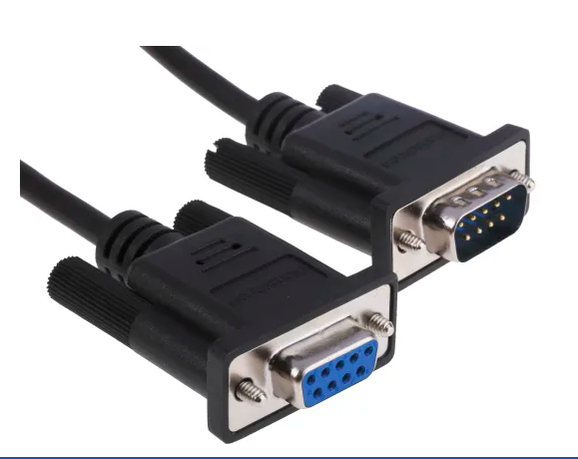
Serial Port Connector

Slide 30
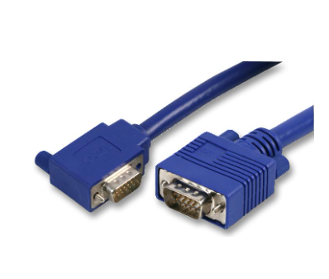
VGA Display Connector

Slide 31
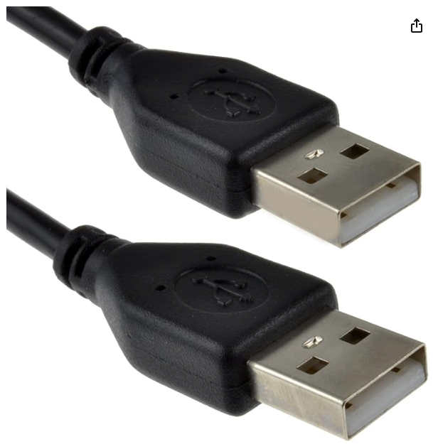
USB Type A Connectors

Slide 32
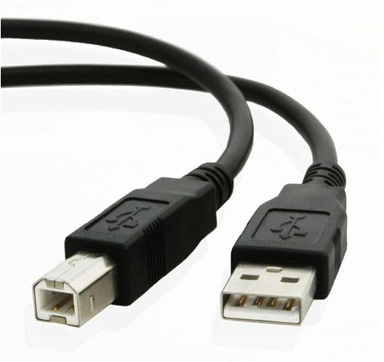
USB Type B Connector

Slide 33
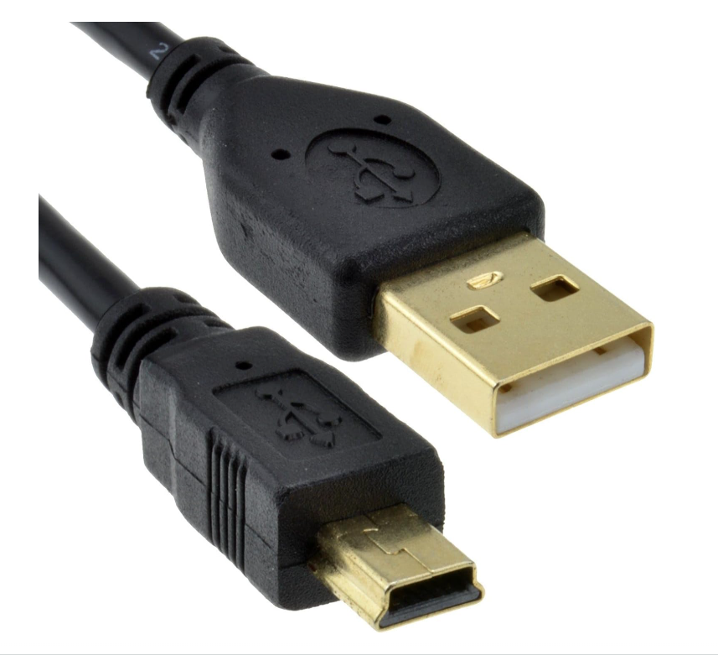
USB Mini Connector

Slide 34
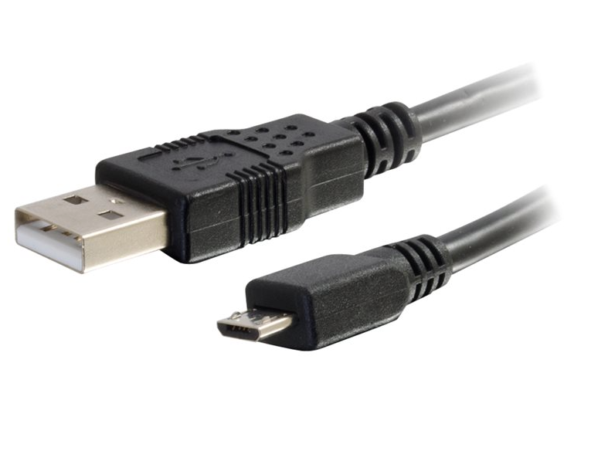
USB Micro Connector

Slide 35
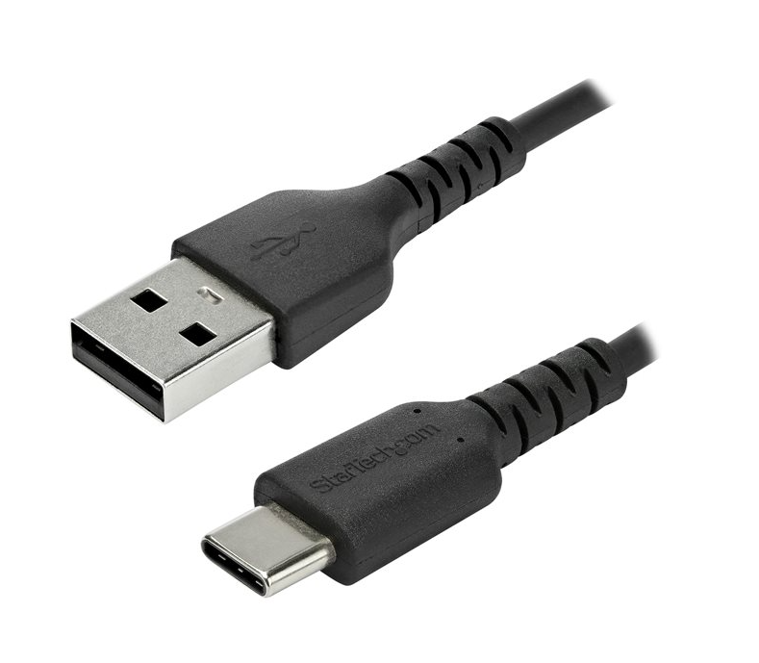
USB Type C Connector

Slide 36
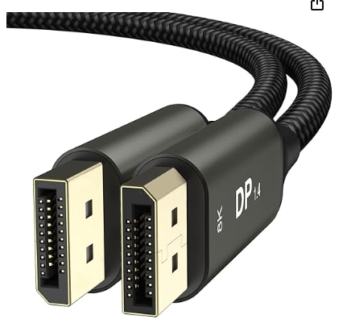
Display Port Connectors

Slide 37
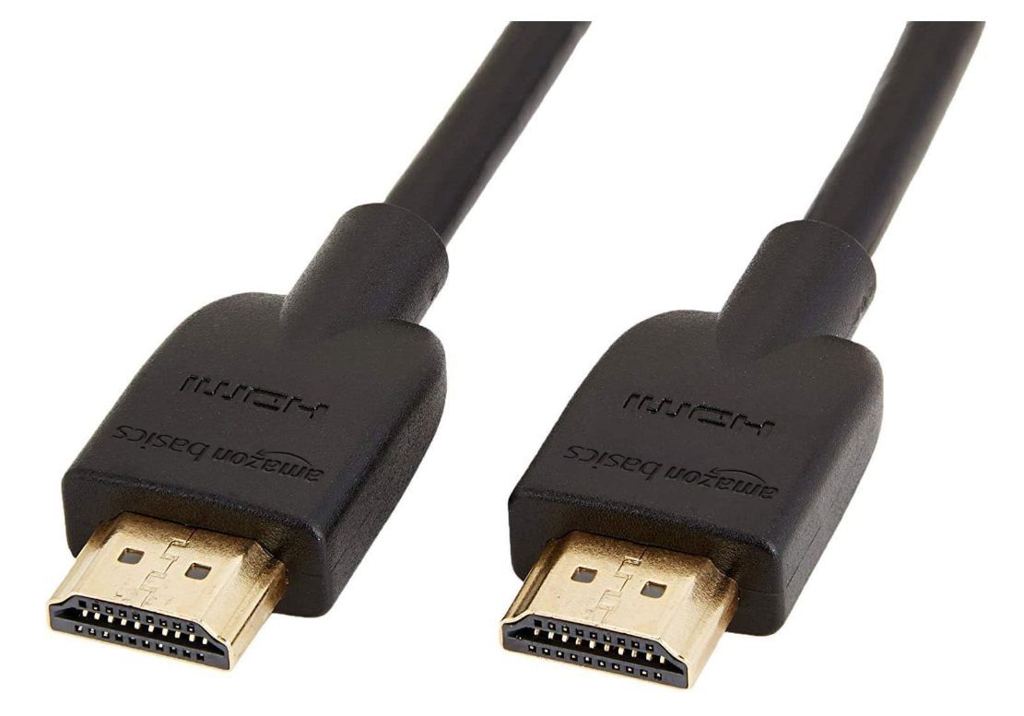
HDMI Connector

Slide 38
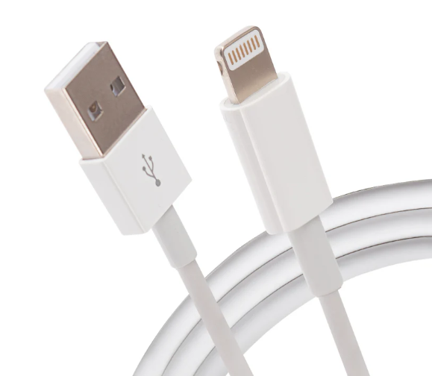
Apple Lightning Connector

Slide 39
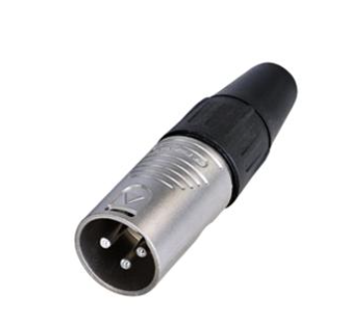
XLR Connector
Notes:
XLR originally stood for “Cannon X‑series, Latch, Rubber.”
Here’s the story in a neat, memorable form:
The connector was invented by James H. Cannon of Cannon Electric.
The first version was called the X‑series connector.
A later revision added a Latch → XL
Then they added a Rubber insulator around the contacts → XLR
So:
X = original series L = Latch R = Rubber (insulator)

Slide 40
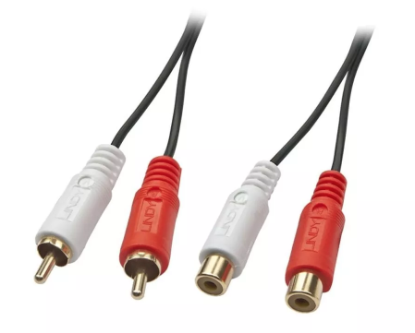
Phono Connectors

Slide 41
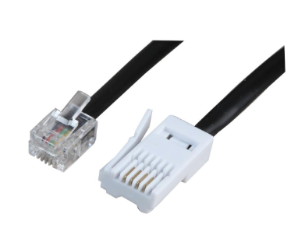
Telephone Connectors

Slide 42
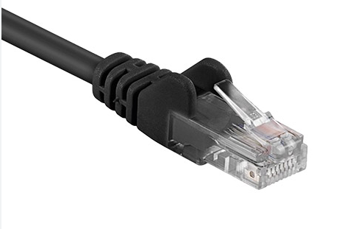
Network (Ethernet) Connector

Slide 43
Question Time
Let's talk cables!
Computer Club | 2026

