Slide 1
What AI Really Is: From the Web to GPT
How search reached its limits — and why GPT emerged
Briefed: Mike Masterson
Researched, taught and drafted: Microsoft Copilot
Editor: Mike Masterson
Notes:
This deck explains AI not as a mystery, but as the next step in the evolution of providing the public with information, games, education— from the Web, to search, to Generative AI.
So far, the process has been going on for 40 years, from the time of Personal Computing. But also, quietly out of public sight of all but very few
This deck was written very largely by an Artificial Intelligence agent – Copilot.
I briefed Copilot on my task. Copilot then researched the topic, taught it to me, and drafted the deck, which I then edited
We will describe GPT through discussing the development history
The point is that there were several development steps
Each step delivered a really exciting new capability
But then reached its limit
Each succeeding step resolved the limits of the earlier step

Slide 2
The Web: Humanity’s First Global Knowledge System
• Decentralised
• Peer‑produced
• Publicly available, at home / office
Exploded in scale
LIMIT: Needed a way to be searched
… if it was to be accessed
… and be available to the masses
World Wide Web
Abbreviation | WWW, W3
Status | Active
Year started | 1989; 37 years ago
First published | 6 August 1991; 34 years ago
Organization | CERN (1989–1994) W£C (1994–current)
Authors | Tim Berners-Lee
License | Public Domain, since April 1993
Copied from Wikipedia
Notes:
The Web was the first time humanity created a global, self‑organising source of information.
An unlimited encyclopeadia of everything; decentralised, peer produced by ourselves
Crucially we already had our own local / at home technology: PC’s from IBM, Apple, others
And we, the public masses, already had global public networks, though very slightly used
But there was a LIMIT: it needed a way to be navigated.

Slide 3
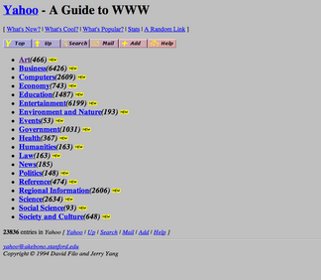
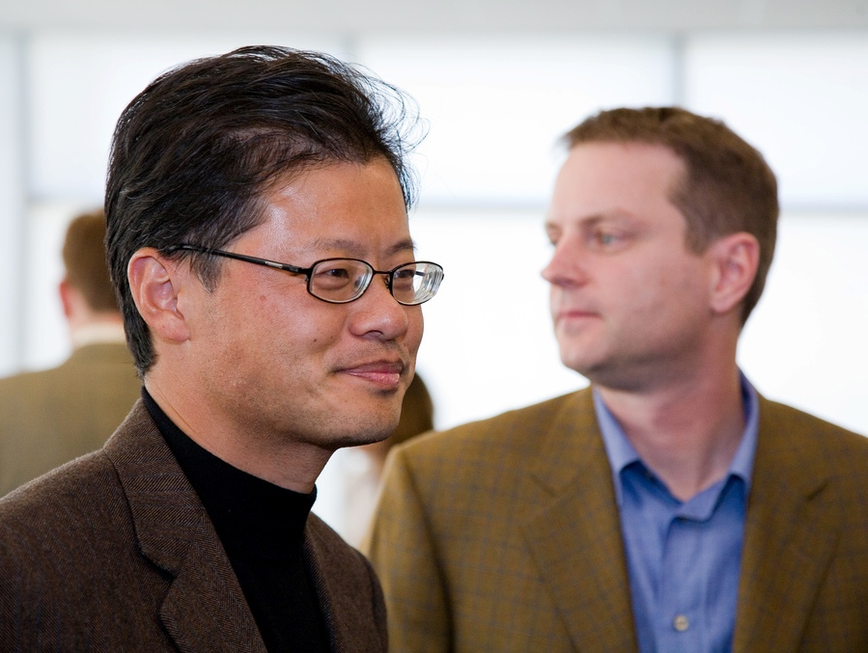

The First Attempt at Order
1994: 2 Stanford students developed yet another hierarchically organised oracle: Gerry Yang / David Filo
Human‑curated categories
Search engine
Mitchell Aidelbaum
LIMIT: Doomed by WWW scale / growth
Notes:
@@@ Fly in 1
I was amazed how often I read that it was a Stanford student (in California) who noted the Limit – and solved it
Though the first AI campus was established at MIT in the 60’s; Massachusetts Institute of Technology
In this case Gerry Yang and David Filo
@@@ Fly in 2 Yahoo!
@@@ Fly in 3 the cover page
@@@ Fly in 4 human curated
Yahoo tried to organise the Web like a library. Humans sorted pages into categories.
@@@ Fly in 5 search engine
But you had to know the paper had been added
Then read it, and categorise it
It worked at 10,000 pages. It collapsed at 10 million.

Slide 4
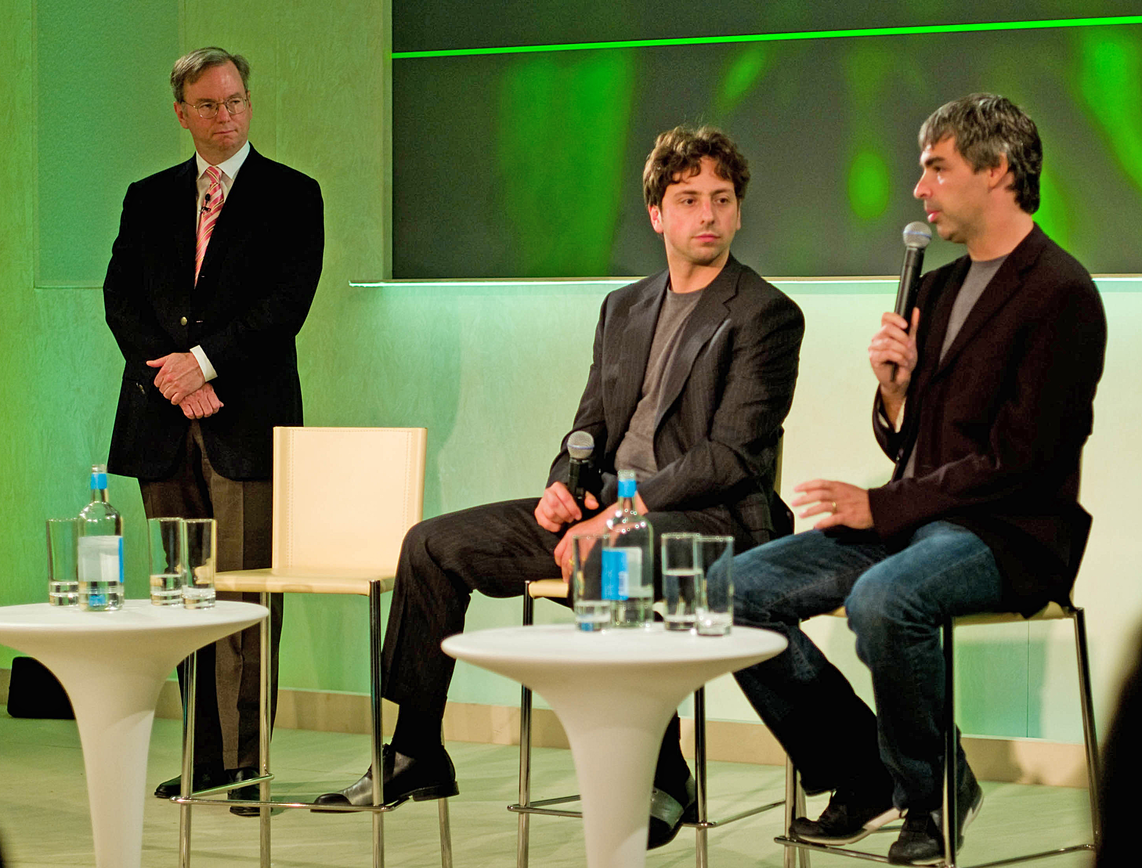

PageRank: A Way to Rank the Web
In 1998 2 more Stanford students: Larry Page and Sergey Brin, invented PageRank
It curates itself - Web votes on what matters
Every link is a vote
Important pages receive more votes
Relevance becomes computable
Search becomes scalable
Limit: Search is retrieval, and retrieval breaks when:
queries become ambiguous
context becomes long
users want explanation, not links
Joi Ito from Inbamura, Japan
Their company needed a name.
The largest number is a ‘googol’.
Notes:
2 more Stanford students; Larry Page and Sergei Brin, invented PageRank
@@@ Fly in 1
PageRank replaced human curation with a mathematical model of importance. The Web became its own curator.
@@@ Fly in 2, 3 ,4 , 5
PageRank was the first system that turned the Web’s structure into meaning. It solved the scale problem — for a while.
@@@ Flyin 6
LIMIT Search engines retrieve documents. They do not understand them.
But users could not always express their requirement in a way the web could be searched
So users needed a way for their requirements to be understood
And for the web contents to be understood
And for the reply to be GENERATED using the context of the query
@@@ Fly in 7
They wanted to INCORPORATE. But Investors wanted an adult; Derek Schmidt.
And they wanted a name for a large number
The largest number is a GOOGOL; 1 with 100 noughts
Invented by a 9 year old child in 1920’s, using a cartoon character
@@@ fly in 8

Slide 5
We Needed a New Paradigm
Not retrieval
Not ranking
Not links
Understanding
Explanation
Generation
So, we have got to the ‘G’ = GENERATIVE
As we go on, we will unpack the meaning of ‘GPT’
Generative
Pre-schooled
Transformer
Notes:
@@@ Fly in 1 to 6
The next step wasn’t a better search engine.
It was a tool that could understand the users query, with all its ambiguity
Perform its own search in the body of knowledge that the tool has curated
Develop an explanation that fits to the context of the query. This implies much more than retrieval
Generate language that delivers the explanation.
@@@ Fly in 7
We have now got to the G …… GENERATIVE
@@@ Fly in 8
As we go on we will unpack the meaning of GPT
Fortunately a solution had been in genesis from as early as 1983
This was found in the tools / algorithms that were developing Artifiicial Vision
For use in the world of ever better animation and even better games

Slide 6
Pictures to Matrices
Think of a picture as a grid of pixels
Each pixel / group of pixels has features: colour, line, shape
Pixels grade across the grid: colour shades, straight becomes curved, line becomes thinner
The picture could be photographic, biased in or out of focus, or graphic cartoon
A matrix is a grid of numbers
Numeric values can be assigned to colour, line, shape
Further values can describe the gradation of features
Further values could describe whole picture
Output = Input X weight X bias
Unfortunate: “Neural Networks”
We can store a digitised picture
We can compare 2 pictures, add features
Matrix maths permits parallel computation, same operation applied to many pixels at once
Notes:
@@@ Fly in 1 to 8
@@@ Fly in 9
Output (pixel) = Input (feature) graded by its weight (eg. shade of colour) and by its bias (connectedness with neighbours or whole picture)
As early as the 1940’s US military made efforts to digitise photography, and use matrix maths to read into the digitised image. They developed concepts and even hardware – the Perceptron. No great success but were taking baby steps
In the 1950’s scientists studying Artificial Intelligence, seeking to digitise knowledge, used matrices to express knowledge
However, in the 50’s this work was philosophical rather than practical. There were only the most basic computers at the time. Think ENIAC
@@@ Fly in 10
Unfortunately, in my very personal view, they called this knowledge as a matrix ‘neural networks’, suggesting that they were exploring / developing an artificial brain
I consider that the analogy to the brain, and its construction, is very thin. No regions. No synapses. No memory
@@@ Fly in 11
However, turning pictures into matrices allows us artificially learn pictures
The first pictures were the handwritten numerals 0 to 9, gathered from high school students across US and Canada
In the eighties Yann LeCun of Bell Labs developed LeNet, which performed Optical Character Recognition with near 99% accuracy

Slide 7
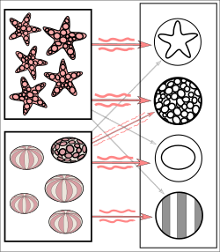
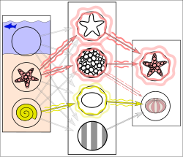
Artificial Vision
Copied from paper by Mikael Häggström, M.D.
The tool is trained on multiple images of STARFISH and SEA URCHINS
Starfish = ringed texture / star outline.
Most sea urchins = striped texture / oval shape.
However, some sea urchins have ringed features = weak weighted association of sea urchins / ringed features.
Some associations are not possible
A new input depicts fish in water, a starfish and a seashell, not in the training
Tool correctly detects the starfish, with a weak signal that the ringed texture might be a sea urchin.
Sea shell gives a weak signal for the oval shape, again suggesting a sea urchin
2 weak signals suggest a false positive result for sea urchin.
Notes:
@@@ Fly in 1`
@@@ Fly in 2
The tool is trained on multiple images of starfish and sea urchins
Imagine a pixelated images of starfish and sea urchins, that have been digitised as matrices
The tool ‘slides’ a small matrix (kernel) over the matrix, performing matrix multiplication and averaging
As the average successively changes the tool is able to note colour, feature and shape
So the tool has learned starfish and sea urchins
Starfish match with a star outline and a ringed texture. There is no ambiguity
Most sea urchins match with an oval shape and a striped texture.
However, the instance of a ring-textured sea urchin creates a weakly weighted association between ringed features and sea urchins.
Some associations are not possible; starfish with oval shape / striped feature
@@@ Fly in 3
@@@ Fly in 4
The tool is given a new input depicting fish in water, a starfish and a seashell
Neither the fish in water, nor the seashell were in the training
The network correctly detects the starfish, with a weak signal that the ringed texture might be a sea urchin.
In addition, a shell that was not included in the training gives a weak signal for the oval shape, again suggesting a sea urchin
These weak signals may result in a false positive result for sea urchin, even though there is no striped feature.
The fish in water and the seashell cannot be visioned

Slide 8
Geoffrey Hinton, the father of AI
We have seen that the tool might make false visions
In 1986 Geoffrey Hinton with others applied Backpropagation
When the tool looks at an image, it produces a prediction
Backpropagation measures accuracy of the prediction
And re-weights backwards through the learned knowledge of digitise image
To improve the use of the learning next time
Strong, accurate visions are reinforced
In-accurate visions, with weak signals are re-weighted
Over time, through multiple visions the learning becomes more reliable
Notes:
When the tool looks at an image, it produces a predeiction
Backpropagation is the method that measures how accurate that prediction was,
…. and re-weights backwards through the learned knowledge of images to improve the use of the learning next time
Strong signals are reinforced, weak signals are re-weighted
Over time, through multiple visions the learning becomes more reliable
However, no matter that we considered that our CPU’s of the 80’s were really fast, the scale of the computation task made AI impractically slow

Slide 9
Ndivia – why GPU’s changed everything
Deep Learning requires billions of matrix multiplications.
2012 Ndivia designed / produced GPU’s for gaming
Graphics Process Units (GPU’s) process thousands of operations in parallel
3GB memory
100 to 300 times faster than CPU’s
Ndivia released CUDA (2006) for public to code GPU’s not just for graphics
Alex Krizhevsky, Hinton’s student
2012 released AlexNet
Trained on 2 NDIVIA GPU’s
60m parameters coding 1.2m images
Won ImageNet by 11%
AlexNet ignited the Deep Learning revolution
P = Pre-schooling.
We have unpacked the next piece of GPT
Notes:
We have seen that Geoffrey Hinton had discovered the method of achieving Deep Learning by 1986
@@@ Fly in 1
But the billions of matrix multiplications required to perform backprop using CPU’s of the day would require weeks and possibly months
@@@ Fly in 2
In 1989 Jensen Huang (another Stanford student) with 2 others built a GPU that perform many operations in parallel
Trebled Sun Microsystems revenue in 2 years
In 1990 they left to set up Ndivia, building chips for PC gaming.
They wanted the competition to be ‘green with envy’ at the power of their new chip. In Latin ‘invidia’
To honour their new chip NV1 they dropped the I to name their company Ndivia
@@@ Fly in 3, 4 5
Up until the AI boom from 2012 Jensen Huang and Ndivia were generally only known to the gaming community
@@@ Fly in 6
However in 2006 Ndivia released CUDA for the public to code GPU’s for other than gaming
Each year the Imaging industry ran a challenge to be the best ImageNet = most accurate imager
@@@ Fly in 7, 8,9,10,11
In 2012 AlexNet beat the next by 11% ; 84% accurate v 735%
AlexNet was only 16% inaccurate
Note the scale factor: AlexNet coded 1.2m images, the next had only 75k images and worked on CPU’s
GPU’s provided the scale and speed
@@@ Fly in 12
AlexNet ignited Deep Learning
And at last we have got to the P in GPT
P = pre-schooling

Slide 10
Attention is all you need
After AlexNet Hinton and his team were absorbed into Google
In 2017 it was another Google group who added the T
T = Transformer
They wrote a paper ‘Attention is all you need’
Describing how an AI understands language
Notes:
@@@ Fly in 1,2,3.,4,5

Slide 11
Consider these 2 cats
‘The cat caught the mouse because it was hungry’
Cat / it = High
Cat / hungry = High
Mouse / it = Low
Mouse / hungry = Low
Hungry /cat = high
AI has established the ‘Attention’ of the sentence: biological needs of the cat
‘The cat sat on the mat’
AI has pre-schooled the exact phrase
Relates to language education of a child, pronouncing ‘at’
Again, AI has established the ‘Attention’of the sentence
Notes:
@@@ Fly in 1, 2. 3, 4, 5, 6
AI uses its learning to understand the attention of this sentence
AI weights the words to understand importance of each word in the sentence
From pre-schooled grammar it understands it relates high to cat, but low to mouse
So hungry relates high to cat, low to mouse
@@@ Fly in 7
AI now understands that the attention of the sentence is the biological needs of the cat, a carnivorous mammal
@@@ Fly in 8, 9 , 10
In the 2nd sentence AI understands the exact phrase from its pre-schooling
The attention is language education of a child
‘cat’ and ‘hat’ and ‘mat’ have low weight. ‘..at’ has high weight
@@@ Fly in 11

Slide 12
Now do the ‘T’ = Transformer
‘The cat sat on the mat. The mat was red, but the hat was black’
AI reads the attention of each sentence, then reads across the whole to ‘transform’ the understanding
Another example of ‘a’ with another attention – colour
The whole has transformed to the education of an older child
‘The cat caught the mouse because it was hungry. Some have a problem with killing.’
AI reads the new attention(ethics of killing), then reads across the whole
The whole has transformed to an ethical discussion
Attentions with Transformers enable AI to understand the meaning of the texts used in pre-schooling, and also the meaning of the input query
We have now unpacked all of GPT
Notes:
@@@ Fly in 1,2, 3, 4
@@@ Fly in 7, 8, 9
@@@ Fly in 10
@@@ Fly 11

Slide 13
In 2015 Sam Altman and others started OpenAI
2018 GPT1: 117m parameters
Proof of concept
2019 GPT2: 1.5b parameters
Coherent paragraphs
Shocked AI community
Not released, too dangerous
2020 GPT3: 175b parameters
Still unusable by the public
2022 ChatGPT
Chatbot dialogue layer
Added safety, tone, refusal rules
Released to public
2023 ChatGPT4: Bigger yet
Notes:
Sam Altman and others started OpenAI
Sam Altman another Stanford standout student
Elon Musk soon left
Key scientists were brought over from Google Brain
@@@ Fly in 1 to 8
Scaled 2000 x in 3 years
@@@ Fly in 9, 10, 11, 12
Added a chatbot to provide a public friendly dialogue layer
Built in rules on safety, tone.
Built in rules on what it might refuse to do

Slide 14
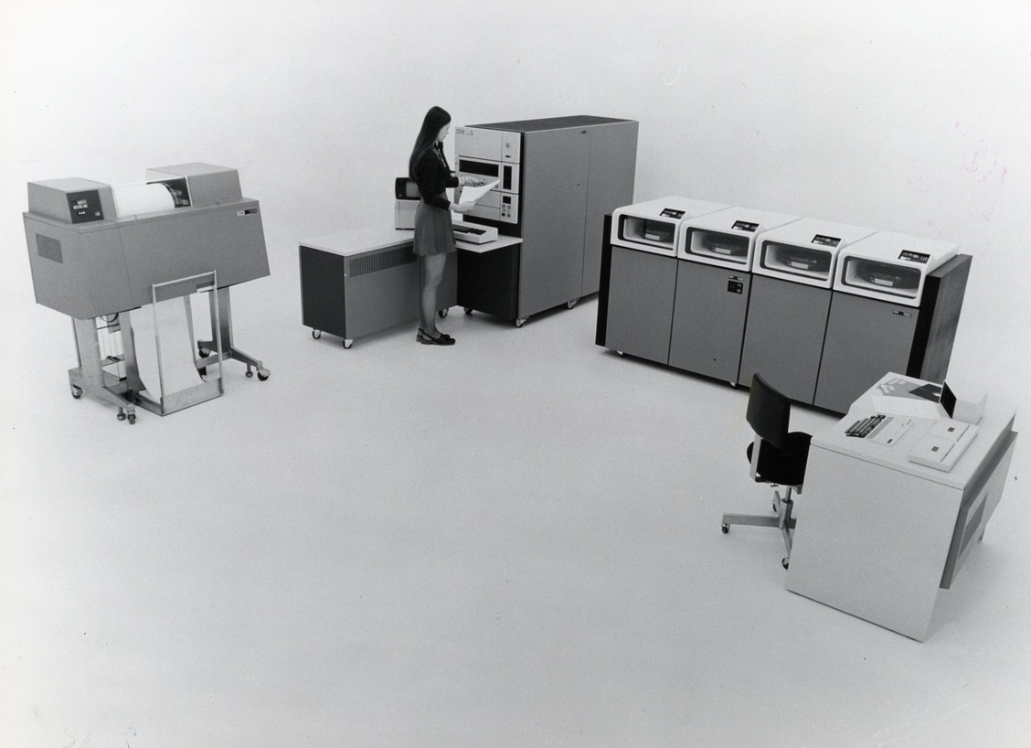
Tyranny, management of…
1978
IT industry was managing the ‘tyranny of large numbers’
2022
The AI industry learned to manage the ‘tyranny of scale’
We are not bad learners, but scale was way beyond our capability.
Artificial Intelligence is NOT intelligence
It is artificial management of scale
Notes:
@@@ Fly in 1, 2 , 3
In an earlier ppt on the beginnings of IT I used the expression that ‘IT had to manage the tyranny of large numbers’, growing very fast
In 1978 we thought 256k memory was quite a large computer.
My 256k computer was roughly 3ft x 6ft x 15ft
Early that year they announced the 256kb RAM chip. My whole computer now fitted to my fingernail
But later that same year the 1Mb chip was released
@@@ Fly in 4, 5, 6
There is a similar story in the AI space
Each chip needs multiple GB of memory, 10 000 x bigger than the 1MB chip
We are not bad learners, but the scale of the task has gone far beyond our capability
@@@ fly in 7
AI is NOT intelligence. It is artificial management of scale

