Slide 1
Welcome, the session will begin shortly
Exploring the world of IT with our Computer Club
Shrewsbury u3a
… where buttons are meant to be pushed
In in doubt, blame the Wi-Fi
Curiosity encouraged – panic discouraged

Slide 2
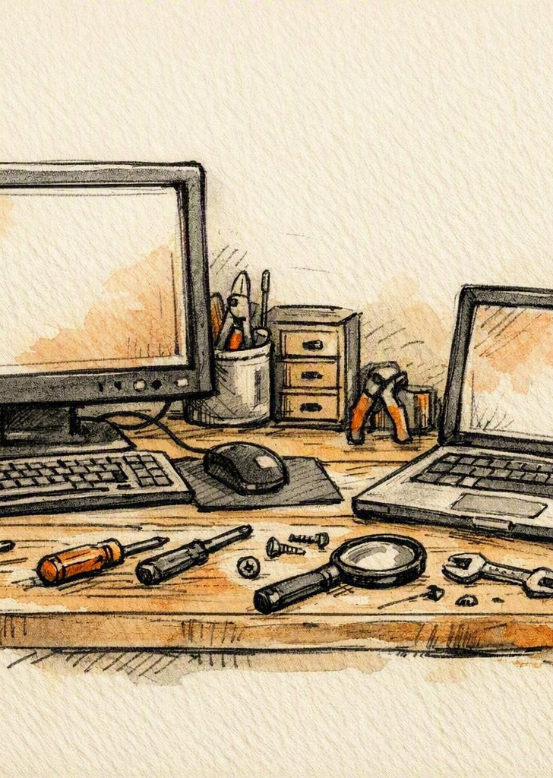
Keeping Your Devices Running Smoothly
COMPUTER CLUB SESSION
Windows, cleaners, tablets and phones — what actually helps, and what doesn't.
Notes:
Welcome everyone. Today we are looking at what actually keeps a computer running well, and what is just marketing.
The short version: modern devices look after themselves far better than they used to.
We will cover Windows PCs, commercial cleaning software, and then tablets and phones.

Slide 3
What this session covers
Introduction
Practical ways to keep Windows PCs, laptops, tablets and smartphones running smoothly — built-in tools versus commercial “system cleaners”, and the habits that genuinely help.
01
02
03
04
Windows PCs
Cleaner software
Tablets & phones
Overall message
What to actually do
Is it worth buying?
Routine upkeep
Less is more
Notes:
Here is the plan for the session, in four parts.
First, what Windows already does for you and the handful of habits that are genuinely worth adopting.
Second, an honest look at commercial cleaner software.
Third, tablets and smartphones, which need even less attention.
And finally the overall message, which is that less really is more.

Slide 4

Windows PCs: what users should actually do
SECTION 1
Modern Windows performs most maintenance automatically. You only need a few simple habits.
Notes:
This first section is about Windows PCs and laptops.
The key point to keep in mind: Windows performs most maintenance automatically in the background.
There is very little left for the user to do, and what remains is simple.

Slide 5
Built-in Windows tools do the heavy lifting
Section 1 — the toolbox you already own
Storage Sense — clears temporary files and old updates automatically
Disk Cleanup — manual control whenever you want it
Startup Apps — in Task Manager — cuts slow boot times
Windows Update — security patches, drivers and performance fixes
Memory management — fully automatic — “RAM boosters” are unnecessary
Notes:
Storage Sense runs on its own and clears temporary files and old Windows update files. Turn it on once and forget it. Settings | System | Storage | Storage Sense.
Disk Cleanup is still there if you prefer to do it by hand.
Task Manager, under the Startup Apps tab, is the single most useful tool for a slow-booting machine. Disable what you do not need at start-up.
Windows Update covers security patches, drivers and genuine performance improvements.
Worth stressing: memory management is fully automatic. Any product selling a RAM booster is selling you nothing.

Slide 6
Seven habits that keep a PC healthy
Section 1 — recommended user habits
Uninstall apps you no longer use
Check startup programs monthly
1
2
Keep 10–15% of disk space free
Restart the computer weekly
3
4
Clean vents and keyboards
Keep Windows and drivers updated
5
6
Back up files — cloud or external drive
7
Notes:
These seven habits are the whole maintenance routine for most people.
Uninstalling unused apps frees space and removes background processes.
A monthly look at start-up programs takes two minutes.
Keeping ten to fifteen percent of the drive free matters more than people expect - a nearly full drive slows everything.
A weekly restart clears things up and lets pending updates finish.
Physical cleaning is genuinely important. Blocked vents cause overheating, and overheating causes throttling.
And back up your files. Whichever service you prefer, just have one.

Slide 7

How many apps are on your machine?
Section 1 — a rough guide for our club comparison
120–180 apps — typical home user
90–130 apps — tech-savvy user
70–100 apps — power user
Fewer than 70 apps — minimalists, or people who never install anything
More than 200 apps — people who need rescuing!
Notes:
Here is a rough guide to how many apps people tend to have installed. These are ballpark figures, not a scientific study.
Typical Home User 120 – 180
Tech Savvy user 90 – 130
70 – 100 Power User
Less than 70. Minimalist or people who never install anything!
Anything over about two hundred usually means a machine that has never been tidied up.
A typical home user sits somewhere around a hundred and twenty to a hundred and eighty, much of it pre-installed.
More confident users often have fewer, because they remove what they do not use.
Before next session, check your own count — Settings | Apps | Installed apps — and bring the number along. We will plot them all on a graph and compare.

Slide 8
For confident users: built-in diagnostics
Section 1 — advanced tools
SFC and DISM
Reliability Monitor
Event Viewer
Repair damaged system files without a reinstall.
A plain-English timeline of recent crashes.
Deeper diagnostics for tracing a specific fault.
These are troubleshooting tools, not routine maintenance.
Notes:
This slide is optional territory for the more confident members.
SFC scannow and DISM repair damaged system files and can rescue a machine without a reinstall.
DISM: Deployment Imagement Servicing and Management Tool. Scan for a health report, Restore to fix it. Then run SFC
Reliability Monitor is the friendliest of the three - a simple timeline showing when things went wrong.
Old Control Panel | All Control Panel items | Security and maintenance | Reliability Monitor.
Better still open up Settings (Win + I) and search for “Reliability Monitor”
Event Viewer is the deep end, useful when you are chasing a specific fault.
Nobody needs these for routine upkeep. They are troubleshooting tools, not maintenance tools.

Slide 9
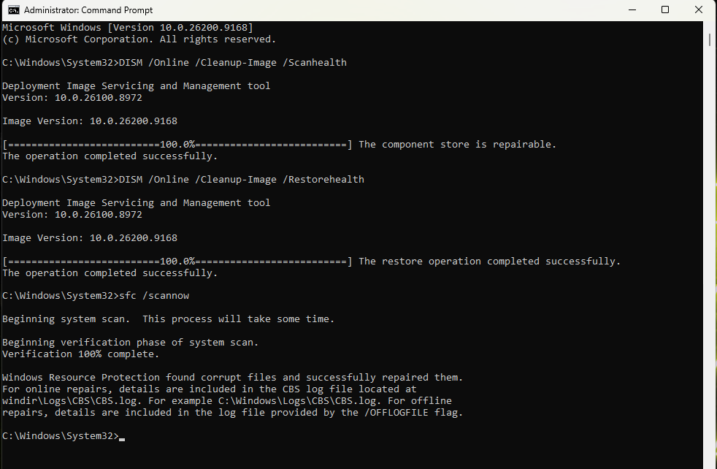
DISM and SFC
DISM /Online
/Cleanup-Image
/ScanHealth
DISM /Online
/Cleanup-Image
/RestoreHealth
sfc /scannow
Notes:
SFC = checks and repairs system files using the local copy. DISM = repairs the component store (WinSxS) that SFC depends on.
If the component store is damaged, SFC can’t fix anything — and that’s where DISM comes in.
Today
Good morning. I'm just going through my notes for tomorrows computer club session. We are doing "Keeping Windows running Sweet". One line I have for advanced users is the use of SFC - I'm familiar with this and do use it. However, It's often mentioned hand in hand with DISM. What does DISM bring to the party?
The short version: SFC fixes Windows files, while DISM fixes Windows itself.
That’s the key distinction your Computer Club members will actually remember.
🧩 The concise takeaway for your slide
SFC = checks and repairs system files using the local copy. DISM = repairs the component store (WinSxS) that SFC depends on.
If the component store is damaged, SFC can’t fix anything — and that’s where DISM comes in.
🧠 What DISM actually brings to the party
1. It repairs the Windows Component Store (WinSxS)
This is the huge repository of every system file, driver, manifest, and update package Windows uses to rebuild itself.
SFC relies on this store. If the store is corrupted → SFC can’t repair files → you get “Windows Resource Protection found corrupt files but could not fix some of them”.
DISM fixes the store so SFC can do its job.
2. It can pull clean copies from Windows Update
This is the big advantage over SFC.
SFC only uses local files
DISM can use Windows Update as a source of truth
So if your local system files are badly damaged, DISM can fetch fresh ones.
Open up a Command Prompt as an Administrator
Enter: DISM /Online /Cleanup-Image /ScanHealth
“The Component Store is repairable”
Run DISM /Online /Cleanup-Image /RestoreHealth
“The restore operation completed successfully”
Now you can run the System File Checker
sfc /scannow
“Windows found corrupt files and successfully repaired them”
Finishes with a command Prompt for you to enter “Exit” to finish and close.

Slide 10
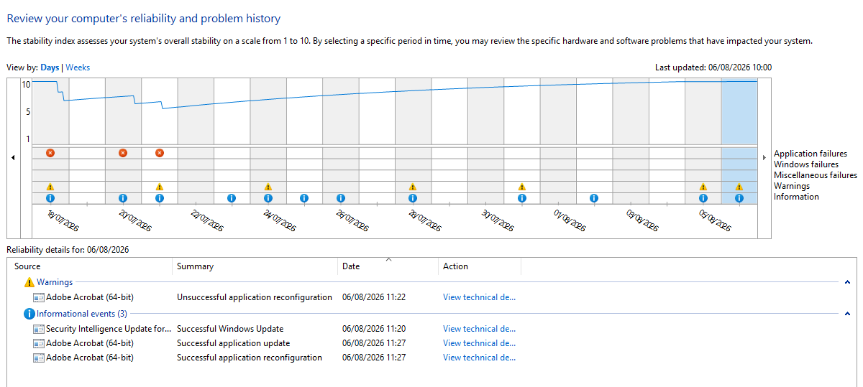
Reliability Monitor
Part of Control Panel tools
These are troubleshooting tools, not routine maintenance.
Notes:
Control Panel – Security & Maintenance – Maintenance – View Reliability History
Norton stopped
One Drive Stopped
Snagit Stopped

Slide 11
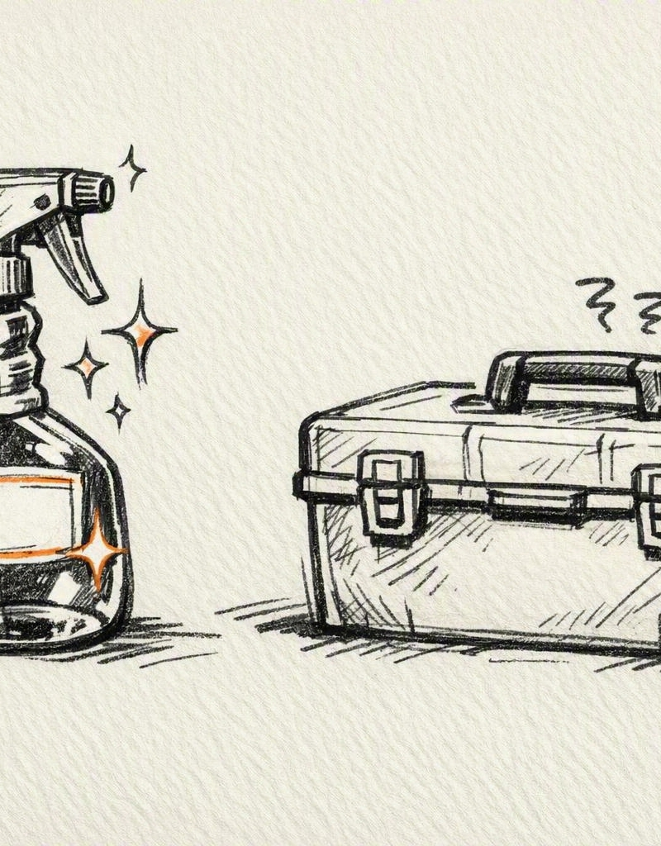
Commercial cleaners: are they worth it?
SECTION 2
They rarely do anything Windows can’t already do. They add convenience, not magic.
Notes:
Commercial cleaners rarely do anything Windows cannot already do.
What they sell is convenience and a tidy dashboard, not magic.

Slide 12
The claims, and the reality
Section 2 — a like-for-like comparison
WHAT THEY CLAIM
REALITY CHECK
Remove junk files
Storage Sense already does this
Clean the registry
Unnecessary, and can be risky
Optimise startup
Task Manager does it, for free
Suspend background apps
Windows manages memory better
“One-click speed boosts”
RAM optimisers are ineffective
Notes:
Let us take their claims one at a time.
Junk file removal - Storage Sense already does this.
Registry cleaning is the big one. It delivers no measurable benefit and a bad clean can break applications. Best avoided.
Start-up optimisation is exactly what Task Manager does, for free.
Suspending background apps usually works against Windows own memory management.
And one-click speed boosts are, in practice, RAM optimisers, which do not work.

Slide 13
The verdict on cleaners
Section 2 — where they do and don’t fit
Fine
Optional
Not essential
Safe for anyone who simply wants automation.
Free tools are fine for occasional use.
Built-in tools are safer and more transparent.
You are paying for automation and a dashboard, not extra speed.
Notes:
So where do these tools fit?
They are perfectly safe for someone who wants everything automated and does not want to learn where the settings live.
Free tools such as Wise Disk Cleaner are fine for occasional use if you like having one.
But for this group, they are not necessary. The built-in tools are safer, cheaper and you can see exactly what they are doing.
Bottom line: you are paying for automation and a dashboard, not extra speed.

Slide 14

Tablets & smartphones: routine maintenance
SECTION 3
Mobile devices need far less maintenance than PCs. They optimise themselves automatically.
Notes:
On to tablets and smartphones.
The good news is that there is far less to do here. These devices optimise themselves continuously.
Most of what follows is about storage and battery, not performance.

Slide 15
Simple habits and battery care
Section 3 — a short list is all you need
Keep storage below 85–90% full
Restart occasionally
Update iOS or Android regularly
Avoid extreme heat and cold
Clean screens and ports weekly
Replace worn-out batteries
BATTERY CARE
Keep charge between 20% and 80%
Avoid full discharges
Use “Optimised Charging”
Notes:
The everyday habits are short and simple.
Keeping storage below roughly eighty-five to ninety percent matters most - a nearly full phone slows down and updates start failing. SO move your photos to your OneDrive or Google drive.
Keep iOS or Android updated,
.
Clean the screen and, importantly, the charging port - lint in the port is a very common cause of charging problems.
An occasional restart clears up odd behaviour.
Avoid leaving devices in hot cars or freezing conditions
On battery care: staying between twenty and eighty percent is kindest to the battery, and both platforms have optimised charging settings that do this for you.
When performance drops noticeably, a battery replacement is usually far cheaper than a new device.

Slide 16
Why phones and tablets need so little
Section 3 — what the hardware does for you
Solid-state storage
Sandboxed apps
Memory management
Nothing to defragment.
No system-wide clutter.
Reclaimed automatically.
Background upkeep
Silent updates
Runs while the device is idle.
Fixes arrive on their own.
Notes:
It is worth explaining why phones need so little attention.
Solid-state storage means there is nothing to defragment.
Apps are sandboxed, so they cannot scatter files across the system the way desktop software can.
Memory management is aggressive - the system closes what you are not using without asking.
Housekeeping runs while the device is idle and charging, and many fixes arrive silently.
This is also why phone cleaner apps are, if anything, less useful than PC ones.

Slide 17

Less maintenance than people think
THE OVERALL MESSAGE
Windows handles most optimisation automatically.
Mobile devices handle even more themselves.
Simple, safe habits beat complicated tune-up rituals.
Notes:
To bring it all together.
Modern devices need far less maintenance than most people believe.
***Windows handles the bulk of optimisation on its own,
***and mobile devices handle even more.
***The value is in a few simple, safe habits - free space, updates, backups, and a restart now and then.
Complicated tune-up rituals and paid cleaning suites are not where the benefit lies.

Slide 18
Thoughts and comments
OVER TO YOU
What has worked, or not worked, on your own machines?
Any cleaner software you have been tempted by?
Second presentation coming up:
Have you got the (right) time please?
Notes:
*** What has worked on your devices
*** Cleaner Software
***Second Presentation coming up

