Slide 1
Welcome, the session will begin shortly
Exploring the world of IT with our Computer Club
Shrewsbury u3a
… where buttons are meant to be pushed
In in doubt, blame the Wi-Fi
Curiosity encouraged – panic discouraged

Slide 2
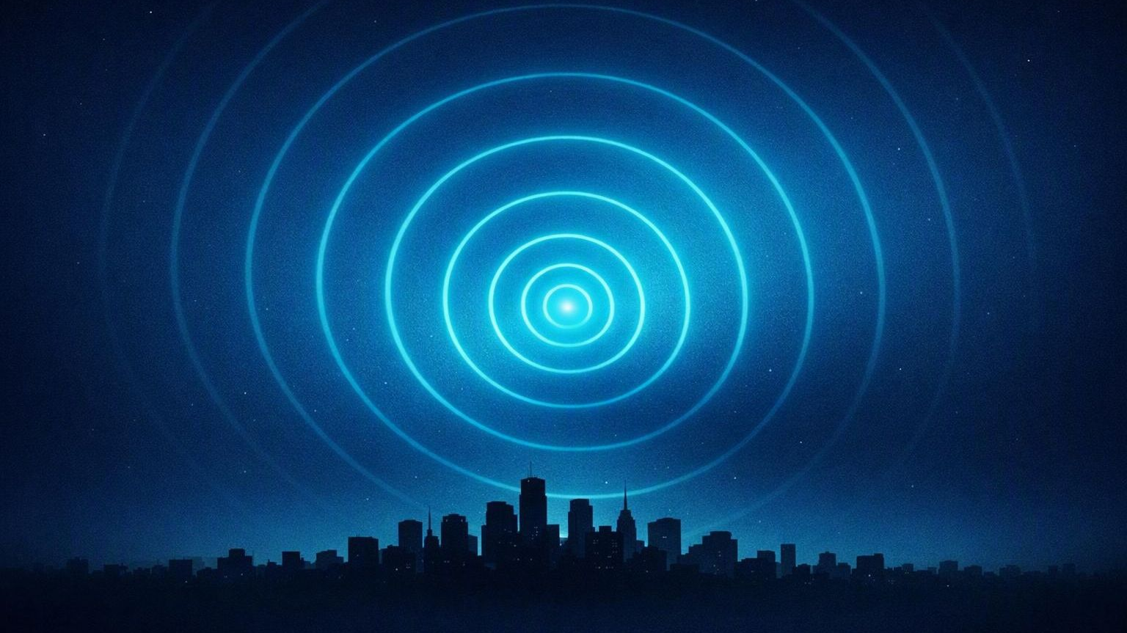
How Modern Devices Keep Accurate Time
Radio Signals vs Internet Time
Notes:
Welcome — today's ten-minute question is a simple one: how do our everyday devices actually know the right time, and which one is the most accurate? We'll look at three: radio-controlled watches, smartphones and computers, and finish with a question for the room.

Slide 3
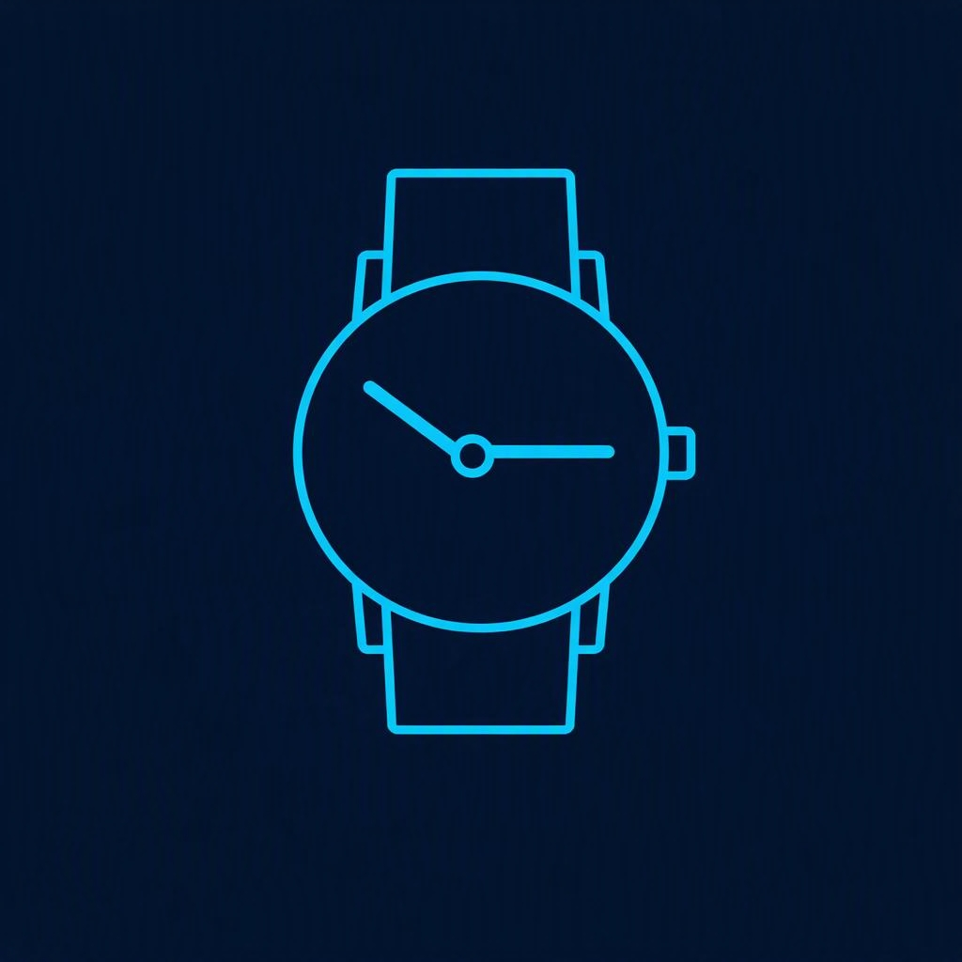


Introduction: What “Accurate Time” Means
WHY OUR DEVICES BOTHER TO SYNCHRONISE
Keeping the same time
THREE WAYS DEVICES GET THE TIME
“Accurate time” is how closely a device’s clock matches official atomic time (UTC) — the world’s shared reference.
Radio-controlled watches
Listen to the DCF77 time signal
Why devices synchronise
Smartphones
Every clock drifts. Messaging, security, logs and networks only work when devices agree on the time — so they correct themselves against a trusted source.
Sync over the internet with NTP
Computers
Sync over the internet with NTP
Notes:
Accurate time means matching UTC — the world's shared atomic reference. Devices care because every clock drifts, and because messaging, security, logs and networks only work when everyone agrees on the time. There are three ways in today: radio-controlled watches use the DCF77 signal; phones and computers use internet time, called NTP. We'll take each in turn.

Slide 4
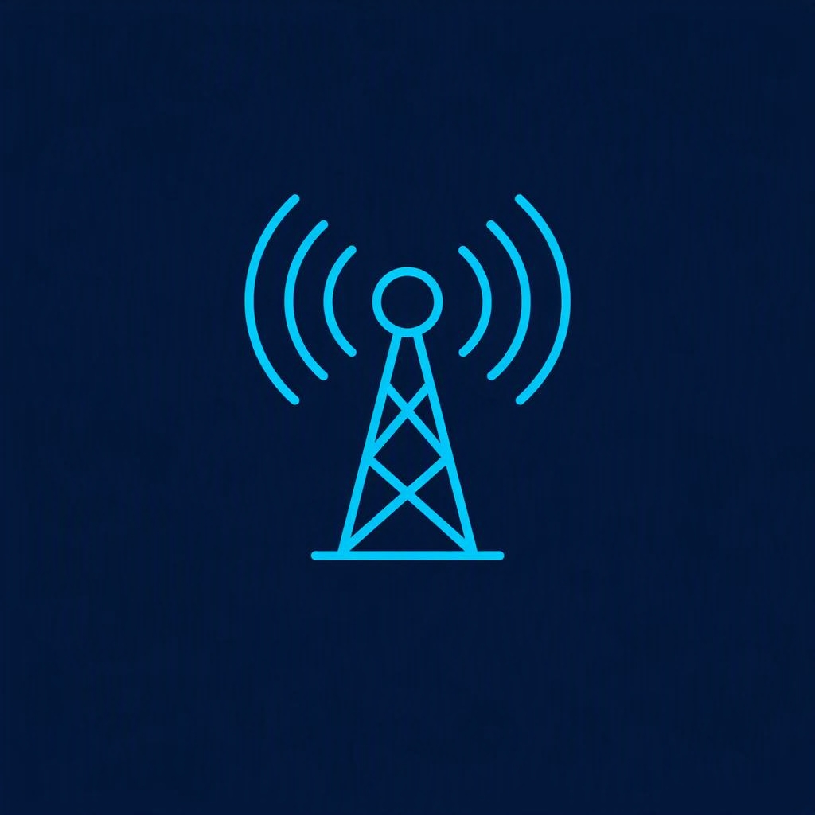
Radio-Controlled Time (DCF77)
A TIME SIGNAL BROADCAST FROM FRANKFURT
HOW IT WORKS
SIGNAL STRENGTH DEPENDS ON
1
A 77.5 kHz long-wave signal is broadcast from Frankfurt.
Distance from Frankfurt
Atmospheric conditions
Building materials
Orientation of the watch
2
Each minute carries one encoded time frame.
3
The watch decodes the frame and adjusts its clock.
4
Propagation delay is tiny — about 3 ms to Shrewsbury.
±ms
1×/night
5
Syncing usually happens in a 2–3 AM window.
accuracy after a
successful sync
only — and it can
miss several nights
Notes:
Radio-controlled watches listen to DCF77 — a 77.5 kHz long-wave signal broadcast from Frankfurt. Every minute it sends one encoded time frame; the watch decodes it and sets itself. The signal itself travels fast — only about 3 ms to Shrewsbury — and watches usually sync in the quiet 2 to 3 AM window. How well they hear it depends on distance, atmospherics, building materials and even the orientation of the watch. After a good sync it's accurate to milliseconds — but it only tries once a night, and can miss several nights in a row.

Slide 5
Inside One DCF77 Minute
ONE ENCODED TIME FRAME, TRANSMITTED SECOND BY SECOND
0
21
29
36
59
Control & weather bits
Minutes
Hours
Date · day, weekday, month, year
Second 59 carries no pulse — that gap marks the start of the next minute, so the watch knows where the frame begins.
HOW EACH BIT IS SENT
ONE FRAME PER MINUTE
Short dip = 0 ≈ 100 ms
The full time and date are spread across the 60 seconds, sent once every minute. The watch collects the whole frame, then updates on the minute mark.
Long dip = 1 ≈ 200 ms
Notes:
Here's what one minute of DCF77 actually looks like. Each second, the transmitter briefly dips its power. A short dip — about a tenth of a second — is a zero; a longer dip is a one. Those bits are grouped: first control and weather data, then the minutes, the hours, and the full date. The 59th second has no dip at all, and that silence marks the start of the next minute, so the watch always knows where the frame begins. One complete time frame, once per minute.

Slide 6


Internet Time (NTP)
NETWORK TIME PROTOCOL — MEASURE THE DELAY, THEN CANCEL IT
HOW NTP WORKS
1–20 ms
Computers
many syncs — often hourly or daily
1
Contacts several time servers at once.
2
Measures the round-trip delay to each.
5–50 ms
Smartphones
sync many times per day — very stable
3
Cancels out network latency mathematically.
4
Rejects bad or inconsistent samples.
5
Continuously disciplines the internal clock.
Works across the whole chain: home routers · BT street cabinets · fibre · undersea cables · remote servers
Notes:
Computers and phones use NTP. Instead of accepting a signal blindly, a device asks several time servers at once, measures the round-trip delay to each, and mathematically cancels out the network latency. It throws away bad samples and nudges its clock continuously rather than jumping. Computers typically land within one to twenty milliseconds, phones five to fifty — and it works right across the internet chain, from your router to undersea cables to a distant server.

Slide 7
How NTP Cancels the Delay
FOUR TIMESTAMPS TURN A NOISY NETWORK INTO AN ACCURATE CLOCK
Your device
Time server
t1
THE MATHS
request
Offset = ((t2−t1) + (t3−t4)) / 2
t2
Delay = (t4−t1) − (t3−t2)
t3
reply
Timing both directions lets NTP subtract the travel time and keep only the true offset — the correction it applies to your clock.
t4
Notes:
This is the clever part. There are four timestamps. Your device sends a request at t1; the server receives it at t2; it replies at t3; and your device gets the reply at t4. From just those four numbers, NTP works out the round-trip delay and — the important one — the offset, which is how far your clock is actually off. Because it has timed the journey in both directions, it can subtract the travel time and keep only the true correction. That measuring of the delay is exactly what a radio watch cannot do.
Radio‑controlled time (DCF77 etc.)
Broadcast only — no handshake
Receiver listens, decodes, and corrects itself
One clean sync per night is enough
Drift happens between syncs, then snaps back
NTP time (computers, phones, Raspberry Pi)
Two‑way handshake: device ↔ server
Server does almost nothing — just stamps t₂ and t₃
Client does all the maths (offset, delay, filtering)
Uses four timestamps to cancel travel time
Offset = how wrong your clock is
Delay = how trustworthy the measurement is
Asymmetric paths distort offset → delay tells NTP to distrust that sample
NTP prefers low‑delay samples → more accurate final time
Result: devices stay within milliseconds of atomic time

Slide 8
Which Is More Accurate?
SYNC METHOD, FREQUENCY AND EVERYDAY ACCURACY COMPARED
Device | Sync method | Frequency | Typical accuracy | Notes
Radio-controlled watch | DCF77 | Once nightly | ms after sync; seconds if unsynced | Depends on reception
Smartphone | NTP | Many times/day | 5–50 ms | Very stable
Computer | NTP | Regular intervals | 1–20 ms | Best overall
Key takeaway: smartphones and computers are usually more accurate than radio watches — they correct for delays and sync far more often.
Notes:
Side by side now. The watch syncs once a night and is excellent right after a sync — but drifts towards seconds if it misses. Phones sync many times a day, at five to fifty milliseconds; computers at regular intervals, one to twenty — the best overall. The takeaway: phones and computers usually win, because they correct for delay and sync far more often.

Slide 9
Why NTP Beats Radio Time
BOTH START FROM ATOMIC TIME — ONLY ONE CORRECTS FOR THE JOURNEY
Radio time
NTP
“Atomic time by broadcast”
“Atomic time with delay correction”
The watch simply accepts the broadcast frame as it arrives. It cannot tell how long the signal took to reach it.
NTP actively measures the network and cancels the delay, so the final clock is corrected — not just received.
NTP MEASURES WHAT RADIO CANNOT
Delay
Jitter
Asymmetry
Server quality
Notes:
Both methods start from the same atomic time. Radio time is atomic time by broadcast — the watch just accepts the frame as it arrives, with no idea how long it took to get there. NTP is atomic time with delay correction — it actively measures delay, jitter, asymmetry and server quality, and adjusts for them. The radio watch has no way to measure any of that; it simply trusts the frame.

Slide 10
Real-World Example: A Night in Shrewsbury
SAME NIGHT, THREE DEVICES, THREE OUTCOMES
Radio-controlled watch
Smartphone
Computer
Syncs only on some nights, when the Frankfurt signal gets through.
Syncs dozens of times per day over the mobile and Wi-Fi network.
Syncs regularly and corrects drift continuously between updates.
May drift by seconds
Within milliseconds
Within milliseconds
Result: the watch may drift by seconds, while the phone and computer stay within milliseconds.
Notes:
Picture a night in Shrewsbury. The watch may only pick up the Frankfurt signal on some nights, so it can quietly drift by seconds. Meanwhile the phone syncs dozens of times a day, and the computer corrects drift continuously. The result: the watch drifts to seconds, while the phone and computer stay within milliseconds.

Slide 11

ONE QUESTION FOR THE ROOM
“Which keeps better time — my atomic radio watch, or your phone?”
Your phone — because it measures the delay and cancels it out.
Notes:
So, to close: which keeps better time — my atomic radio watch, or your phone? The answer is your phone — because it measures the delay and cancels it out, while the watch just trusts the signal.
But not as good as my Desktop Computers
Atomic clocks (cesium‑133)
Defined by a hyperfine transition in cesium‑133
9,192,631,770 microwave oscillations = 1 second
Stable, reproducible, independent of Earth’s rotation
Current international definition of the second
Optical clocks (the future)
Use light‑frequency transitions (hundreds of trillions of ticks per second)
100×–1000× more accurate than cesium
Can detect height differences of 1 cm via relativity
Expected to redefine the second in the 2030s
Domestic appliance clocks
Old appliances: counted 50 Hz mains cycles
Modern appliances: cheap quartz oscillators → drift
Smart appliances: NTP (same as your Pi)

