Slide 1


Useful & Interesting Websites

Slide 2
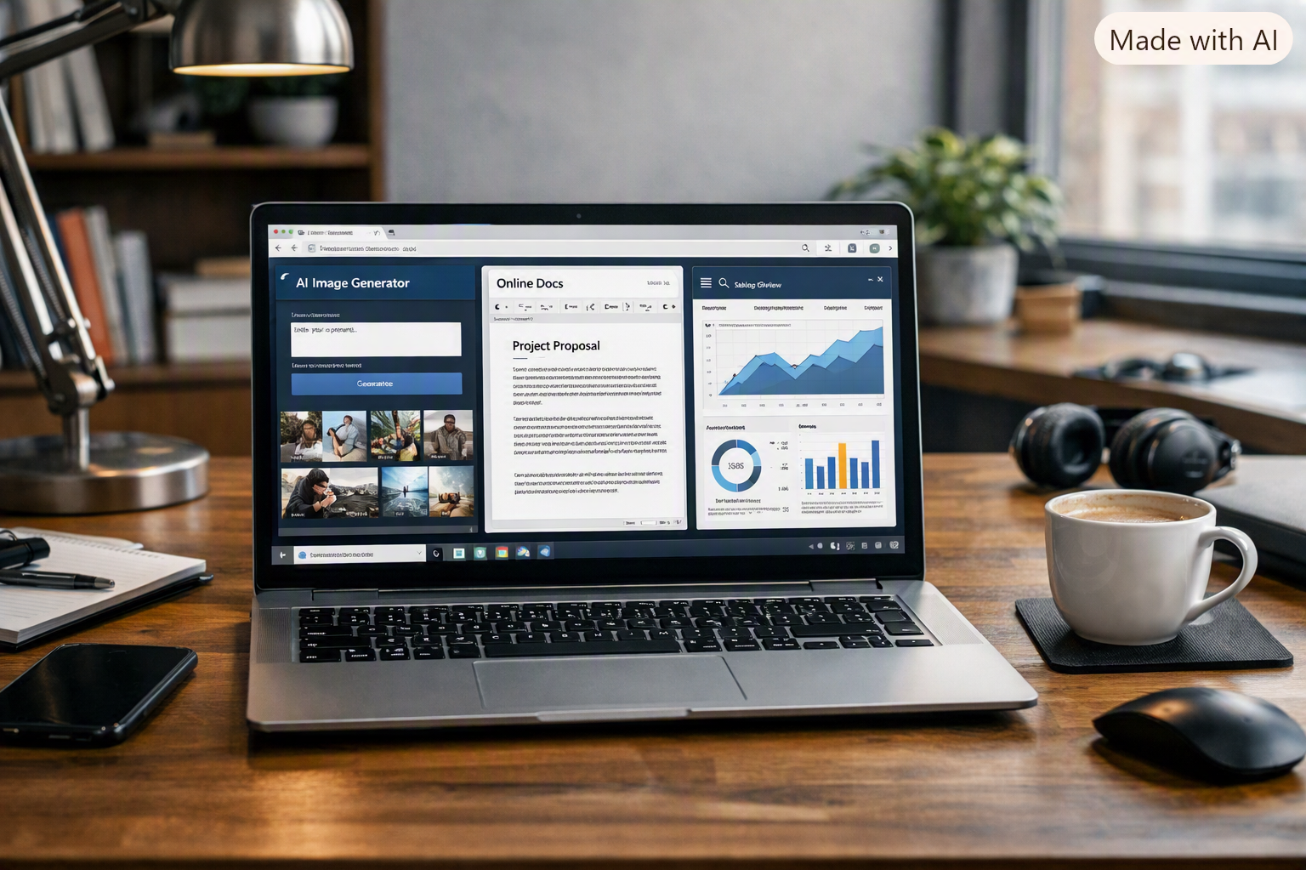
The Rules
Everything is web-based – no downloads involved
Must be free, or have a free component, without credits
Must work on Windows though may also have Ios or Linux versions

Slide 3



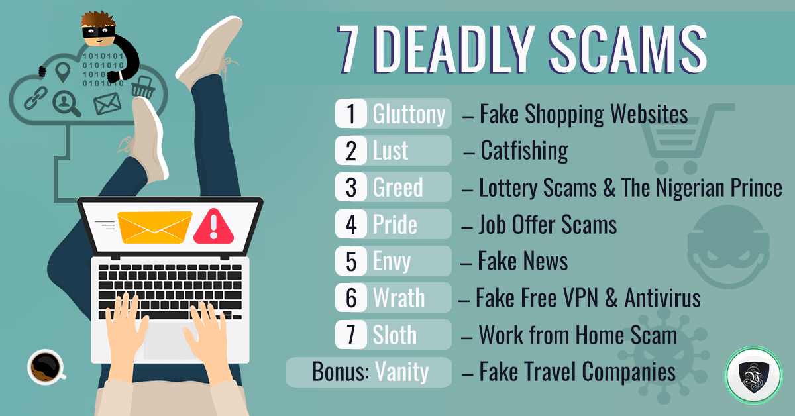
The Caveats
There is also much that is dangerous – take precautions
There is a lot of rubbish out there….
Not everything is useful for everyone…

Slide 4
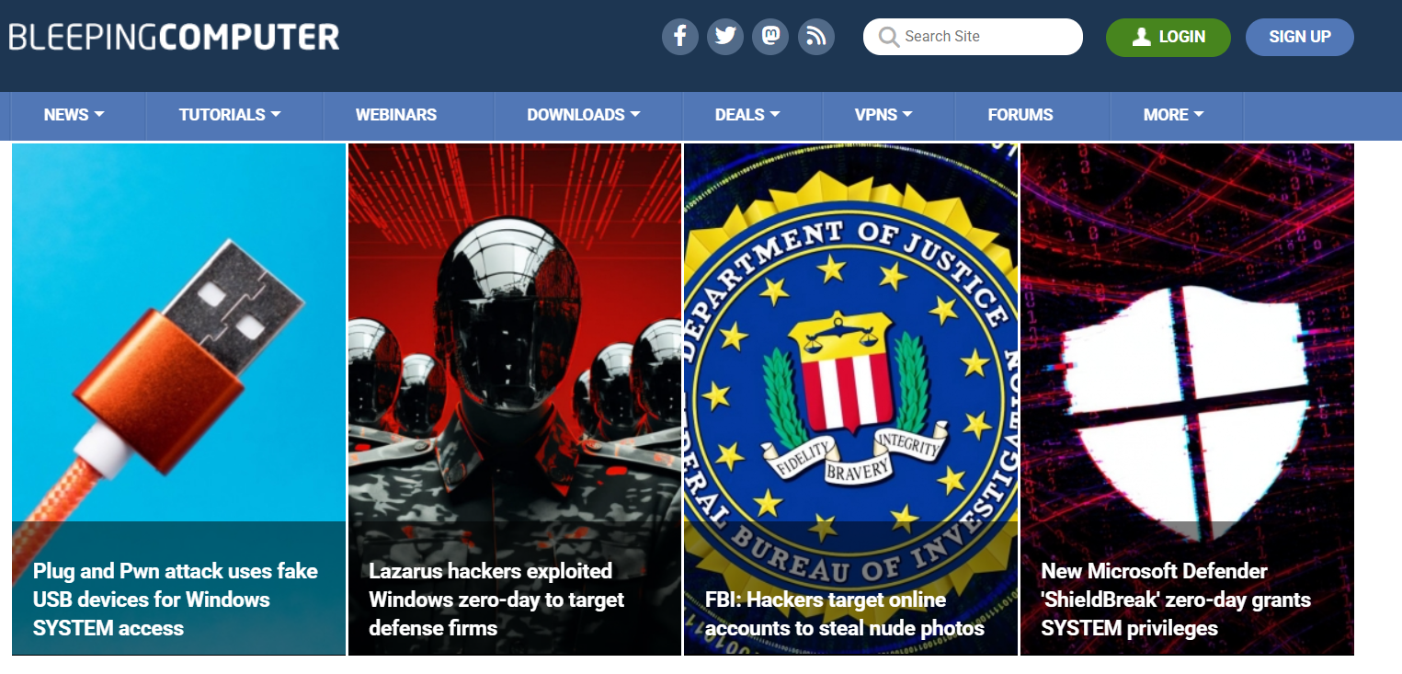
Bleeping Computer

Slide 5

Bleeping Computer is a free community where people come together to discuss and learn how to use their computers. There are over 700,000 registered members asking and answering questions

Slide 6
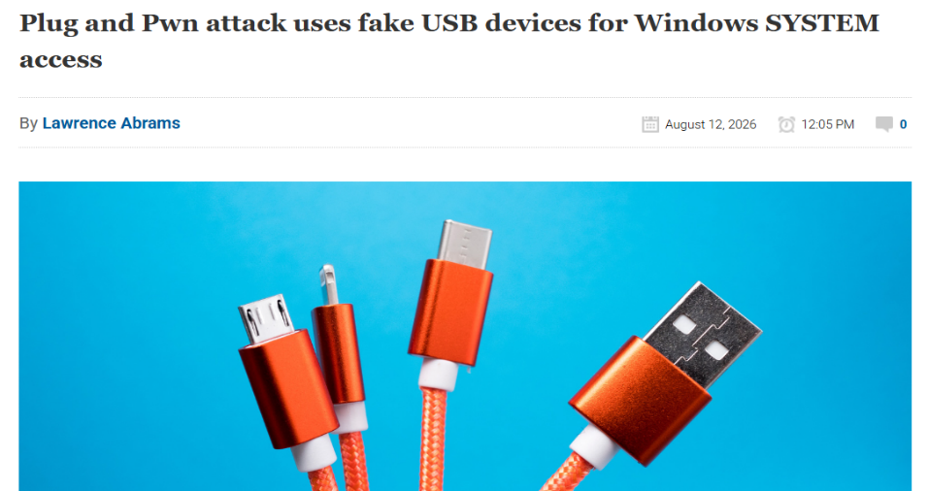
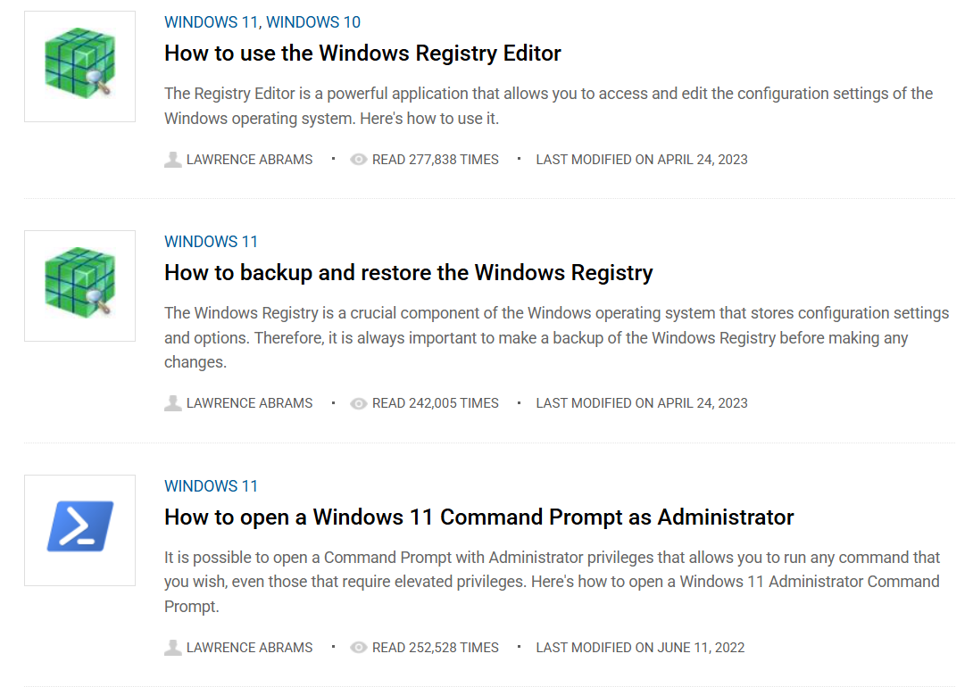
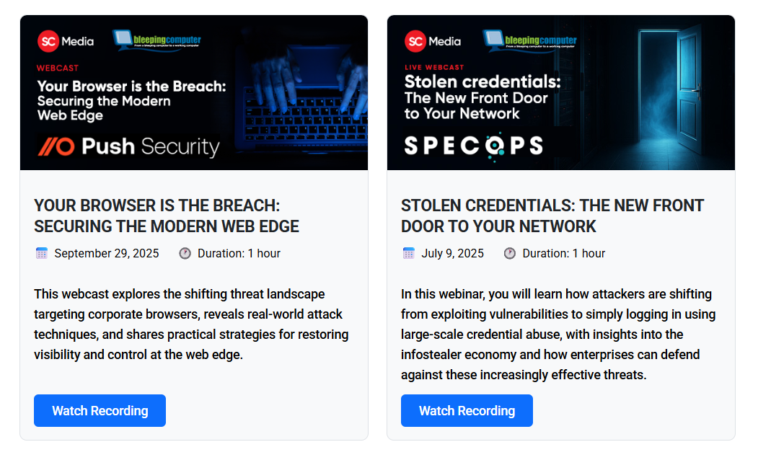
The site has news articles, like MSN, but related to computer technology
It also has tutorials and webinars on several different subjects
Tutorials
Webinars

Slide 7
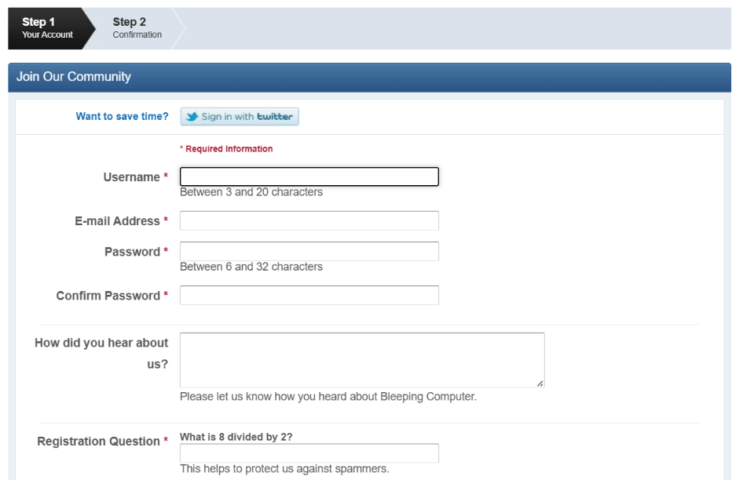
You do have to create an account, but this is free
Link to Site:
BleepingComputer | Cybersecurity, Technology News and Support

Slide 8
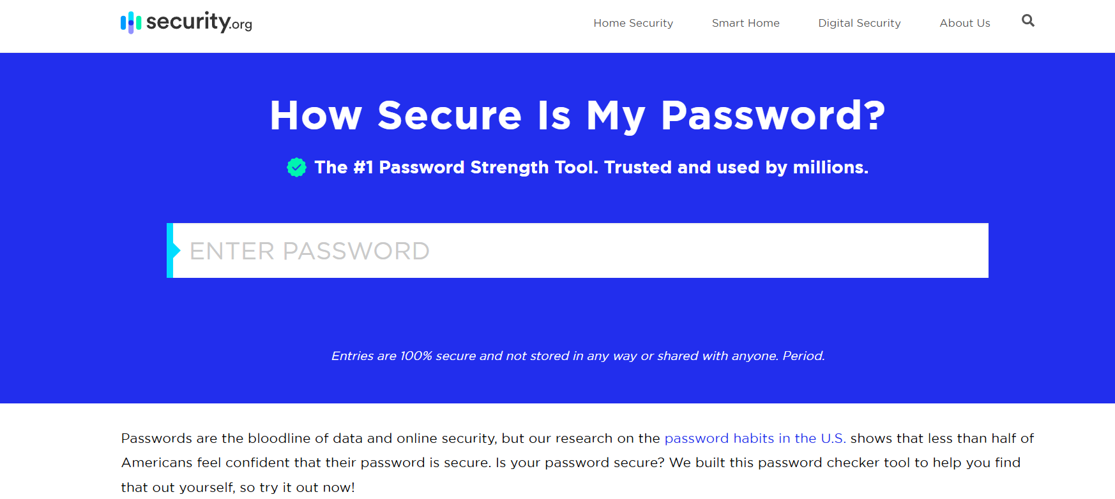
How Secure is my Password?

Slide 9
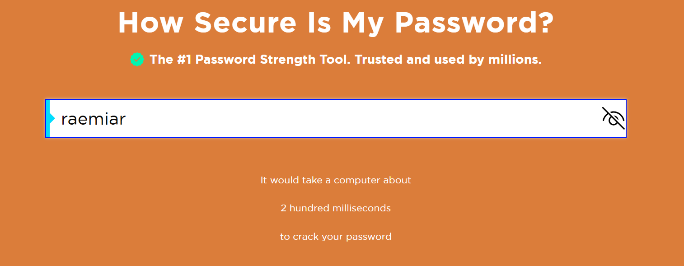

Slide 10
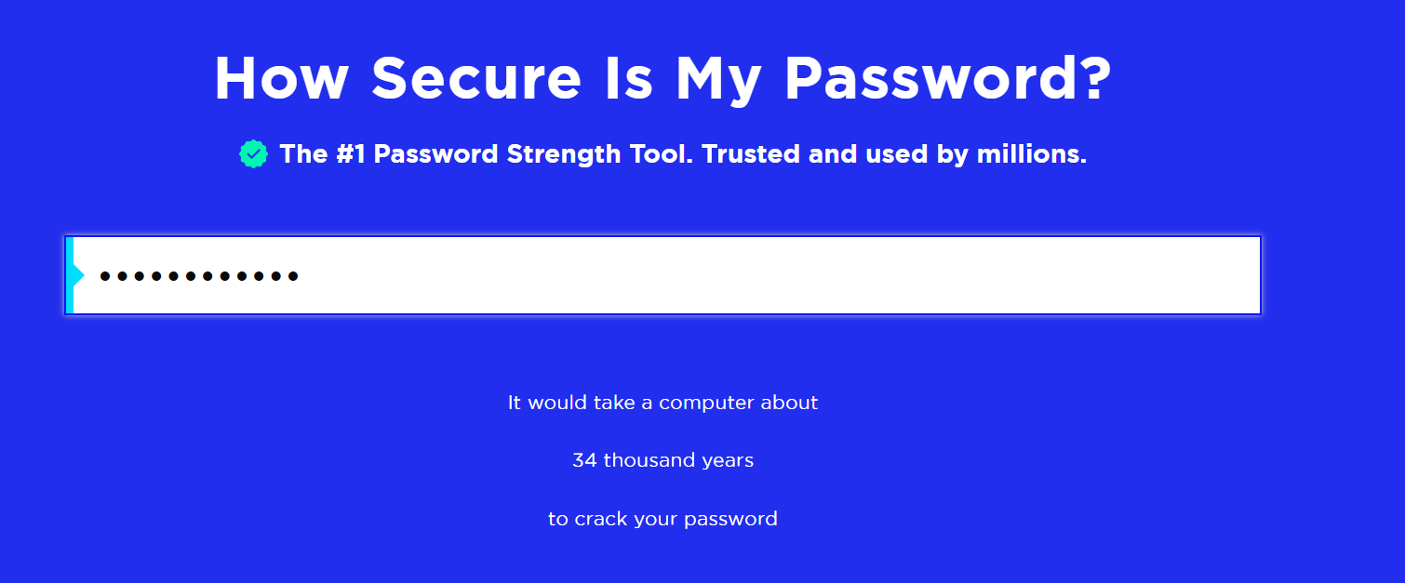
Link to Site:
How Secure Is My Password? | Password Strength Checker | Security.org

Slide 11
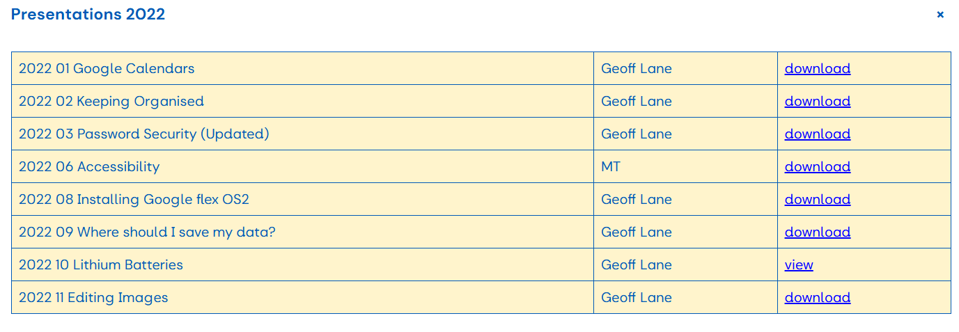
Geoff has already mentioned this website, and much more about password security in this group – go to our group’s section on Siteworks…

Slide 12
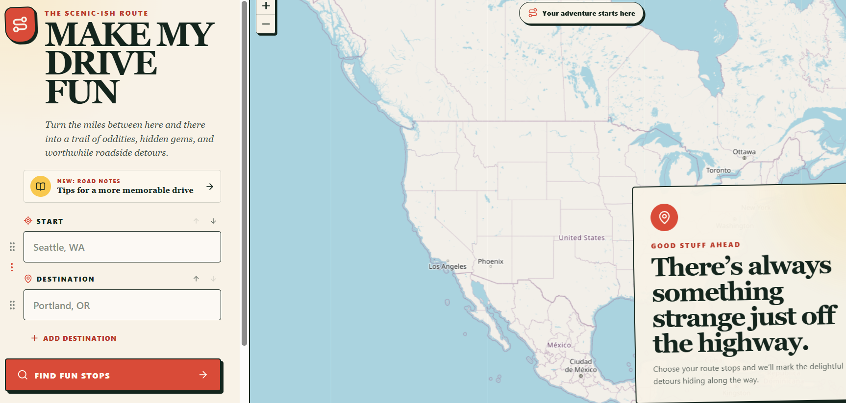
Make My Drive Fun
This site looks to turn the miles between ‘here and there’ into a trail of oddities, hidden gems, and worthwhile roadside detours
Link to Site:
Make My Drive Fun

Slide 13
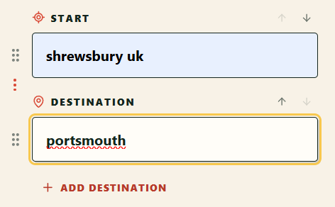

Slide 14
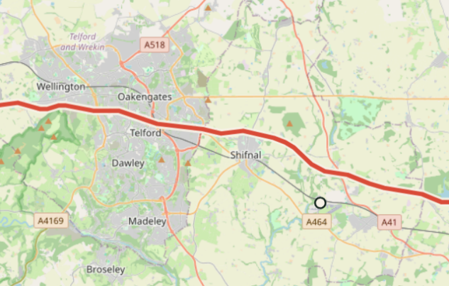
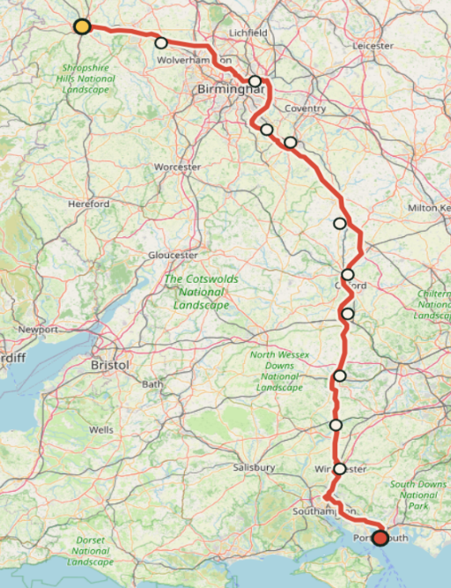
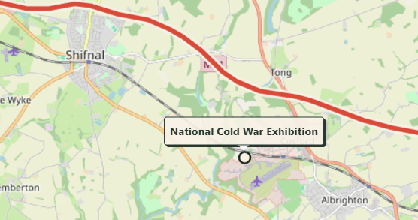

Slide 15
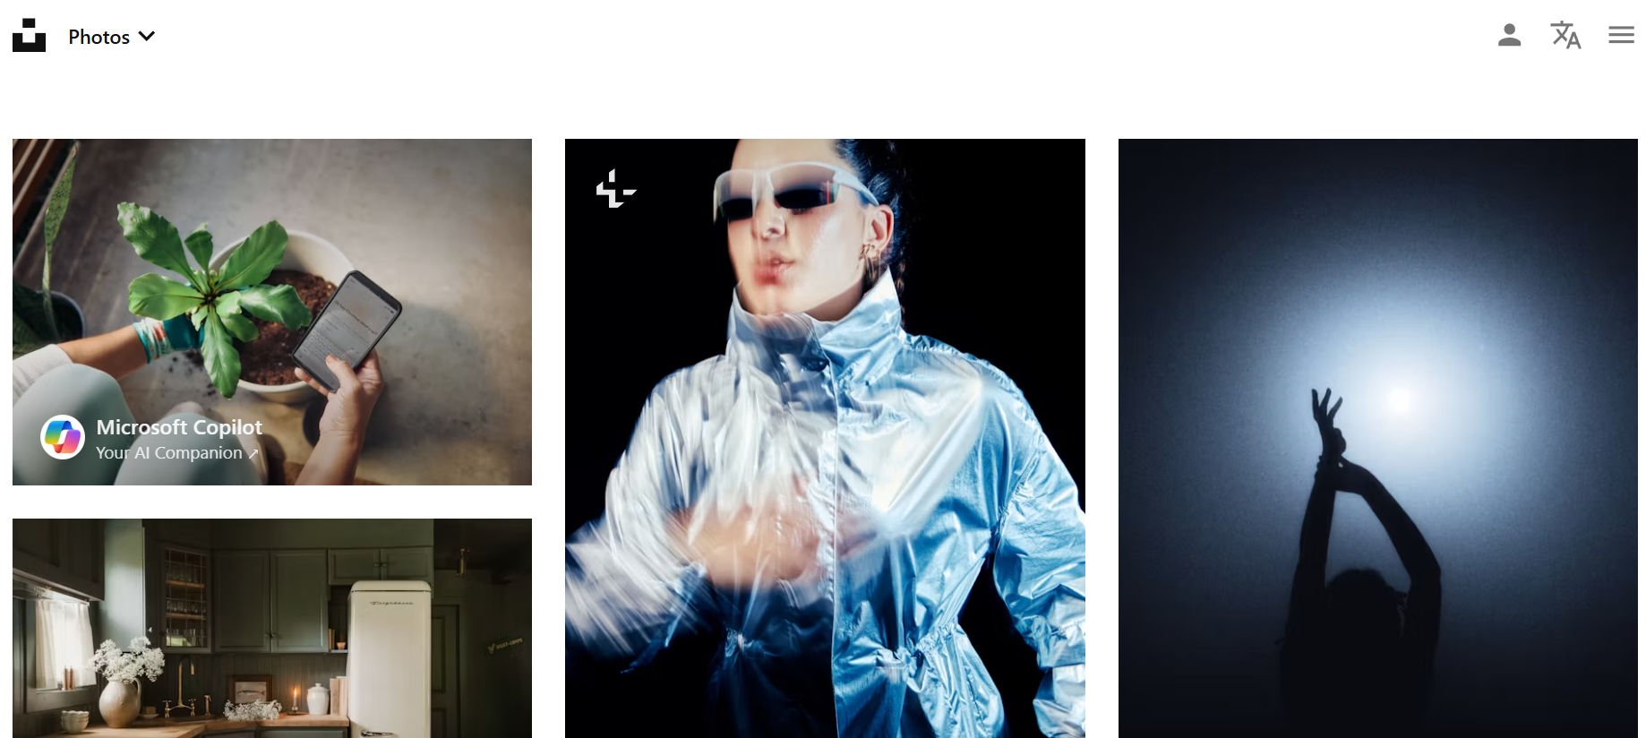
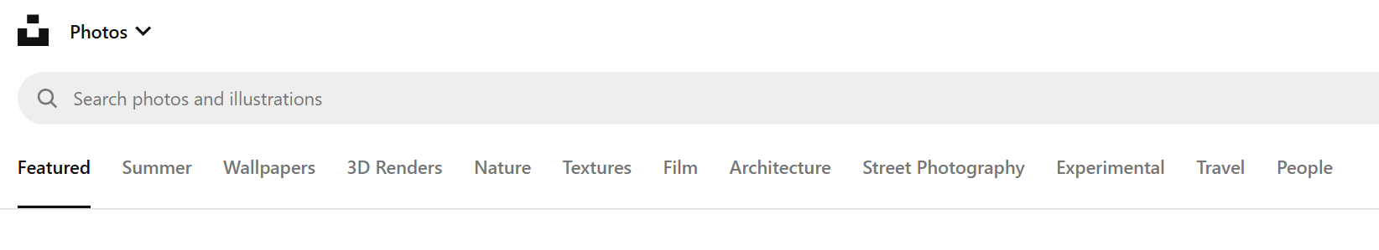
Unsplash
Link to Site:
Beautiful Free Images & Pictures | Unsplash
Notes:
Scroll down to reach the free photos. Click the down arrow for Illustrations

Slide 16
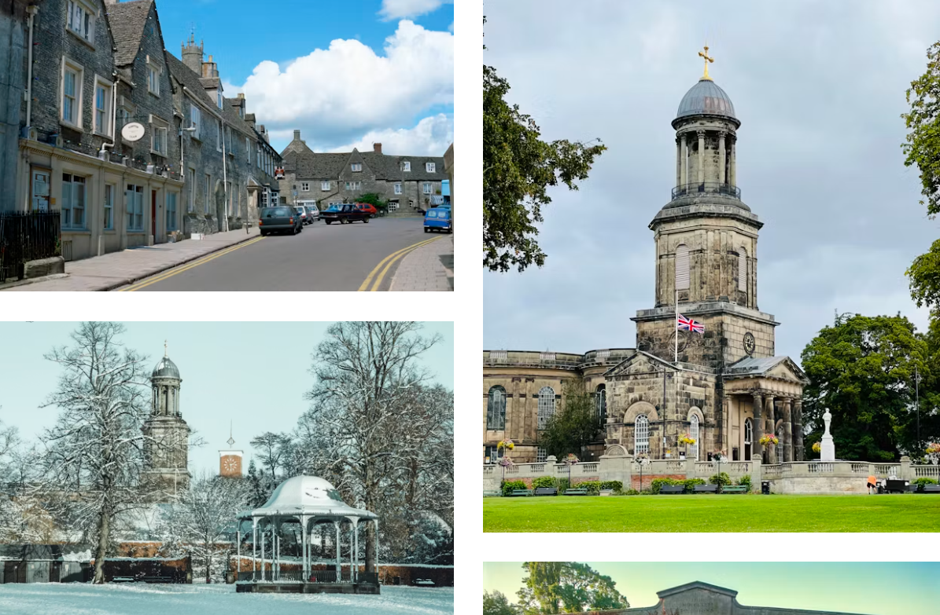
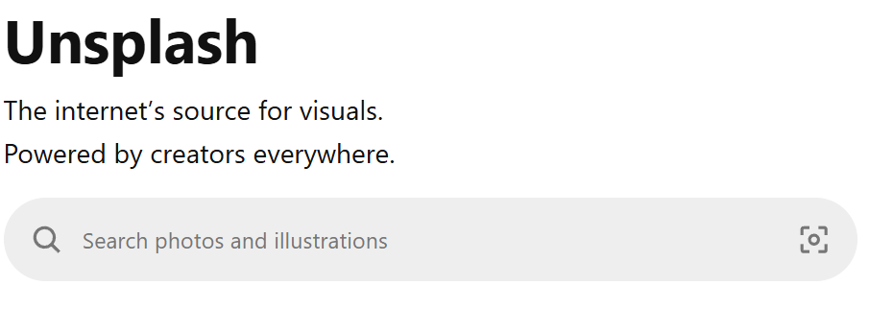
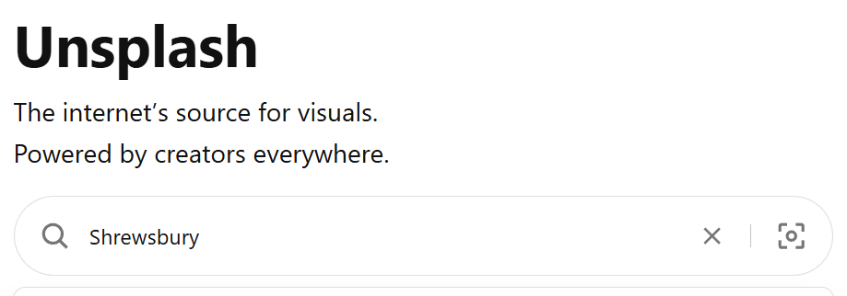
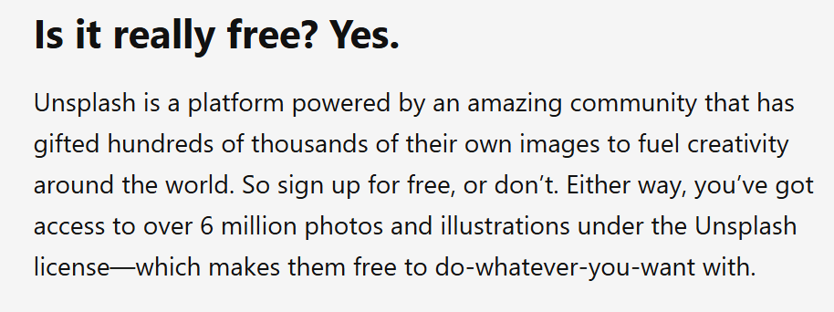
Notes:
You can create a free account, but this is not necessary

Slide 17
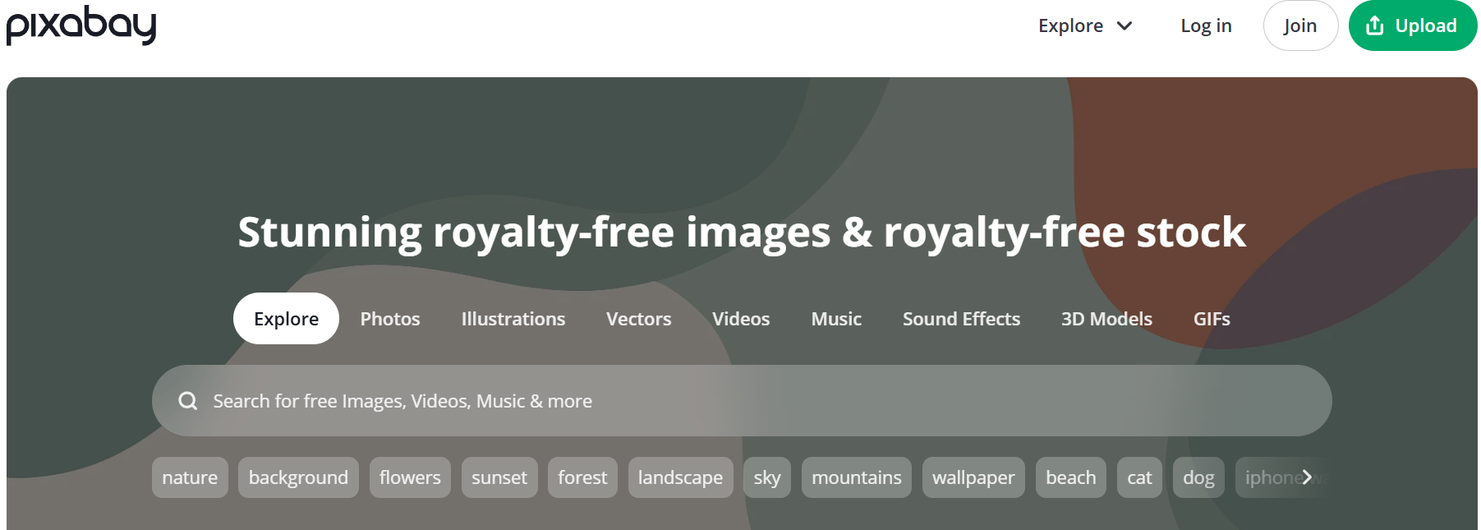
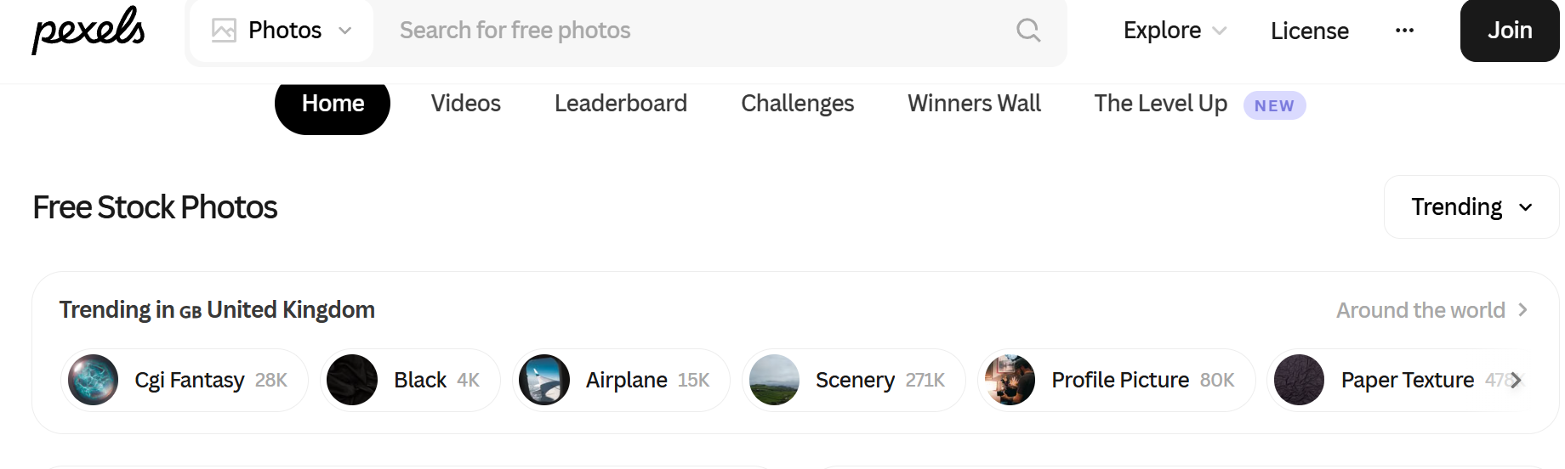
Decent Alternatives

Slide 18
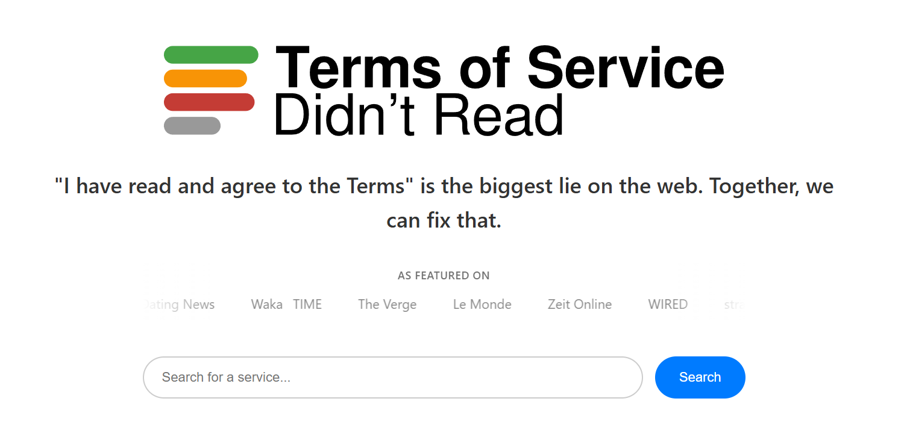
ToS:DR

Slide 19
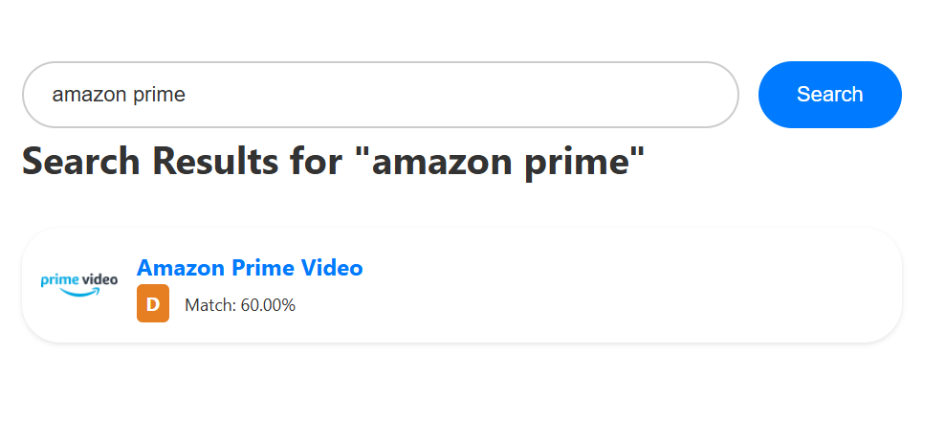
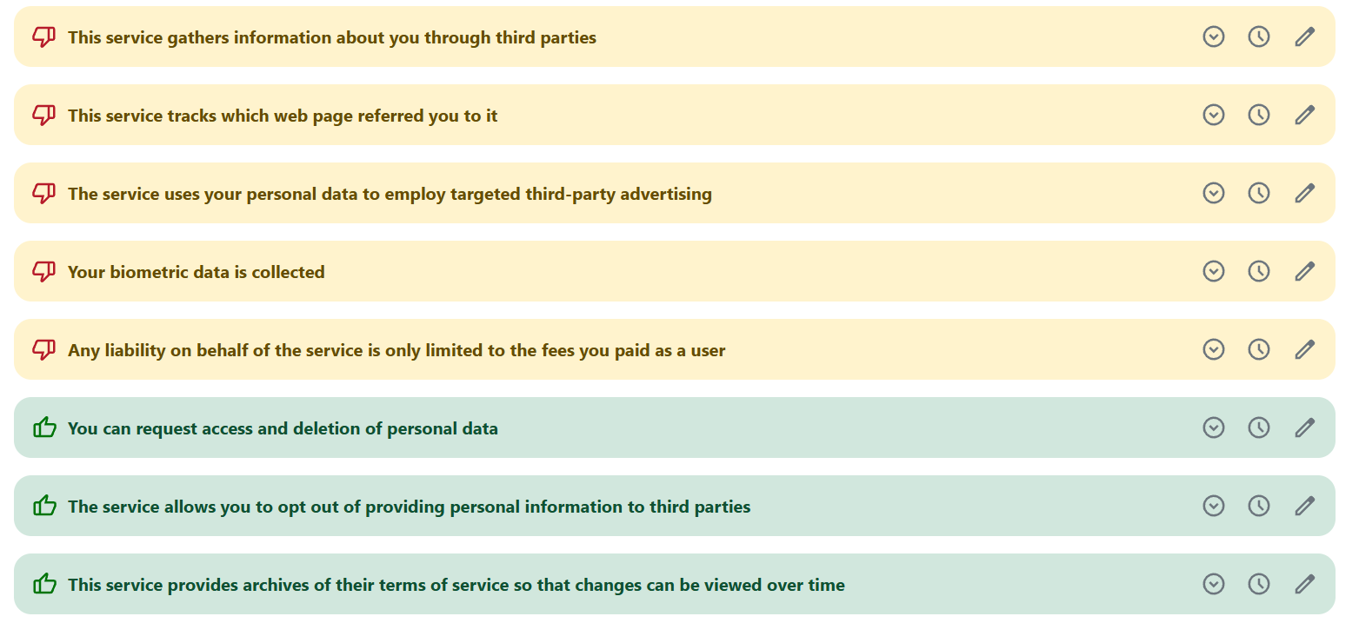
Link to Site:
Home Page - ToS;DR

Slide 20
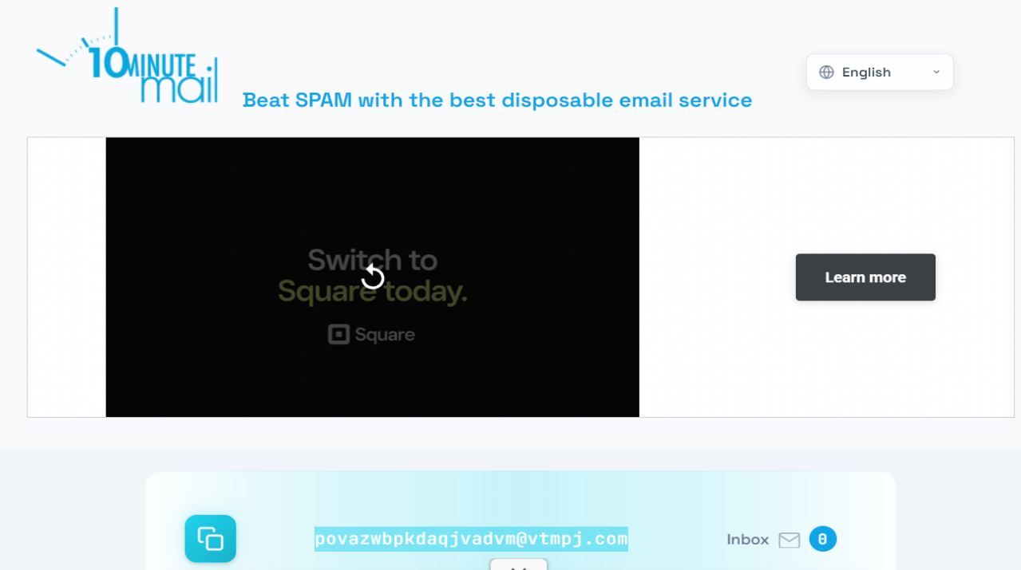
10-Minute Mail

Slide 21
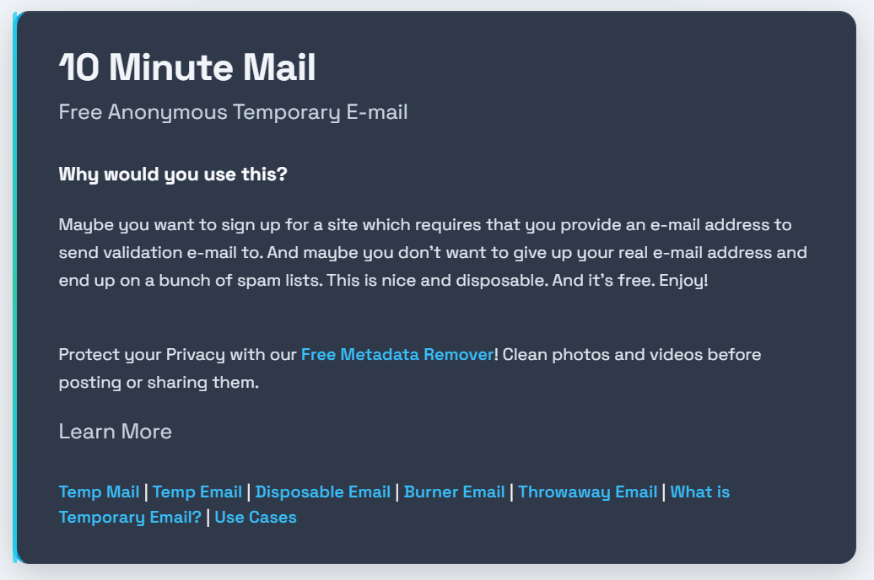
Link to Site:
10 Minute Mail - Free Anonymous Temporary email

Slide 22
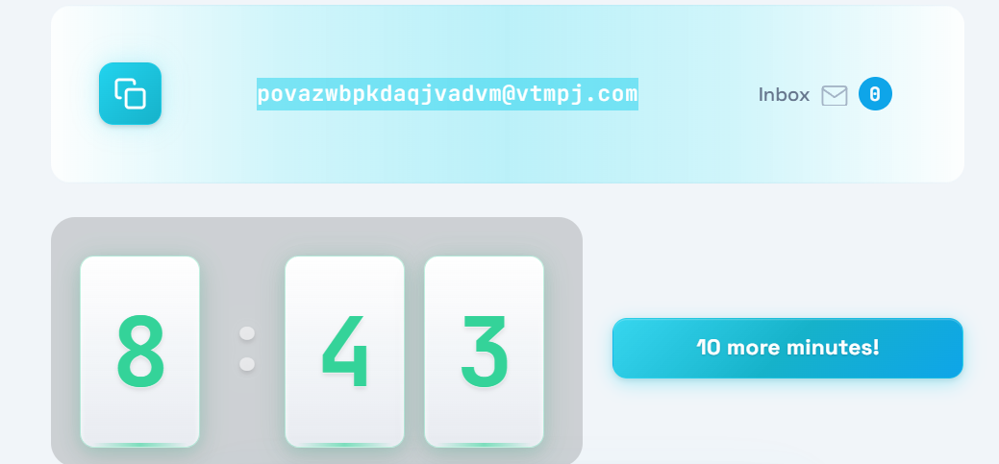

Slide 23
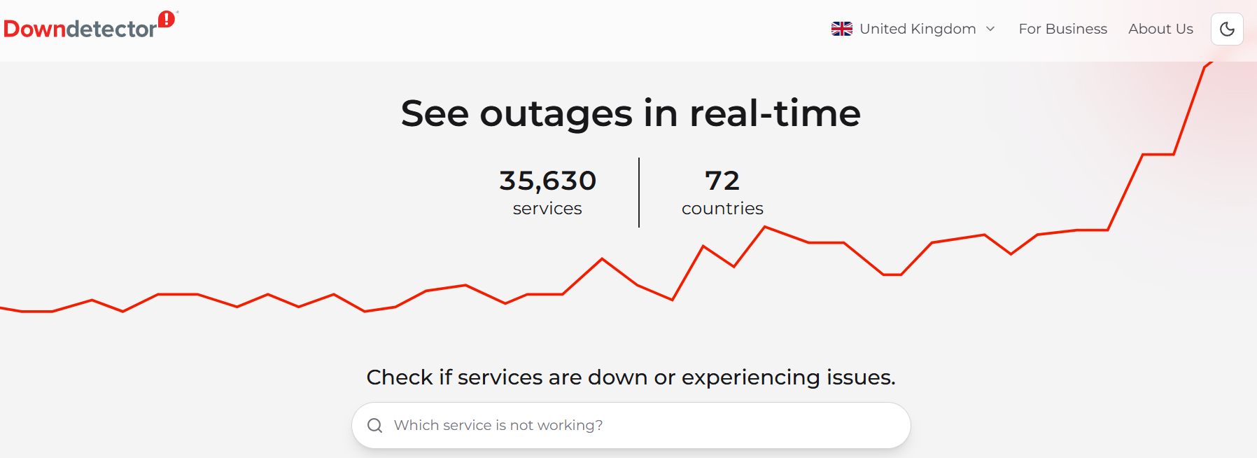
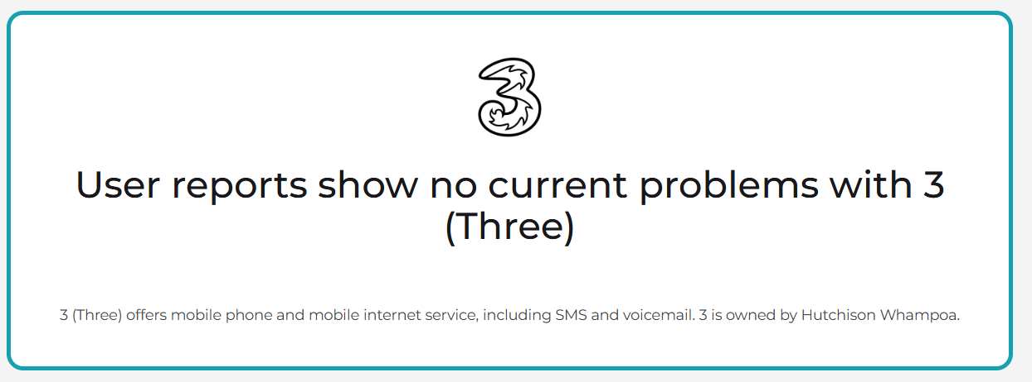
Downdetector

Slide 24
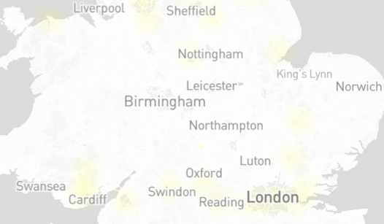


Slide 25
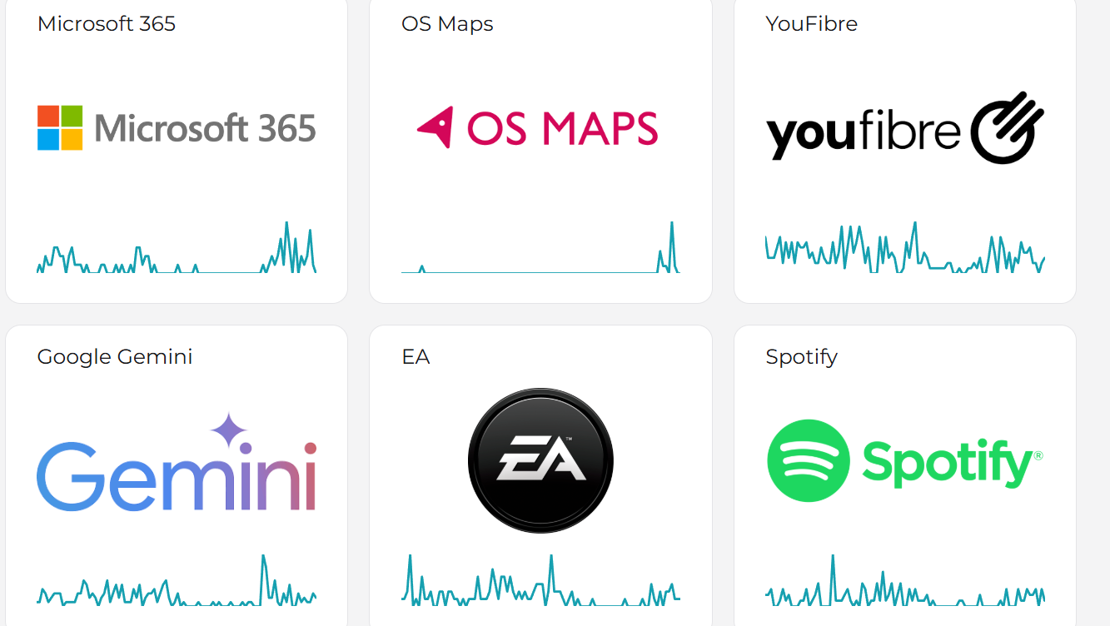
Link to Site:
Downdetector - Check real-time service problems and outages GB

Slide 26
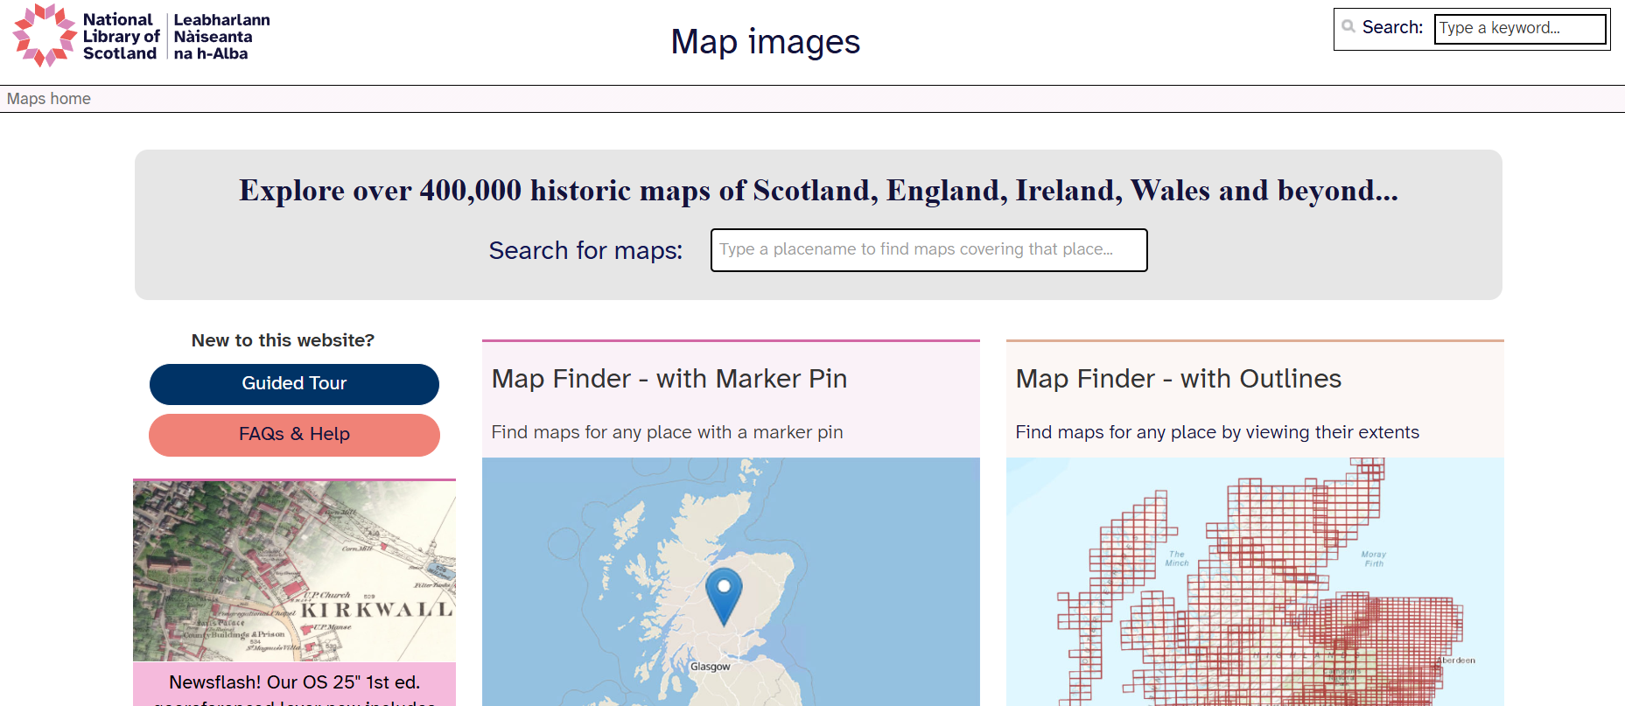
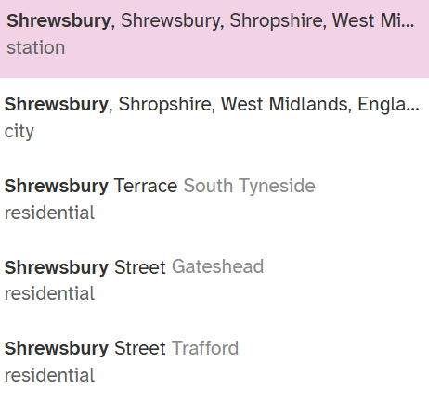
Old Maps
In the search box, type the location of your choice, e.g. Shrewsbury
NB: It can be fussy about grammatical convention – i.e. Shrewsbury NOT shrewsbury
From the list provided, choose the option you want…

Slide 27
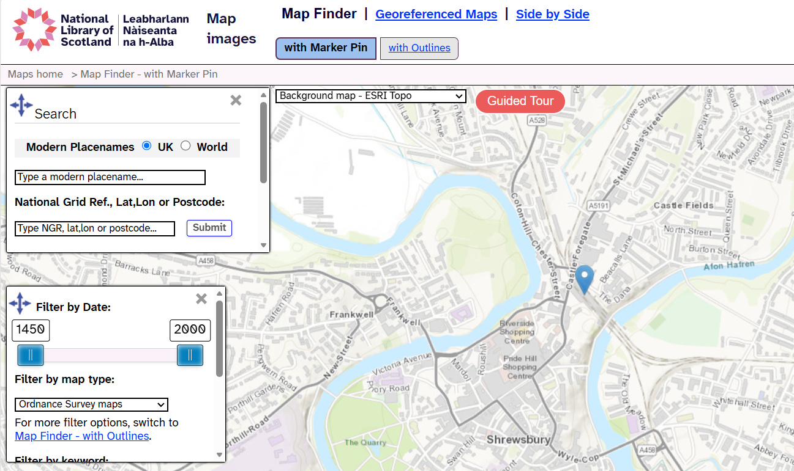
Link to Site:
Map images - National Library of Scotland
When you reach the location you want, it will show you a modern map. To get a historical map, choose the Georeferenced Maps option, which will then open an OS Map 1888-1905

Slide 28
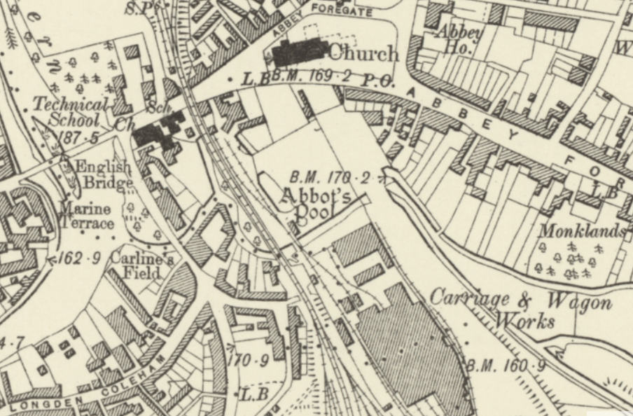
You can then zoom in to a particular area…

Slide 29
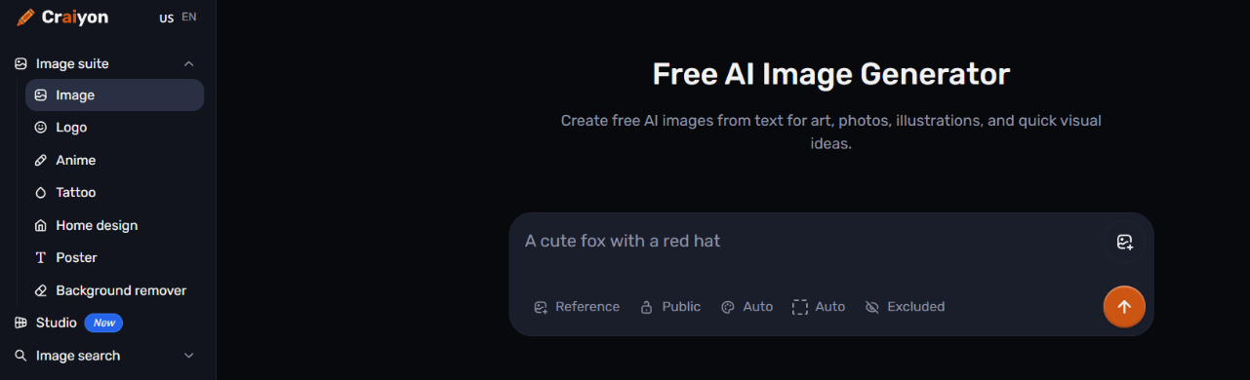
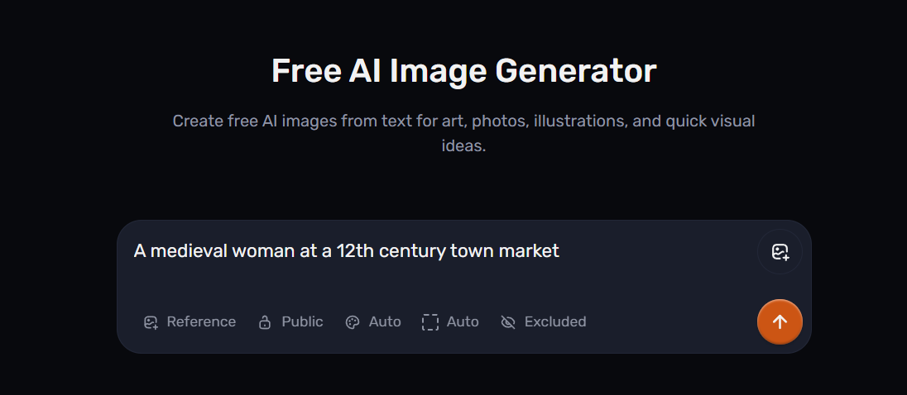
AI Image Generator

Slide 30
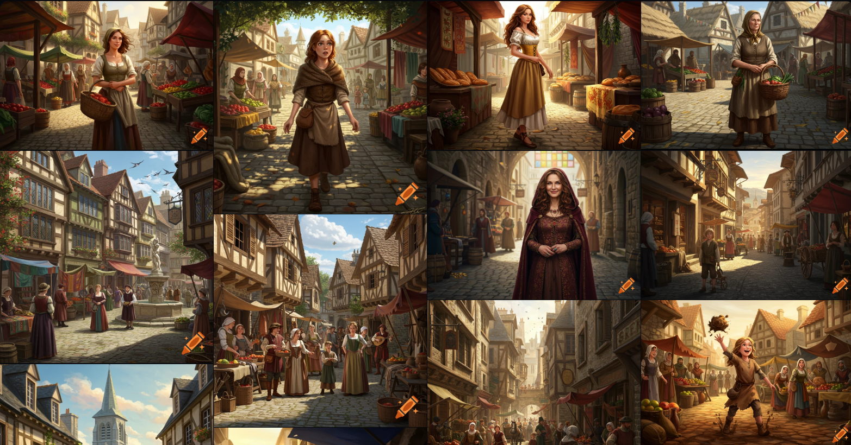

Slide 31
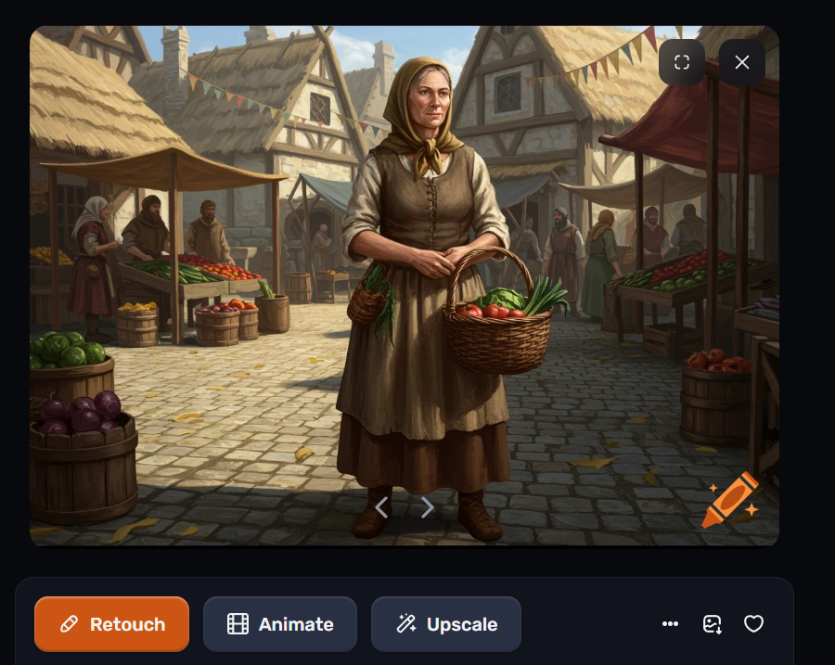
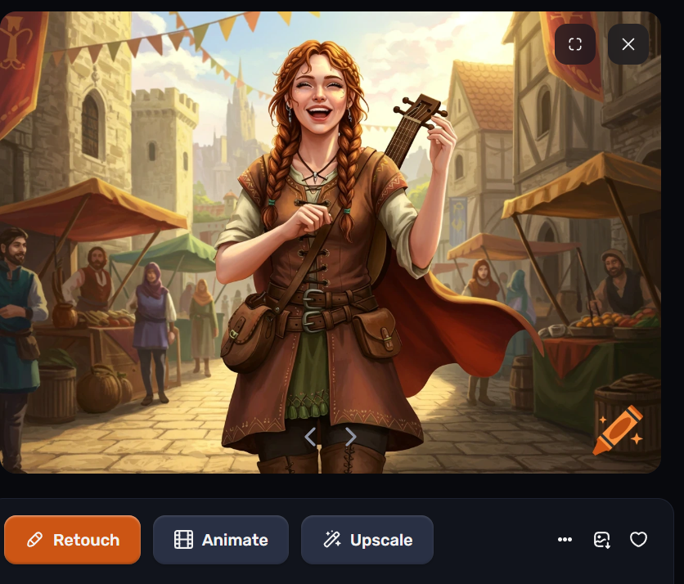
Link to Site:
Free AI Image Generator | Craiyon

Slide 32
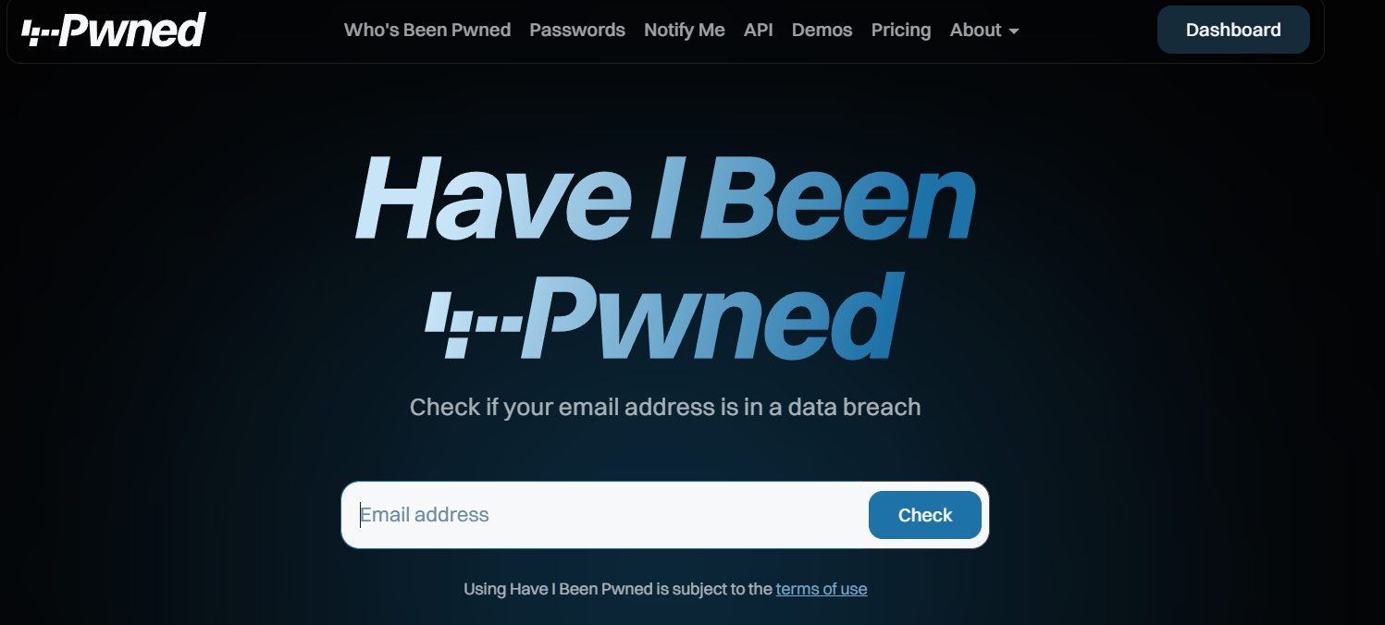
Have I Been Pwned
Link to Site:
Have I Been Pwned: Check if your email address has been exposed in a data breach

Slide 33
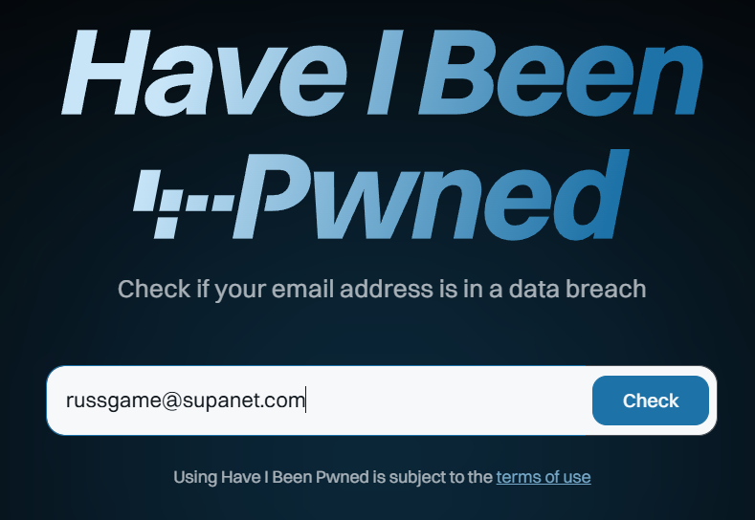


Slide 34

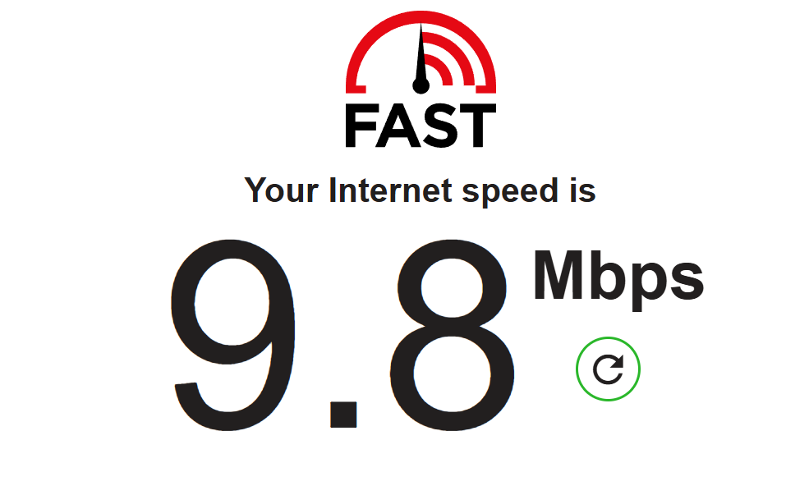
Internet Speed Test
Link to Site:
Internet Speed Test | Fast.com

Slide 35
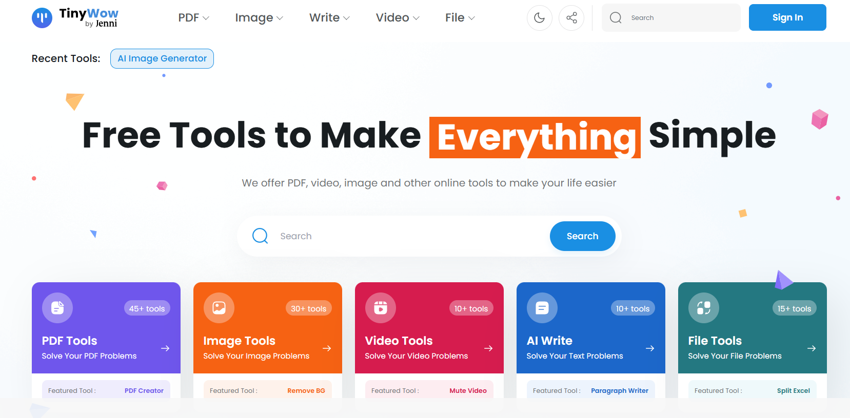
TinyWow

Slide 36
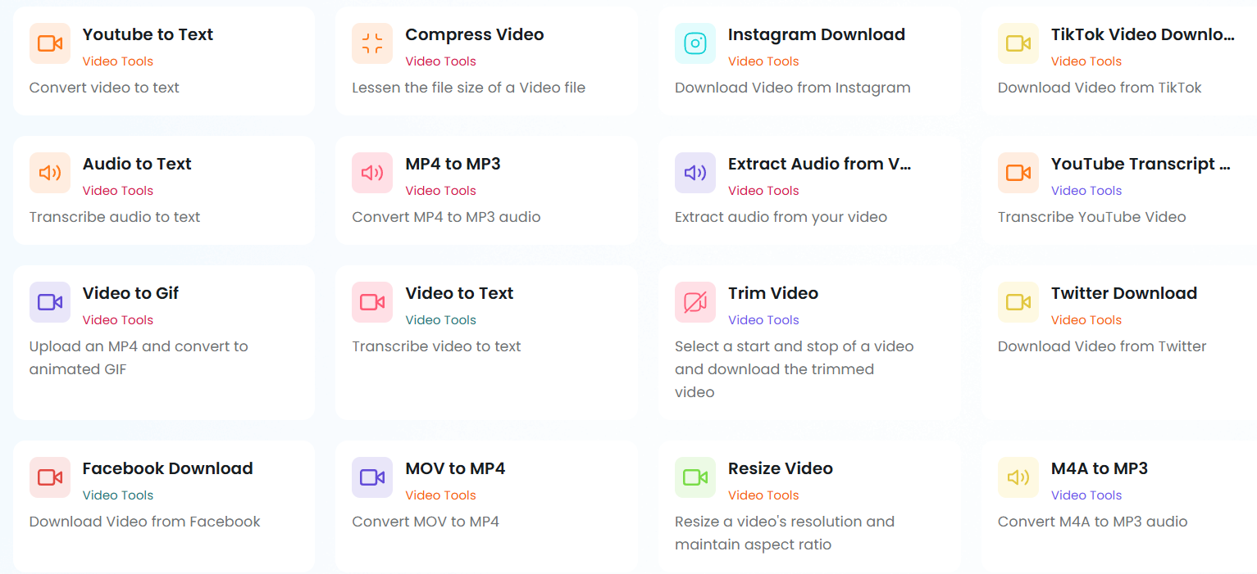
Video Tools
Link to Site:
Free AI Writing, PDF, Image, and other Online Tools - TinyWow

Slide 37
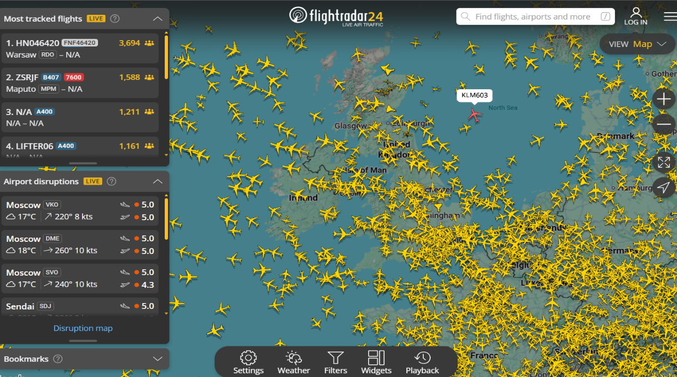
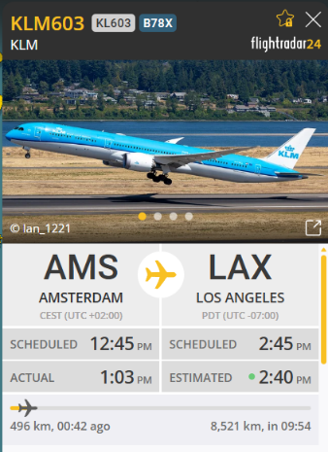
FlightRadar24
Link to Site:
https://www.flightradar24.com/

Slide 38

What 3 Words
Every 3-metre square of the world has been given a unique combination of three words…

Slide 39



Link to Site:
what3words /// The simplest way to talk about location

Slide 40

Earth Cam

Slide 41


Link to Site:
Rovaniemi (Santa Claus Village)
EarthCam - Webcam Network

Slide 42

Geofs
Actually – it’s GEO-FS, and it’s a free flight simulator

Slide 43

Link to Site:
GeoFS - Free Online Flight Simulator

